Slide 1
IAS 2019
Scientific summary of the major clinical studies presented at the 10th IAS Conference on HIV Science
Résumé scientifique des principales études cliniques présentées à le 10e Congrès de l’IAS sur les sciences du VIH

Slide 2

CAHR is pleased to provide this scientific summary of the major clinical studies presented at the 10th IAS Conference on HIV Science). The synthesis aims to improve the cascade of care by increasing the skills and knowledge of Canadian health care professionals working in the realm of HIV. This presentation was made possible with the support of an educational grant from ViiV Healthcare.
L’ACRV a le plaisir de vous offrir ce résumé scientifique des principales études présentées à le 10e Congrès de l’IAS sur les sciences du VIH. Cette synthèse a pour objet d’améliorer la cascade de soins en relevant les techniques et connaissances des professionnels canadiens de la santé qui travaillent dans le domaine du VIH. Cet exposé a été rendu possible avec le soutien d’une subvention éducative de ViiV Soins de santé.

Slide 3
Incidence & Epidemiology

Slide 4
HIV Incidence in High-risk Populations
Data from the ECHO trial showed high HIV incidence in young women: 5.03/100py in women 18-20 & 4.72/100py in women 21-30, compared with 1.67/100py in women 31-35.
A systematic review and meta-analysis of HIV incidence during pregnancy/breastfeeding in sub-Saharan Africa found an overall pooled incidence rate of HIV of 3.6/100py, with estimates higher for women <20 years old
Data from San Francisco indicate persistently high HIV incidence among TGW there, at 1.4/100py
In Latin America, a significant number of new HIV cases are reported (from 7, 271 new cases in 2013 to 11, 945 in 2017), particularly among young men; from 34.5% - 46.7% of new cases between 2013 and 2017.
Palanee-Philips, Thesla IAS Mexico City July 21-24 2019
Graybill, Lauren IAS Mexico City July 21-24 2019
Wilson, EC IAS Mexico City July 21-24 2019
Carlos, Beltran IAS Mexico City July 21-24 2019

Slide 5
State of the evidence on acquisition risk
A recent large literature review identified the highly-studied Risk Factors with high magnitude of effect for HIV acquisition risk.
Protective Factors:
Risk Factors
Circumcision
HIV beliefs, knowledge on prevention of HIV
Living with a partner
PrEP use
Being a student
Drug use
Genital ulcer disease
Gravida
HIV beliefs, concern about being infected
HPV positive status
HSV-2 positive status
Injection drug use
Multiple partners
Urban residence
Syphilis positive status

Slide 6
Stigma
Stigma remains a pervasive issue for PLH around the world. Results from the ITPC global survey (LMIC countries) are particularly demonstrative:
  65% of respondents experienced anticipated stigma leading to avoidance of social gatherings, and non-disclosure.
  38% of respondents had experienced stigma , including 10.8% who reported job loss as a result of HIV status, and 6.2% who experienced assault.
Stigma remains a barrier to access to PrEP, as demonstrated in qualitative studies in Kenya (Jilinde program)
ITPC Global Survey 2017-2018
MOAD0305 IAS Mexico City July 21-24 2019

Slide 7
Mucosal Inflammation & The Microbiome

Slide 8
The role of the microbiome
In the female genital tract, a lactobacillus-dominated microbiome is associated with health; a more diverse microbiome, particularly when colonizers are associated with BV, increases HIV acquisition risk and decreases efficacy of topical TDF.
Burgener A TUPL0102 IAS Mexico City July 21-24 2019

Slide 9
Microbiome in HIV-exposed infants
Infants born to HIV+ mothers exhibit significant differences in GI microbial composition when compared to HIV-unexposed.
Brown, B TUPDA0101 IAS Mexico City July 21-24 2019

Slide 10
Inflammation
Persistently abnormal inflammatory cytokine profiles in HIV+ individuals on ART.
  Despite systemic normalization of most inflammatory cytokines after ART is established, high levels were persistently detected in stool supernatant from HIV+ participants, regardless of immune-response to ART (CD4 > or < 350 cells/mL)
Ruiz-Briseno, M IAS Mexico City July 21-24 2019

Slide 11
Gut Mucosal Inflammation
Plasma REG3α levels in PLWH
From Montreal, analyses conducted in elite controllers, chronically infected individuals on and off ART, and those treated in acute infection show that REG3a is a potential systemic marker of GI inflammation, which could be conveniently measured.
Correlates well with cytokine markers of gut microbial translocation.
Isnard, S TUPDA0103 IAS Mexico City July 21-24 2019

Slide 12
Mucosal Inflammation
HCV therapy in a cohort of HIV/HCV women (WHIS) resulted in reduction in markers of microbial translocation as well as macrophage activation, suggesting a mechanism for improvement in non-AIDS morbidity through HCV cure.
Different glycosylation profiles in the GI tract in ART-treated PLH is associated with markers of inflammation, microbial translocation and HIV-DNA levels.
In addressing the role of hormonal contraception in HIV risk, results from CAPRISA and ECHO participants was inconsistent with respect to the association of DMPA with mucosal inflammation and alterations of the female genital tract microbiome. More investigation is needed to better understand the relationship between hormonal contraception, mucosal inflammation, and HIV risk.
French, A TUPDA0106 IAS Mexico City July 21-24 2019
Giron, L TUPDA0102 IAS Mexico City July 21-24 2019
Jaspan, H TUPDA0107LB, Molathegi, RP TUPDA0105, Romas, LN TUPDA0104 IAS Mexico City July 21-24 2019

Slide 13
Basic Science Updates

Slide 14
HIV Pathogenesis Insights
Using RNAseq and HIV SortSeq techniques has demonstrated that the HIV-1 promoter silences upstream host gene promoters, resulting in abnormal downstream transcription that supports transcription of HIV (IMPDH1 and JAK1 in particular).
  Potential therapeutic targets in Jak-1 and IMPDH1 inhibitors. In cell lines Filgotinib (a JAK-1 inhibitor) restored abnormal transcription to the level of uninfected cells.
Another group showed that in ART-suppressed PLH, integration sites of clonally-expanded cells are enriched for actively transcribed genes associated with cell proliferation and immune function. Single integration sites were more likely in silenced genes.
Ho, Y TUSY305 10th IAS 2019, July 23 Mexico City, Mexico
Symons, J TUAA0206 10th IAS 2019, July 23 Mexico City, Mexico

Slide 15
HIV Pathogenesis Insights
𝛽7^{hi} CD4 T cells contained 8x more integrated DNA than 𝛽7^{low} cells during Fiebig II/III compared to chronic infection.
Preliminary data suggest increased immune activation of 𝛼4𝛽7 T cells, and/or 𝛼4𝛽7 upregulation during acute infection.
McKinnon, L TUAA0201 10th IAS 2019, July 23 Mexico City, Mexico

Slide 16
The HIV Reservoir(s)

Slide 17
Reservoirs - Macrophages
HIV is present in urethral macrophages, where it remains replication competent and inducible in patients on ART, whereas urethral resident T-cells did not harbor replication-competent virus.
  Latency and latency-reversal differ significantly between macrophages and T-cells, cure strategies will need to address this compartment.
Two compounds; bergenin and rufinamide, are shown to accelerate cell-death in HIV-1 infected macrophages, but not uninfected cells, in vitro.
Ganor, Y TUSY302 10th IAS 2019, July 23 Mexico City, Mexico
Rufinamide
Bergenin
= Uninfected Macrophages
= Uninfected Microglia
% alive cells
= Drug treated Microglia
X
= Drug treated Macrophages
0.01 0.1 1 10
0.01 0.1 1 10
µM Rufinamide
µM Bergenin
Microglia EC₅₀ = 0.07 µM
Microglia EC₅₀ = 0.03 µM
Macrophage EC₅₀ = < 0.01 µM
Macrophage EC₅₀ = 0.06 µM
Gavegnano, TUAA0204 10th IAS 2019, July 23 Mexico City, Mexico

Slide 18
Reservoirs – T cells
Tissue-resident CD4 T cells (CD69⁺, CD103^{+/-}) are more likely than other subsets to become infected in vitro; these cells contribute ~90% of the reservoir in tissue, but <10% in the blood.
CD20 seems to identify transcriptionally active T-cells in ART-suppressed individuals in both blood and tissue.
Buzon, MJ TUSY303 10th IAS 2019, July 23 Mexico City, Mexico
Data from a small sample (n=2) of suppressed patients suggests naïve CD4 T cells display a lower rate of viral integration, but contain a higher % of proviruses compared to memory T cells, and this increases with their differentiation.
# intact proviruses/ million CD4+ cells
2 yrs
9 yrs
2 yrs
9 yrs
Rullo, EV MJ TUAA0205 10th IAS 2019, July 23 Mexico City, Mexico

Slide 19
Adipose Tissue as a Reservoir
Data from NHPs suggests that adipose tissue may be an anatomic reservoir, and contribute to persistent inflammation in ART-treated HIV
Sette, P TUAA0203 10th IAS 2019, July 23 Mexico City, Mexico

Slide 20
Latency Reversal
IL-15 superagonist N-803 shows promise as a latency reversal agent in humanized mice, accelerating time to viremia (compared to untreated mice).
The SMAC mimetic AZD5582 selectively induces cell-associated HIV expression in CD4 T cells ex vivo through the ncNF-κB pathway.
Ray, Alex IAS Mexico City July 21-24 2019
Sampey, G WEPEA060 IAS Mexico City July 21-24 2019

Slide 21
Latency – Novel Mechanisms
CD8 T cells appear to mediate suppression of HIV expression in CD4 T cells, inducing and maintaining latency.
  Co-culture of HIV-infected memory CD4 T cells with activated CD8 T cells resulted in a significant reduction of HIV-GAG⁺ cells, an effect which was consistent across memory cell subsets.
HIV entry into latency may be a direct result of HIV-induced entry into quiescence for CD4 T cells.
  In vitro, HIV infection resulted in downregulation of cellular pathways involved in quiescence seen in uninfected cells entering quiescence. Mock-infected cells retained proliferative phenotype.
  KFL-2 and long non-coding RNAs appear to be key regulators.
Franchitti, L IAS Mexico City July 21-24 2019
Plasek, L IAS Mexico City July 21-24 2019

Slide 22
Interesting Insights Into The Reservoir
Cell-associated HIV RNA has a circadian cycle in HIV+ adults on ART, concordant with CD4 T cell gene expression circadian cycling.
Total inducible RNA reservoirs (measured by EDITS assay) were significantly smaller in women than in men. Estrogen appears to block HIV-RNA transcription and spreading infection in female but not male CD4+ T cells. Female cells also demonstrated higher levels of inhibition of TCR activation in the presence of beta-estradiol, and greater enhancement after treatment with SERMs.
Stern, J IAS Mexico City July 21-24 2019
Dobrowolski, C IAS Mexico City July 21-24 2019

Slide 23
On The Path To Cure

Slide 24
Progress with CRISPR/Cas9
Using guide RNAs targeting tat and rev, CRISPR-transduced T-cells infected with HIV-1 exhibited inhibition of HIV-1 related cytopathic effects. Tat and rev protein expression in these cells was decreased, and further reduced by additional rounds of transduction, and a high frequency of mutations was observed in tat and rev genes at Cas9 cutting sites.
When persistently infected cells were transduced with Cas9, HIV-1 capsid production was significantly reduced (225-fold reduction with Cas9 bearing six guide RNA), and similar results were obtained in latently infected cells, even after activation.
In uninfected cells, transduction of CRISPR/Cas9 resulted in HIV-1 capsid reduction >350 fold at 4 dpi, with some rebound at 8 dpi, with continued suppression of p24 until 16 dpi
Ophinni, Y IAS Mexico City July 21-24 2019

Slide 25
Other Gene-Editing Platforms for Cure
Zinc-Finger Nucleases (ZFN) can introduce DNA strand breaks at specific locations, resulting in gene knockouts. A mouse model has already demonstrated that this strategy can be used to created CCR5 knockouts, and that CCR5-ZFN mice infected with HIV were able to suppress infection without treatment.
  A human trial is currently in process, with 14 enrolled, 8 treated, and 2 on ATI.
Progress has also been made using this platform and CRISPR to introduce new genes at the sites of DNA break, allowing for insertion of anti-HIV genes while simultaneously creating knockouts.
  Proof-of-concept studies have demonstrated the capacity of this technology to target the selected locus and successfully insert target genes.
Cannon, P MOPL0103 Mexico City July 21-24 2019

Slide 26
Anti-α4β7 for HIV
Anti-α4β7 blockade with vedolizumab in humanized CD34 mice did not prevent HIV-1 infection, and did not suppress or delay HIV-1 rebound after interruption of cART in infected, treated animals.
Lijun L IAS Mexico City July 21-24 2019

Slide 27
HIV Vaccine Updates

Slide 28
New Insights from Vaccine Studies
Reduced risk of HIV seroconversion in the RV144 trial correlated with non-neutralizing antibodies specific to the V2 domain of gp120 in the helix/loop conformation.
  This site appears to be conserved between SIV and HIV, and is associated with a₄b₇ binding in both.
  A mAb (mAb CH58) has been derived from RV144 vaccine and captures V2 in helical conformation.
Analysis of samples from the RIVER trial (therapeutic vaccination in combination with ART) demonstrates that vaccine recipients developed maintained HIV-specific CD8 T cell responses characterized by PDI/TIGIT expression after randomization, as compared to ART-only recipients.
Arthos, J TUAA0104 IAS Mexico City July 21-24 2019
Kopicynski TUAA0105 IAS Mexico City July 21-24 2019

Slide 29
New Insights from Vaccine Studies
Analysis of samples from the RIVER trial (therapeutic vaccination in combination with ART) demonstrates that vaccine recipients developed maintained HIV-specific CD8 T cell responses characterized by PDI/TIGIT expression after randomization, as compared to ART-only recipients.
CD8+ T cell mediated HIV inhibition and response
HIVconsv responses post-randomisation
ART Only
ART + V + V
HIV induced Vaccine-induced
Kopicynski TUAA0105 IAS Mexico City July 21-24 2019

Slide 30
Vaccines in the Pipeline
The APPROACH trial (heterologous Ad26 vector with mosaic gag, pol, env antigens & soluble trimeric envelope proteins of gp140) is now 2 years into long-term extension phase of study.
  No HIV infections yet documented
  Cellular and antibody immunity is maintained out to 2 years in all participants.
In Non-Human Primates
  GOX-B11, DNA/MVA vaccine elicits good immune response with a prime/boost regimen enhancing anti-gp120 response and suppressing anti-gp41 response.
  A vaccine which targets the sequences surrounding 12 protease cleavage sites (pcs) using rVSVpcs (which deliver single pcs peptides), and nanopcs (which are capable of delivering all 12 pcs) platforms showed 80% per-exposure protection against intravaginal challenge with SIV.
Tomaa, F M TUAA0101 IAS Mexico City July 21-24 2019
Robinson, H TUAA0102 IAS Mexico City July 21-24 2019
Luo, M TUAA0103 IAS Mexico City July 21-24 2019
Notes:
100% response is maintained up to 2 years (Ab titers >2 log₁₀)
Env-specific cellular immunity persists with plateau near 100 SFU/10⁶ cells

Slide 31
Vaccine candidates in the pipeline
HVTN 702/UHAMBO (pox-protein heterologous prime boost)
Evidence of modest efficacy in RV144
Adapted to Clade C: met the go/no go criteria in HVTN 100
HVTN 703/704/AMP (monoclonal antibody infusions of VRC 01)
Evidence of protection in NHP challenge model
Being evaluated in MSM and heterosexual women
HVTN 705/IMBOKODO (Ad26-Ad26/protein, heterologous double prime/double boost)
Evidence of protection in NHP challenge model
heterosexual women in SSA
Evaluated in RSA only
Advanced in POC after meeting go/no go criteria in TRAVERSE
HVTN 706/MOSAICO (Ad26-Ad26/protein, heterologous double prime/double boost)
Evidence of protection in NHP challenge model
Adjuvanted Clade C gp140 and Mosaic gp140
Cis-gender Men and Transgender Individuals who Have Sex with Cis-gender Men and/or Transgender Individuals
5407 fully enrolled
1900 fully enrolled
2637 fully enrolled
3800 to be enrolled
Graphics by: Gray G MSY1003 Mexico City July 21-24 2019

Slide 32
MOSAICO Vaccine Trial
Guzman, SUSA20 Mexico City July 21-24 2019
MOSAICO has begun enrollment. This large (n=3,800) multicenter Phase III trial will assess the efficacy of a mosaic vaccine Ad26.Mos4.HIV candidate for primary prevention of HIV in a high-risk American and European population (1 or more of >5 partners, condomless receptive intercourse, STI diagnosis, syphilis use)
A booster (CladeC + Mosaic gp140) will be given based on results of the ASCENT trial showing better antibody and T-cell responses with this strategy.
MOSAICO Study design:
Group
N
Vacc 1
Mo 0
Vacc 2
Mo 3
Vacc 3
Mo 6
Vacc 4
Mo 12
Follow up
Month 24-30
Primary analysis
1 | 1,900 | Ad26.Mos4.HIV | Ad26.Mos4.HIV | Ad26.Mos4.HIV, CladeC + Mosaic gp140 | Ad26.Mos4.HIV, CladeC + Mosaic gp140
2 | 1,900 | Placebo | Placebo | Placebo | Placebo
Follow‑up
HIV-1 negative: ≥24 m after 3rd vaccination
HIV-1 positive: 6 m after diagnosis

Slide 33
Broadly Neutralizing Antibodies (bNAbs)

Slide 34
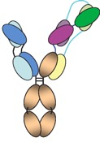
Broadly Neutralizing Antibodies for Prevention
VRC01 mAb in women (HVTN 703) and men (HVTN 704)
  10 infusions q8weeks in 2 dosing arms
  Primary objectives: seroconversion, safety
  Secondary objectives: dose, PK/PD
VRC07-523LS
  Engineered antibody based on VRC01 with 5-8x the potency of VRC01 in vitro, and an extended half-life
Combinations of bNAbs (Phase I/II)
Tri-specific antibodies (Phase I/II)
  bNAbs which contain regions to bind V1-V2, MPER and CD4
    Enrollment complete
    >98% adherence
MPER (back)
CD4
V1-V2
(front)
Mgodi MOSY0502 Mexico City July 21-24 2019

Slide 35
Current bNAb Studies
Study | AMP Studies | HVTN-127 HPTN-087 | HVTN 130 HPTN 089 | HVTN 136 HPTN 092 | HVTN 129 HPTN 088
Product/s | VRC01 | VRC07-523LS | VRC07-523LS with PGT121, PGDM1400 or 10-1074 | PGT121.414.LS VRC07-523LS | SAR441236
Objectives | Safety and tolerability Prevention efficacy | Safety and tolerability Serum concentrations Development of anti-drug antibodies (ADA) | Safety and tolerability Serum concentrations | Safety and tolerability Serum concentrations | Safety and tolerability Serum concentrations Development of anti-drug antibodies (ADA)
Study design | Randomized, controlled, double-blind, 10 doses (1 every 8 weeks) via IV (10-30 mg/kg) | Randomized, multi-dose (5 doses 16 weeks apart), IV, SC, IM doses) | Part A: Randomized, single dose of dual combinations Part B: Open label, triple combination | Part A: Single dose escalation Part B: Randomized, open label, dual combination | Part A: Randomized, single dose escalation Part B: Randomized, three doses includes placebo (48 participants)
Study population and sites | 1900 women and 2700 MSM or transgender (at risk for HIV) 46 sites globally | 124 healthy adults at low risk for HIV 6 US sites, I site in Switzerland | 27 healthy adults at low risk for HIV 4 US sites | 34 healthy adults at low risk for HIV 6 US sites | 78 healthy adults at low risk for HIV 6 US sites
Unique feature/s | Proof of concept | Broader (neutralizes more HIV-1 isolates [~96%]), more potent and longer half-life than VRC01 | Many HIV strains that are resistant to one are sensitive to the other(s) Theoretically, could be effective against 99% of HIV-1 strains | Both mAbs have been engineered to have a longer half-life | Single mAb engineered to bind HIV in three locations (CD4 binding site, MPER epitope and V1/V2 epitope)
Mgodi MOSY0502 Mexico City July 21-24 2019

Slide 36
PrEP, Challenges and Successes

Slide 37
New PrEP Strategies
Injectable Cabotegravir as PrEP (Human Trials)
  HPTN 083 & 084 are currently enrolling participants to compare long-acting injectable cabotegravir vs TDF/FTC for PrEP in MSM and women respectively.
Implantable devices (Preclinical)
  Tenofovir alfenamide subdermal implant maintains drug levels at target in animal testing, promising candidate for implantable PrEP
  Translocation inhibitor MK-8591 (EFdA) in an implant can maintain drug levels at or above target for >180 days, and potentially for up to 1 year based on animal testing
Transcutaneous delivery – removable patches (Phase I)
  Microneedle patches 30-60cm² can deliver Cabotegravir at appropriate drug concentrations in adults
Rajoli et al. CROI 2018, Barrett SE et al. Antimicrob Agents Chemother 2018, M Gunawardana et al., Antimicrob Agents Chemother 2015; 59: 3913
Flexner MOSY0504 10th IAS 2019, July 23 Mexico City, Mexico

Slide 38


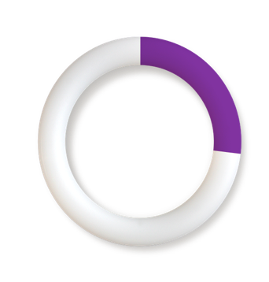

Topical PrEP – Dapivirine Ring
Well tolerated, good adherence in extension trials (DREAM and HOPE), with slightly better efficacy than seen in ASPIRE and The Ring Study
90day version in development
Regulatory submissions in process in Europe and Africa, submission to FDA planned in 2019
Efficacy for HIV seroconversion
27%
reduction
31%
reduction
Baeten MOSY0505 & TUAC0203 10th IAS 2019, July 23 Mexico City, Mexico
Baeten et al., Nel et al., NEJM 2016

Slide 39
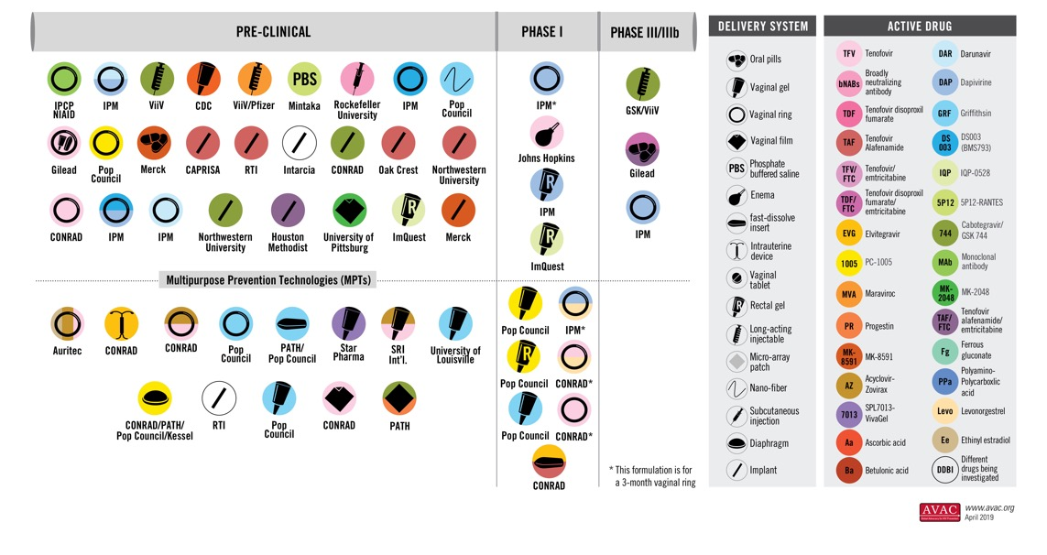
Topical PrEP Pipeline
Baeten MOSY0505 10th IAS 2019, July 23 Mexico City, Mexico

Slide 40
PrEP and STIs
Results of a recent meta-analysis* suggest that STI incidence and prevalence is much higher than global estimates in individuals seeking PrEP, overall there was agreement in incidence regardless of anatomical site, income-level, or study type.
 | In Meta-analysis | Global estimates 2016
Pathogen | Pooled incidence per 100 PY (95% CI) | Men | Women
Chlamydia | 21.5 (17.9-25.8) | 3.3 (2.1-4.8) | 3.4 (2.5-4.5)
Gonorrhoea | 37.1 (18.3-25.5) | 2.6 (1.5-4.1) | 2.0 (1.4-2.8)
Early syphilis | 11.6 (9.2-14.6) | 0.2 (0.1-0.2) | 0.2 (0.1-0.2)
Hepatitis A | -
Hepatitis B | 1.2 (0.6-2.6)
Hepatitis C | 0.3 (0.1-0.9)
Any Ct/Ng/Tp | 72.2 (60.5-86.2)
*Mainly HIC, MSM studies
Ong,J SUSA07 10th IAS 2019, July 23 Mexico City, Mexico

Slide 41
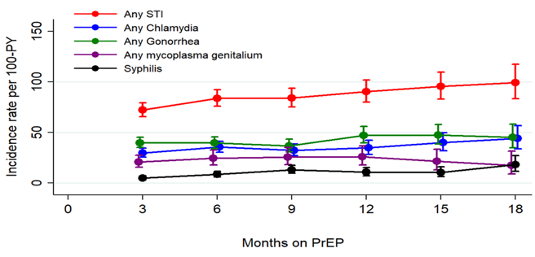
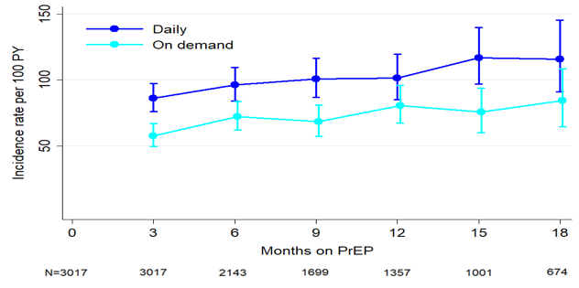
PrEP and STI Risk
Molina TUAC0202, IAS Mexico City July 21-24 2019
PREVENIR study results showed Incidence of bacterial STIs increased 38%/year (syphilis rates in HIV- MSM remained stable over the same interval).
Similar trends between daily vs on-demand groups but with higher incidence in daily users, who tended to have more condomless sex and more partners.
Bacterial STI rates among PrEP recipients in the PREVENIR study

Slide 42
PrEP and STI Risk
Veloso, SUSA07 10th IAS 2019, July 23 Mexico City, Mexico
PrEP Brasil (a pilot project ahead of PrEP scale-up in Brazil) observed variable STI incidence after enrollment, which was significantly dependent on risk factors
Overall
Young (18-24 years)
Transgender women
30
STI Incidence overall, and in the highest incidence groups:
20
20
(per 100 participants)
Prevalence
14.29
12.39
12.5
Week
9.38
10.6
10
8
7.73
7.5
7.61
Baseline (n = 450)
6.79
6.67
48 (n = 375)
4.89
3.73
4.35
4
4.76
96 (n = 280)
0
0
Chlamydia
Gonorrhea
Chlamydia
Gonorrhea
Chlamydia
Gonorrhea
Upper limit
10.5
10.4
9.7
6.9
5.7
10.6
18.5
13.0
16.5
16.3
8.5
20.6
11.7
29.2
19.3
0.0
13.9
40.2
Lower limit
5.5
5.0
3.8
2.9
1.8
4.4
6.3
2.2
2.2
4.9
0.2
4.4
0.0
0.0
0.0
0.0
0.0
0.0
p = 0.58
p = 0.22
p = 0.40
p = 0.93
p = 0.58
p = 0.22

Slide 43
PrEP and STI risk
In a large longitudinal cohort of PrEP users in Chicago, no significant relationship between PrEP use and STI diagnosis was observed. In a German multicenter study, STI prevalence was similar between PrEP users and non-PrEP users at baseline.
Proportion of positive rectal STI in a Chicago cohort
STI and PrEP use at baseline in the BRAHMS study
Pre-PrEP Uptake
Post-PrEP Uptake
No PrEP
No PrEP

Slide 44
PrEP and STI Risk
In the Australian PrEPX Study with a mean follow-up of 1.1 years, STI Incidence was modestly increased after PrEP initiation, more so in PrEP-naïve participants.
  Partner frequency was more important than condom use habits in predicting risk of STI
  25% of participants accounted for 76% of STIs
 | STI Incidence 1 year before Per 100 PY | STI Incidence Post Entry Per 100 PY | Incidence Rate ratio (95% CI) | Adjusted IRR* (95%CI)
All | 69.5 | 98.4 | 1.41 (1.29-1.56) | 1.12 (1.02-1.23)
PrEP-Exp (n=541) | 92.4 | 104.1 | 1.13 (0.99-1.28) | 1.05 (0.92-1.19)
PrEP-Naive (n=837) | 55.1 | 94.2 | 1.71 (1.49-1.96) | 1.21 (1.06-1.39)
Risk Factors for STIs | aOR | 95% CI | p
Age (5 years increase) | 0.94 | 0.90-0.97 | < 0.001
No. anal sex partner in last 6 months (< 5 vs. >10) | 1.91 | 1.48-2.46 | < 0.001
Group sex (monthly vs none) | 1.45 | 1.15-1.83 | 0.002
Condom use (never vs always) | 1.31 | 0.88-1.97 | 0.18
Molina TUSY0806IAS Mexico City July 21-24 2019
Traeger M. et al, JAMA 2019;321:1380

Slide 45
PrEP & Transgendered people
PrEP continuum among transgender women from the LITE cohort in USA identified that half of HIV-uninfected TGW studied met criteria for PrEP, but that use was low.
Wirtz. A IAS TUPEC482 Mexico City July 21-24 2019

Slide 46
On-Demand vs Daily PrEP
Molina TUAC0202, IAS Mexico City July 21-24 2019
In the Paris ANRS PREVENIR cohort study of PrEP users, about 50% use on-demand and 50% use daily TDF/FTC for PrEP.
  HIV incidence was 0.09/1000PY (2208 PY of follow-up), with an estimated 143 averted cases. Both new cases of HIV occurred in participants who had discontinued PrEP.
PrEP / Condom use at last sexual intercourse
(n, %) | Daily n = 3806 acts | On Demand n = 3879 acts | Total n= 7685
Total PrEP use | 3705 (97.3) | 3188 (82.2) | 6893 (89.7)
Correct use* | 3613 (97.5) | 3072 (96.4) | 6685 (97.0)
Suboptimal | 92 (2.5) | 116 (3.6) | 208 (3.0)
No PrEP | 101 (2.7) | 691 (17.8) | 792 (10.3)
Condoms | 716 (18.8) | 851 (21.9) | 1567 (20.4)

Slide 47
PrEP Implementation Successes
Ongoing low HIV incidence is reported from the expanded PrEP implementation in New South Wales, Australia (1/1000py).
In the POWER study from Cape Town, PrEP uptake was high (92%) among women and adolescent girls.
  Interruptions were common (95% had at least one interruption), with re-initiation in about 25%.
Breakthrough infections with resistant virus remains rare in PrEP recipients.
  M184V/I is most commonly observed in TDF/FTC users who seroconvert
Omollo, V TUAC304 IAS Mexico City July 21-24 2019
Grulich, A TUAC201 IAS Mexico City July 21-24 2019
Ryan, K MOAD0303 IAS Mexico City July 21-24 2019
Molina & Kuritzkes, TUSY0206 IAS Mexico City July 21-24 2019

Slide 48
PrEP Implementation Challenges
PrEP scale-up has had variable success in different regions, with some regions struggling with falling retention affected by social, geographic, and programmatic factors.
PrEP continuation by month
Rolling cohort study in Ho Chi Minh City (n=1,342), Mar 2017-Apr 2019
1-month PrEP continuation rates in Lesotho
Tarumbiswa & Nguyen, SUSA07 10th IAS 2019, July 23 Mexico City, Mexico

Slide 49

PrEP Implementation Challenges
In Mexico, MSM users of a social networking app who participated in study surveys demonstrated a high level of knowledge about PrEP, but low uptake (3.5% currently taking, 5% having taken in the past 12 months).
  PrEP knowledge and use increased with STI testing, substance use, and age.
  The study execution itself highlighted PrEP implementation challenges persisting in LMIC; PrEP funding changes proposed by the Mexican government and medication shortages required enrollment to be paused.
Sources of PrEP prescriptions
6%
Other Sources
6%
Friends
8%
Internet
29%
Research studies
50%
Doctors
ImPrEP
Holloway MOAD0301 IAS Mexico City July 21-24 2019

Slide 50
PrEP - Adherence & Retention
Over 85% of the EPIC-NSW participants reported no discontinuations of PrEP, and those discontinuing >3 months generally had lower levels of behavioural risk.
  High-risk behaviours were still common in treatment-free periods.
  HIV seroconversions occurred mainly in participant who had discontinued completely.
In the PrEPX study 25% of participants discontinued PrEP & 22% of these recommenced it later. Discontinuation was more likely among younger (16-29), PWID, PrEP naïve, and those reporting regular condom use.
  10 new diagnoses (2.28% positivity) of HIV in participants who had discontinued
  STI diagnoses were not different between those who continued or discontinued PrEP
Bavinton, B TUAC03 IAS Mexico City July 21-24 2019
Grulich, A TUAC201 IAS Mexico City July 21-24 2019
Ryan, K MOAD0303 IAS Mexico City July 21-24 2019

Slide 51
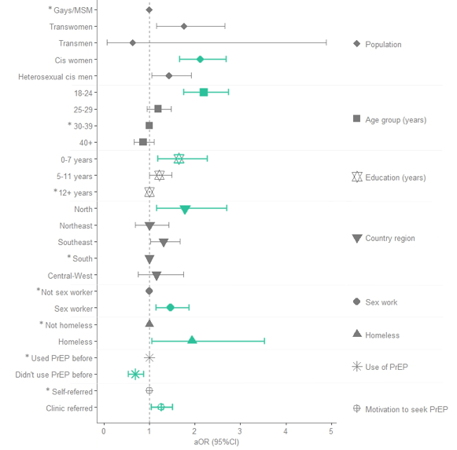
PrEP - Adherence & Retention
Likelihood of PrEP discontinuation
Since Jan 2018 in Brazil, PrEP is free-of-charge for individuals who meet guideline recommendations for use. From a population-based database, 6,079 PrEP users attended a 1st appointment; 691 were lost to follow-up/discontinued before the next visit.
  Factors associated with discontinuation included female gender, TGW, younger age (<24), lower education, homelessness, living in a northern region, and sex work.
Pereira IO MOAD0304 IAS Mexico City July 21-24 2019

Slide 52
PrEP – Adherence & Retention
Celum, C TUAC0301 IAS Mexico City July 21-24 2019
While PrEP had high uptake among women participating in HPTN 082, retention and continued adherence remain a challenge, with more than half of women with low or undetectable TDF levels 3 months after initiation.
  Adherence was not impacted by enhancing adherence support, but was more common for women who reported a high perceived risk of HIV and greater PrEP readiness at baseline
 | 3 months | 6 months | 12 months
Tenofovir diphosphate (TFV-DP), DBS | N=371 | N=363 | N=347
Detectable | 83.6% | 56.5% | 31.4%
>700 fmol/punch* (among those with detectable TFV-DP) | 24.8% | 20.9% | 8.6%
 | 3 months | 6 months | 12 months
Tenofovir diphosphate (TFV-DP), DBS | N=371 | N=363 | N=347
Detectable | 83.6% | 56.5% | 31.4%
>700 fmol/punch* (among those with detectable TFV-DP) | 24.8% | 20.9% | 8.6%
Plasma tenofovir | N=380 | N=370 | N=363
Detectable | 64.8% | 46.8% | 25.3%
>40 ng/ml** | 48.4% | 38.4% | 17.4%
Detectable TFV-DP in women receiving PrEP from HPTN 082

Slide 53
PrEP – Adherence & Retention
For female participants in PrIYA, there was a low rate of initiation of PrEP (22%), with only 40% of participants retained in care after 4 weeks. Among those who were retained, TDF was detectable in 66% overall using POC DBS testing, and adherence was associated with .
Frequency of detectable TFV-dp level
Age
Pregnancy status
n=21,291
n=4,684
Partner HIV status
Pintye TUAC0305 IAS Mexico City July 21-24 2019

Slide 54
Thinking Outside The Clinic – Point-of-Care HIV Testing

Slide 55
Peer-Delivered HIV Self-Testing
Peer-delivered HIV self-test kits are effective in reaching FSWs and MSM, who found the testing acceptable.
  Linkage to care and saturation of the peer-tester networks were observed challenges in Burundi, but linkage to care was high among MSM tested in South Africa and Thailand (72 & 93% receiving confirmatory tests, 95 & 95% initiating ART)
  Signals for increased interpersonal violence and relationship problems were noted for FSWs Malawi.
Linkage Cascade for HIVST recipients in South Africa
HIVST uptake trend, Burundi (June 2018 to March 2019)
Mee, P WEAC02 IAS Mexico City July 21-24 2019
Shapiro & Nguyen & Gashobotse WEAC02 IAS Mexico City July 21-24 2019

Slide 56
POC Testing – Updates on Available Tests
Dried Blood Spot (DBS) VL testing technology is improving. DBS provides opportunities for POC testing.
  Periodic testing showed consistent adherence in a subset of participants with high VL from the M-Spot Study
  HIV1 RNA VL using automated filtered dried plasma spot performed better than dried blood spot in head-to-head comparison, and correlated better with results from venous samples.
POC NAAT
  GeneXpert VL test uses 1mL of plasma, TAT 90 minutes, with LOD 32 copies/mL (not yet available in North America)
  mPIMA
  SAMBA II
Teran, Richard TUPDD0103 IAS Mexico City July 21-24 2019
Pham, MD IAS Mexico City July 21-24 2019
Branson, TUSY0202 IAS Mexico City July 21-24 2019

Slide 57
POC Testing
The mPima test for VL quantification was tested as a POC test for pregnant and post-partum women in Mozambique. The cartridge-based test requires 50uL of blood and delivers results in 70 minutes. mPima results were highly correlated with SOC methods, and capillary blood samples correlated well with venous samples which would facilitate sample collection.
Correlation between conventional plasma & POC VL
Correlation between venous & capillary blood POC VL
Mudenyanga, SUSA04 IAS Mexico City July 21-24 2019

Slide 58
POC Testing – Early Infant Diagnosis
POC testing for Early Infant Diagnosis (EID) significantly improved TAT, time to treatment initiation, and was cost effective in a large implementation study in 9 countries in Africa.
 | Conventional EID (N=102 sites, n=3082 tests) | POC EID (N=1574 sites, n=126,789 tests) | p value
Median TAT from blood sample collection to result returned to caregiver (IQR) | 50 days (31-71s) | 0 days (0-1 ) | p<0.001
Results received by caregiver within 30 days | 19.2 % | 96.9% | p<0.001
Percent of HIV-infected infants started on ART within 60 days of sample collection | 41.5% (44/106) | 92.2% (3990/4327) | p<0.001
Median TAT from blood sample collection to ART initiation for HIV-infected infants (IQR) | 50 days (30-68) | 0 days (0-1) | p<0.001
Lyons, C SUSA04 IAS Mexico City July 21-24 2019

Slide 59
Rapid Treatment Start
Who, What, When?

Slide 60
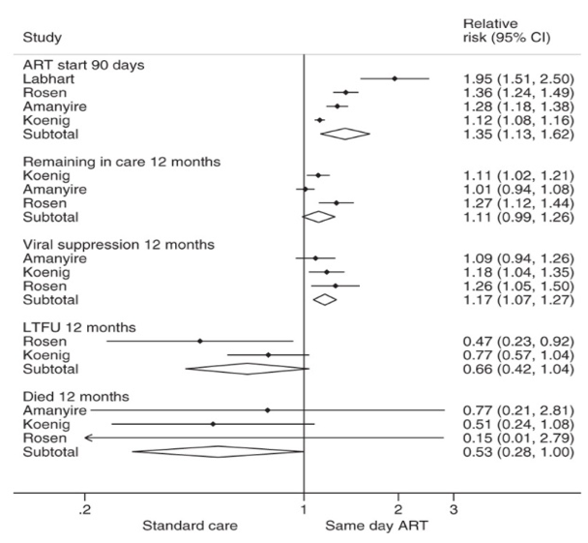
Rapid Treatment Start
Koening, S IAS TUSY0405 Mexico City July 21-24 2019
VL suppression
Rapid ART start has been shown to be safe and effective in adults.
  4 Large RCTs (CASCADE, RapIT, START-ART, SDART Haiti) demonstrated better retention in care, better VL suppression and lower mortality for same-day starts in LMIC nations.
  SLATE II will aim to assess safety of same-day ART among participants with mild TB symptoms
  In the HIC nations, cohort studies from San Francisco, Atlanta, and New Orleans have demonstrated more rapid VL suppression and higher rate of VL suppression with rapid treatment start
Saag MS et al. JAMA 2018, Ford N et al, AIDS, 2017, Rosen S et al, in press, Pilcher CD et al, JAIDS 2017;
Hughes A et al, IAS 2018; Coffey AIDS el al 2019; Colasanti J et al OFID 2018; Halperin J et al, OFID 2019

Slide 61
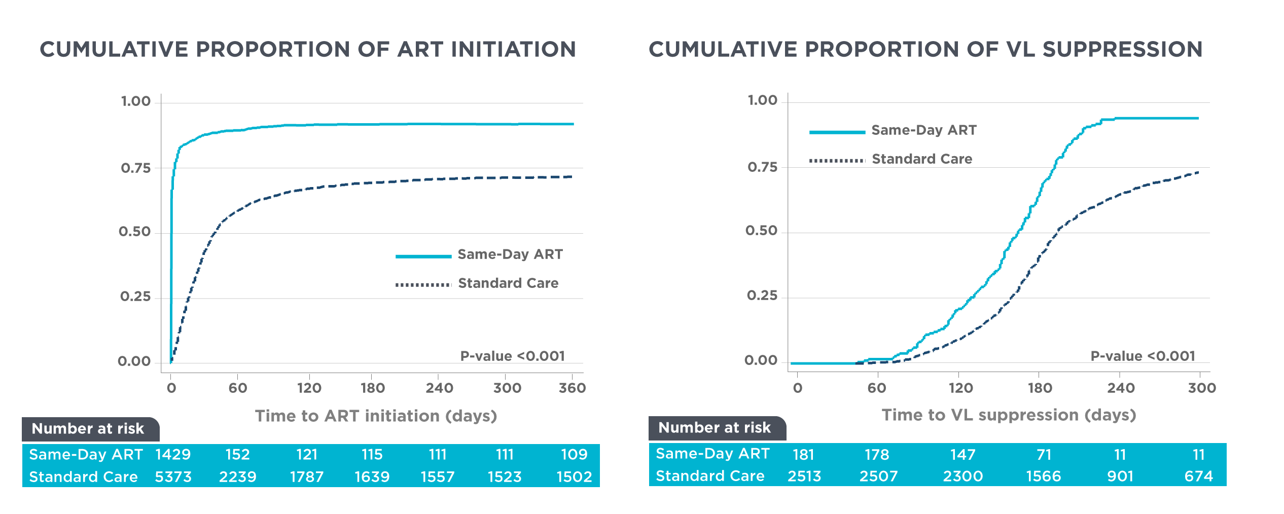
Rapid Treatment Start
In Thailand, same-day ART was successful (no increased adverse events or mortality), and acceptable to participants when those who were felt to be at low risk of OIs were not required to perform baseline blood work.
Seekaew, P WEAB0102 IAS Mexico City July 21-24 2019

Slide 62
Rapid Treatment Start
In a model from Amsterdam, high-risk MSM referred from primary care for a rapid trajectory strategy of diagnostic testing (which included HIV RNA testing) showed more participants could be diagnosed and treated during early infection.
2008
n=768
2014
n=108
HIV Diagnosis by Feibig stage
4.6%
2015-2017
SOC
n=118
4.2%
2015-2017
Rapid Trajectory
n=19
52.6%
Dijkstra, M WEAB0101 IAS Mexico City July 21-24 2019

Slide 63
Rapid Start – longer-term outcomes
In a retrospective analysis from Tanzania, same day initiation (SDI) was compared to standard of care (SOC, <14d) over 1 year, finding better retention in care for SDI than SOC by 12 months, and comparable VL suppression.
Msongole, B WEAB0103 IAS Mexico City July 21-24 2019

Slide 64
Rapid Treatment Start – Areas of Concern
In Mozambique increased mortality among TB/HIV cases from 2013-2017 was observed after introduction of a test-and-treat model in conjunction with GeneXpert testing rollout.
Treatment mortality rates disaggregated by sex, 2006-2017
Xpert MTB/RIF
introduction
test and treat
approach
Valverde E WEAB0105IAS Mexico City July 21-24 2019

Slide 65
Rapid Treatment Start - Recommendations
IAS-USA Guidelines support initiation of treatment as soon as possible, including at the first visit, unless the patient is not ready.
This includes before test results (HIV1 RNA, CD4 count, resistance testing, Hepatitis serologies) are available for review.
  Rapid Start regimens recommended include Biktarvy, and DTG or DRV/r + TAF/TDF + FTC/3TC
Koening, S IAS TUSY0405 Mexico City July 21-24 2019
Saag MS et al. JAMA 2018

Slide 66
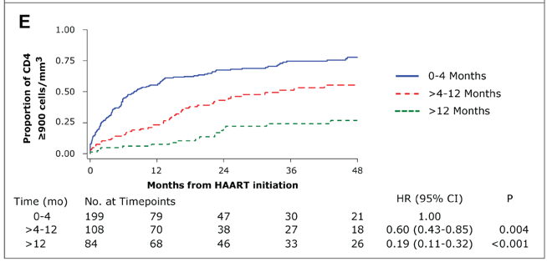
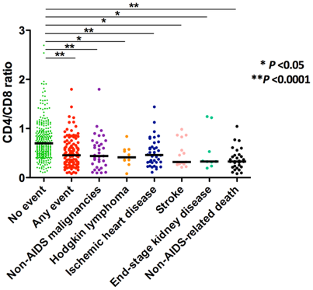
Treatment During Acute Infection
Treatment during primary HIV infection confers advantages including
  Better recovery of CD4, restoration of CD4:CD8 ratio (associated with improved survival and CD4 decline rate)
CD4:CD8 ratio associated with
comorbidity and mortality
CD4 Count after ART initiation during pHI, post-PHI and chronic infection
Frater J IAS WEPL0104 Mexico City July 21-24 2019
Le et al NEJM; Jan 2013, Serrano-Villar PLoS One 2014, Serrano-Villar PLoS Pathog 2014

Slide 67
Treatment During Acute Infection
Treatment during Primary HIV Infection (PHI) may also be important for treatments with novel therapeutic strategies
  Lower HIV reservoir, better HIV-specific immunity, decreased immune activation and immune exhaustion, reduced viral immune escape potential, and post-treatment control have all been described in PLH who begin therapy during PHI
Treatment during PHI may also reduce transmission rates.
Challenges remain in recognition and diagnosis of PHI
Frater J IAS WEPL0104 Mexico City July 21-24 2019
Manu Marchi; Unpublished, Takata Sci Transl Med Feb 2017, Lee et al Nat Comms 2019

Slide 68
ART Updates
New Drugs, New Paradigms, Safety & Side Effects

Slide 69
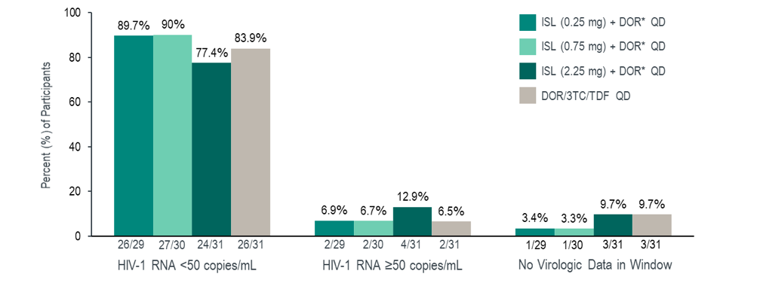
Nucleoside reverse transcriptase translocation inhibitors (NRTTI)
In its dose-ranging study, Islatravir was effective for control of HIV and well tolerated at doses of 0.25, 0.75 and 2.25mg in combination with DOR + 3TC.
  No discontinuation due to AE, no dose-related or laboratory abnormalities
  No resistance testing was required (no protocol-defined virologic failure occurred)
VL outcomes to week 48
Molina, JM LBPE46 IAS Mexico City July 21-24 2019

Slide 70
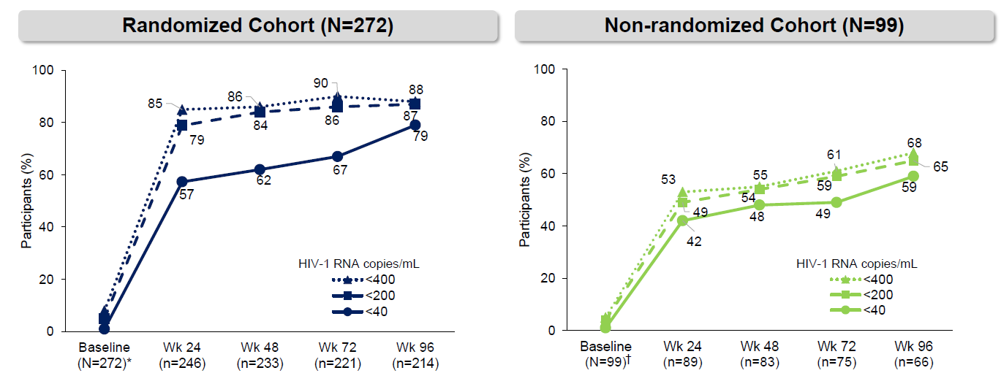
Fostemsavir for heavily treatment experienced PLH
In the BRIGHTE study, addition of Fostemsavir to a current failing regimen improved VL suppression in the randomized cohort (participants had 1 or 2 susceptible ARV classes remaining) & in the non-randomized cohort (participants had 0 classes remaining) out to 96 weeks.
Lataillade et al. 10th IAS conference. Mexico. Slides MOAB0102
Cahn, P, WEAB0404 IAS Mexico City July 21-24 2019

Slide 71
New ART Regimens
From the EMERALD and AMBER studies; adherence to single-tablet Darunavir/c/FTC/TAF was high up to 96 weeks
  Adherence >95% was observed in 87% and 92% of AMBER and EMERALD participants respectively
  No treatment-emergent DRV, PI, or TFV resistance was observed, and emergence of FTC resistance was rare (M184I/V in 2 patients)

Slide 72
TANGO results: DTG/3TC for maintenance
Switching to DTG/3TC was non-inferior to continuation of a TAF-containing 3 drug regimen (3DR) with respect to virologic suppression out to 48 weeks.
  Virologic outcomes: Snapshot
More AE-related withdrawals (4 vs 1%) occurred in the DTG/3TC group
Greater changes in Creatinine and eGFR were observed in the DTG/3TC
ª
Van Wyk , WEAB0403IAS Mexico City July 21-24 2019

Slide 73
GEMINI Results: DTG/3TC as Initial Therapy
DTG/3TC was non-inferior to DTG + TDF/FTC for initial therapy in treatment-naïve adults
  Virologic Outcomes: Snapshot
Participants included had no major resistance mutations, did not required HBV or HCV therapy and had VL of 1,000-500,000 copies/mL
No treatment emergent INSTI or NRTI mutations in patients with virologic failure were observed
 | DTG + 3TC (N = 716)
 | DTG + TDF/FTC (N = 717)
Cahn, P, WEAB0404 IAS Mexico City July 21-24 2019

Slide 74
Choosing Initial Therapy: Treatment-naïve, High VL
OPERA, a prospective observational study in the US, assessed data from 2,038 treatment-naïve people with VL >100,000.
  Dolutegravir outperformed elvitegravir, raltegravir, and darunavir for viral suppression at week 36.
Unadjusted VL suppression at week 36
Mills, A et al. 10th IAS conference. Mexico. Slides MOAB0103

Slide 75
Choosing Initial Therapy
Results of the ADVANCE trial in South Africa (where baseline INSTI-resistance is 5-15%) support the use of DTG-based regimens for initial therapy, with improved time to VL suppression compared with EFV-based regimens.
For participants with VL >50 at week 48, VL suppression was more likely for recipients of DTG-based therapy than EFV
Treatment-emergent resistance was lower in DTG groups
Adverse events were comparable across groups (SAE 5-7%, any AE 63-72%)
Proportion of participants with HIV-1 RNA <50 copies/mL (ITT)

Slide 76
Regimen Switching
Virologic Outcome by FDA Snapshot
In 380-4030 switching to BIC/TAF/FTC from DTG + TAF or TDF/emtricitabine was non-inferior based on virologic suppression, regardless of pre-existing NRTI resistance.
  VL suppressed at enrollment
  No emergent resistance
Virologic suppression remained high out to 96 weeks in HIV-positive women who switched to BIC/TAF/FTC from PI-based therapy.
  VL suppressed at enrollment
  No emergent resistance
  Improved renal markers
  No new pregnancy data
B/F/TAF (n=284)
DTG+ F/TAF (n=281)
Participants, %
HIV-1 RNA
≥50 c/mL
HIV-1 RNA
<50 c/mL
No Virologic
Data
n
N* =
1
284
3
281
265
284
256
281
18
284
22
281
Virologic Outcomes Weeks 48 and 96 (M=E Analysis)
% Participants with
HIV-1 RNA <50 copies/mL, M=E
n
N* =
229
230
191
194
420
424
207
208
Group A
B/F/TAF
Group B
SBR to B/F/TAF
Groups A+B
All B/F/TAF
Group A
B/F/TAF
Kityo et al. 10th IAS conference. Mexico. Slides MOAB0106
Week 48
Week 96
Sax et al. 10th IAS conference. Mexico. Slides MOAB0105

Slide 77
Regimen Switching
In an open-label trial of switching to Bictegravir/TAF/FTC in adults >65, week 24 results showed virologic suppression at 98% after switch, and no drug-related SAEs or deaths.
Switching to DTG + boosted Darunavir was non-inferior to continuation of 3 drug therapy in the DUALIS study for the primary endpoint of VL <50 copies/mL. Adverse events were comparable between groups, but drug-related AEs were more common in the DTG+bDRV group
Spinner, CDIAS Mexico City July 21-24 2019

Slide 78
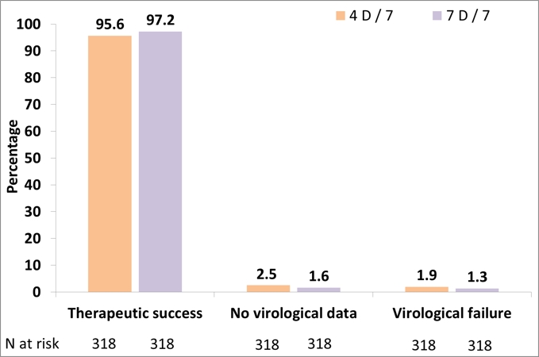
4/7 day ART for Maintenance
Results of the QUATOR study found that taking ART for 4/7 days was non-inferior to daily treatment in maintaining VL suppression.
  Virologic Outcomes
Open-label study included participants on PI, NNRTI, and INSTI backbones with 2 NRTI who had VL <50 for at least 12 months and no genotypic resistance.
No difference in viral blips, treatment-related adverse events,
No differences in lipids, weight, eGFR or glucose
No difference in CD4 count or CD4:CD8 ratio
  VL <50
Landman, WEAB0406LB IAS Mexico City July 21-24 2019

Slide 79
Side Effects with 1st line agents
In the OPERA cohort, no increased risk of GI side effects was observed in treatment-naïve patients beginning EVG, RAL, DTG, or DRV-based regimens. However, ART-experienced participants switching to RAL or DRV (compared to DTG) showed a trend toward increased risk of new GI side effects in the first 6 months.

Slide 80
2DR Therapy
Meta-analysis data supports the safety and efficacy of DTG+3TC and DTG+RPV for maintenance in patients who are already virologically suppressed
Further evidence from the ANRS 167 LAMIDOL study supports previous findings that seminal HIV RNA detection did not differ between participants taking DTG+3TC and those taking 3 drug regimens.
Punekar, MOPEB267 IAS 2019 conference.
Descamps, D IAS 2019 conference.

Slide 81
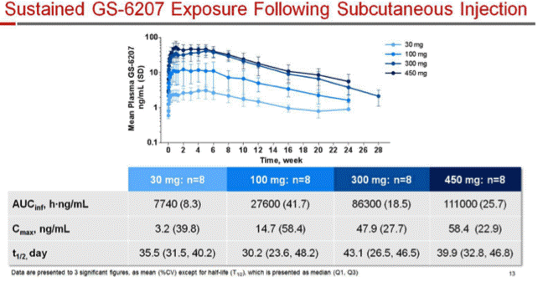
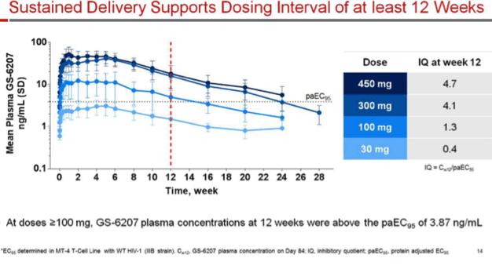
Novel Therapies – Capsid Inhibitors
GS-6207 is currently in Phase I studies where it was well-tolerated by healthy volunteers (ongoing in HIV-1 patients), and demonstrated high plasma concentrations for >12 weeks after single injection.
Sager J, et al. CROI 2019. Abstract 141
Cahn, P, WEAB0404 IAS Mexico City July 21-24 2019

Slide 82
Injectable ART (Cabotegravir + Rilpivirine IM q4w)
Pooled analysis from ATLAS and FLAIR at week 48: long-acting therapies were non-inferior to oral antiretroviral treatment with respect to VL suppression.
97% of participants in ATLAS preferred injectable therapy to oral treatment, and tolerated therapy very well, only 1% of participants withdrawing due to injection-site reactions.
  Virologic outcomes
Virologic Nonresponse (≥50 c/mL)
Virologic Success
(<50 c/mL)
No Virologic Data
Overton E IAS MOPEB257 Mexico City July 21-24 2019

Slide 83
Injectable ART (Cabotegravir + Rilpivirine IM q4w)
Overton E IAS MOPEB257 Mexico City July 21-24 2019
RPV is detectable 12-24 months after single injection
Cabotegravir is detectable out to 48 weeks after single injections
  Cabotegravir was detectable for longer in women than in men.

Slide 84
HIV Drug Resistance
Global updates

Slide 85
Drug Resistance
Bictegravir/FTC/TAF treatment outcomes were not affected by low-frequency resistance variants in ART-naïve participants in Phase III studies
  Baseline primary NRTI-R was detected in 2%, NNRTI-R in 13.2%, PI-R in 2.9% with deep sequencing
BIC/FTC/TAF was also effective (virologic suppression 93% at 48 weeks) in participants with baseline NRTI, NNRTI, and PI resistance, including up to 24% with known or suspected NRTI resistance.

Slide 86
Drug Resistance – Global Perspective
Prevalence of ART resistance in HIV varies significantly depending on population. Transmitted resistance is still increasing in some countries, though it is decreasing in others.
  Data from Brazil demonstrates declining transmitted HIV drug resistance among PLH who are treatment-experienced.
  In Cameroon, pre-treatment EVF/NVP resistance reached >10% in some regions.
  In South Africa among women with virologic failure of ART presenting for delivery, drug resistance mutation prevalence was >70%, predominantly NNRTI mutations were detected.
Goncalves, RE WEPDB0101 IAS Mexico City July 21-24 2019
Fokam, J WEPDB0102 IAS Mexico City July 21-24 2019
Adeniyi OV, WEPDB0105 IAS Mexico City July 21-24 2019

Slide 87
Drug Resistance – Global Perspectives
Data presented from Detroit showed a significant increase in INSTI RAMs over time, particularly in treatment-experienced patients, but a rise in RAMs were also increasing among INSTI-inexperienced patients.
In two urban centers in Mozambique, 18.5% of samples demonstrated pre-treatment drug resistance, predominantly due to NNRTI resistance.
In a study in the Philippines, transmitted drug resistance for INSTI was detected in 57/266 of treatment naïve patient samples tested.
Gudipati, S IAS Mexico City July 21-24 2019
Carnimeo, V IAS Mexico City July 21-24 2019
Salvana, EM, PB254 IAS Mexico City July 21-24 2019

Slide 88
Salvage Therapies – New Insights
Results from week 96 of the OPTIONS study showed that salvage therapy could safely omit NRTIs without compromising efficacy or durable virologic response if the regimen contained a cumulative activity of >2 active drugs.
  70% of participants in the omit NRTI group and 65% in the Add NRTI group achieved VL <200 (61% and 59% with VL <50)
Modeling of Ibalizumab in addition to optimized background regimen for heavily-treatment experienced patients suggests an increase in 5 year survival from 38% to 47%, and a decrease in 5 year transmission rates from 4.7/100py to 3.51/100py at an increased cost of USD708 million over 5 years
Ghandi, R, S IAS Mexico City July 21-24 2019
Millham, L MOPEB275 IAS Mexico City July 21-24 2019

Slide 89
TB & HIV
Diagnosis & Treatment Updates

Slide 90
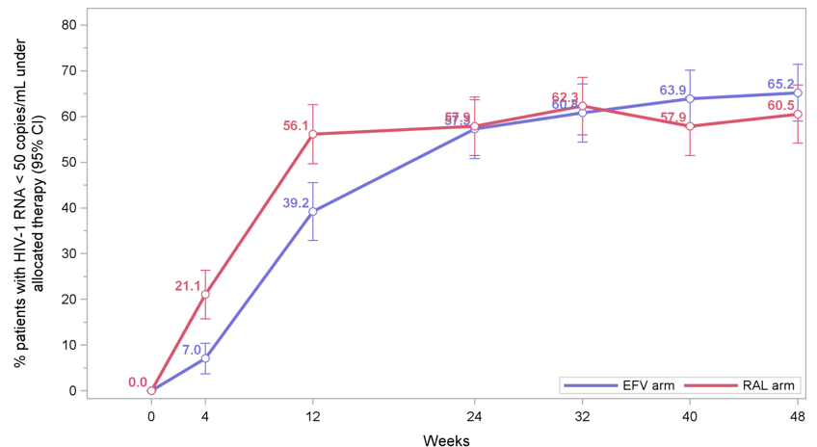
Management of TB/HIV
Week 48 results of the Reflate TB2 trial showed that virologic control during TB treatment with raltegravir 400mg BID was not non-inferior to efavirenz. Efavirenz remains 1st line for HIV in the context of TB.
Virologic Outcomes from Reflate TB2
EFV 57.3% (95% IC 50.8-63.7)
RAL 57.9% (95% IC 51.5-64.3)
De Castro et al. 10th IAS conference. Mexico. Slides MOAB0101
Notes:
)

Slide 91
TB Prevention: Scale-up Progress
From PEPFAR databases of people living with HIV in DRC, Haiti, Kenya, Lesotho, Mozambique, Nigeria and Eswatini who were initiating TB preventive therapy with INH:
  In 2018 between 2 – 20% of PLH initiated TB preventive therapy. Completion rates varied from 13 – 75%.
  In 2019 between 3 – 21% of PLH initiated TB preventive therapy, and completion rates varied from 27-90% up to the 2nd quarter.
  Women were more likely than men to both initiate and complete treatment.

Slide 92
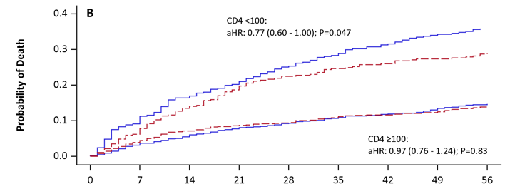

Diagnostic Testing Updates in TB: LAM
In the STAMP trial (n=2600), urine LAM tests were performed in combination with sputum & urine Xpert in PLH hospitalized in Malawi & South Africa with TB symptoms. Compared to sputum Xpert alone (SOC), use of urine LAM testing:
  Increased pre-discharge diagnosis and treatment for TB
  Reduced 56-day mortality among subgroups with CD4 < 100 cells/mL, severe anemia, and clinically suspected TB.
  Was cost-effective, & could be performed on more patients (59.6% producing sputum vs 99% producing urine)
Microbiologically confirmed TB,
intervention arm (n=210)
8.6%
(n=18)
14.3%
(n=30)
Sputum Xpert (n=85)
13.8%
(n=29)
3.8%
(n=8)
41.4%
(n=87)
11.4%
(n=24)
6.2%
(n=13)
Time to death (by baseline CD4 cell count)
Urine Xpert
(n= 74)
Urine LAM (n=158)
Reddy et al . Lancet Global Health 2019
Days since randomisation

Slide 93
STAMP Trial – Mortality at 56 days
 | Standard of Care [SOC] n (%) | Intervention n (%) | Risk Difference* % (95% CI) | p-value | Interaction p-value
Intervention - SOC | 272 (21.1) | 235 (18.3) | -2.8 (-5.8, 0.3) | 0.074
Risk Difference (%) & 95% CI
Subgroup analyses:
Site |  |  |  |  | 0.668
Zomba, Malawi | 161 (24.4) | 137 (20.9) | -3.5 (-8.0, 1.0) | 0.128
Edendale, South Africa | 111 (17.7) | 98 (15.5) | -2.2 (-6.3, 1.9) | 0.301
Baseline CD4 cell count, cells/μL |  |  |  |  | 0.063
<100 | 133 (35.7) | 107 (28.8) | -7.1 (-13.7, -0.4) | 0.036
≥100 | 131 (14.6) | 127 (14.0) | -0.1 (-3.3, 3.1) | 0.963
Baseline haemoglobin, g/dl |  |  |  |  | 0.056
<8 | 116 (38.9) | 86 (29.8) | -9.0 (-16.6, -1.3) | 0.021
≥8 | 156 (15.8) | 149 (15.0) | -0.9 (-4.1, 2.3) | 0.580
TB clinically suspected at admission |  |  |  |  | 0.111
Yes | 136 (27.5) | 106 (21.2) | -5.7 (-11.0, -0.5) | 0.033
No | 136 (17.2) | 128 (16.4) | -0.8 (-4.4, 2.9) | 0.682
* adjusted by site (except for sub-group analysis by site). 29 patients missing CD4 cell counts, 5 patients missing haemoglobin, 9 patients missing clinical TB suspect at baseline data.
-15
-10
-5
0
5
← Favours Intervention
Favours SOC →

Slide 94
LAM Testing in the outpatient setting
In a large observational study in DRC across multiple levels of care (inpatient, urban health center, and HIV clinic), urine LAM testing performed well:
  100% of patients with laboratory-confirmed TB had positive LAM tests (vs 81.4% for microscopy and 81.0% for Xpert) for an overall sensitivity of 65%.
  Mortality was significantly higher among participants who had positive LAM results but received no treatment.
  TAT for test result was <2h (vs 2 days for Xpert) and time to first dose of TB therapy was <3h in study setting.
Mortality at 6 months in symptomatic outpatients with CD4 < 200
 | Mortality (%) | RR (95% CI) | p-value | aRR* (95% CI) | p-value
LAM positive and treated | 12.8 | 1 |  | 1
LAM positive and not treated | 36.8 | 2.9 (1.4–5.9) | <0.01 | 2.6 (1.3–5.2) | <0.01
LAM negative and treated | 2.9 | 0.2 (0.03–1.6) | 0.14 | 0.3 (0.04–2.3) | 0.26
* Model adjusted for sex, age, BMI, heamoglobin, ART, seriously ill, CD4

Slide 95
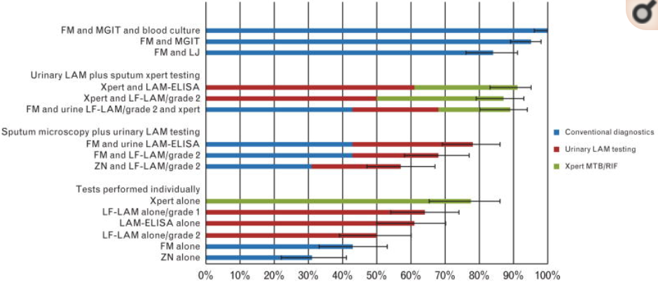
LAM testing Caveat: Combination with Xpert
LAM performance results are from interventions which combine it with sputum Xpert (Sensitivity 85%). LAM testing alone shows poorer sensitivity in PLH (sensitivity 49% vs sputum Xpert alone 76%).
Shah M. et al, AIDS, 2014

Slide 96
Diagnostic Testing Updates in TB: Xpert Ultra
Xpert Ultra is more sensitive than Xpert for detection of TB disease in smear-negative and in HIV+ patients, with a slightly lower specificity (detection of dead bacilli) and performs similarly for detection of Rifampin resistance.
 | Sensitivity By Smear and HIV Status (95% CI; n/N) |  |  |  | Specificity (95% CI; n/N)
 | All culture-positive | Smear-negative | HIV-negative | HIV-positive | All culture-positive
Xpert | 83% (79-86; 383/462) | 46% (37-55; 63/137) | 90% (84-94; 143/159) | 77% (68-84; 88/155) | 98% (97-99; 960/977)
Xpert Ultra | 88% (85-91; 408/462) | 63% (54-71; 86/137) | 91% (86-95; 145/159) | 90% (83-95; 103/115) | 96% (94-97; 934/977)
Difference (Ultra minus Xpert) | 5.4% (3.3-8.0; 25/162) | 17% (10-24; 23/137) | 1.3% (-1.8-4.9; 2/159) | 13% (6.4-21; 15/115) | -2.7% (-3.9 -1.7; 36/977)
Dorman S et al. Lancet Infect Dis 2018;18:76-84
WHO; The use of LF-LAM for the diagnosis and screening of active TB in people living with HIV; 2015; Broger, Lancet Inf Dis 2019; S1473-3099 (19)30001-5

Slide 97
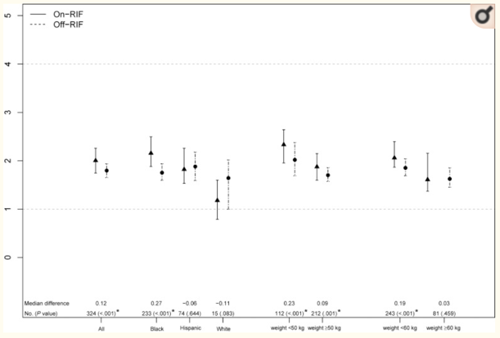
Co-treatment of TB & HIV: DDIs
Antiretroviral medication | Rifamycin* | Trial name/sponsor | Dose adjustments in adults
Efavirenz | High-dose rifampicin | RIFAVIRENZ/ ANRS 12 292 | Probably none (600mg EFV +RIF still suppressed VL; C24,AUC down 17%, 13%)
Lower-dose efavirenz | Rifampicin | ENCORE-1 substudy OPTIMIZE project | Likely not necessary
Raltegravir | Rifampicin | REFLATE/ANRS 12 180 | Increase raltegravir to 800 mg twice daily (standard dose still suppressed VL)
Dolutegravir | Rifampicin | INSPIRING/ViiV | Increase dolutegravir 50 mg twice daily
Ritonavir-boosted lopinavir | Rifabutin | ACTG A5290 | Decrease rifabutin to 150 mg once daily
 | Riafmpin |  | Double-dose r/LPV (better tolerated)
Ritonavir-boosted darunavir | Rifampin | Ebrahim et al, CROI 2019 | 1600/200 qday & 800/100 BID (not tolerated)
Tenofovir alafenamide (TAF) | Rifampicin | Gilead Sciences | Increased TAF Likely not necessary
EFV C_{min}
EFV with RIF
EFV alone
1 µg/mL
Atwine et al IAS 2017 MOPEB0340 Poster; NCT01986543; Cerrone 2019 CID and Kaboggoza 2019 Open Forum Inf Dz ; Grinsztejn et al Lancet ID 2014 14:459; Clinical Infectious Diseases 2019 (in press); in preparation (see also Naiker 2014; Lan 2014); Cerrone M et al, Journal of Antimicrobial Chemotherapy, Volume 74, Issue 6, June 2019, Pages 1670–1678

Slide 98
TB & HIV: managing DDIs
Results of the INSPIRING study of HIV/TB naïve adults initiating therapy for both with either DTG 50mg BID or EFV showed similar outcomes for VL suppression between regimens, and participants maintained therapeutic DTG levels.
INSPIRING Modified FDA Snapshot Analysis (ITT-E)
INSPIRING pharmacokinetic data
Pre-dose concentration: DTG 50 mg BID with RIF-based TB treatment
Time | n | DTG C_{T} (ng/mL) geometric mean (%CVb)
Week 8 | 42 | 870 (118)
Week 24 | 23 | 964 (263)
Pre-dose concentration: DTG 50 mg QD (post-TB treatment phase)
Time | n | DTG C_{T} (ng/mL) geometric mean (%CVb)
Week 36 | 27 | 854 (208)
Week 48 | 26 | 881 (281)
Dooley KD et al, Clinical Infectious Diseases.April 2019

Slide 99
LTBI & HIV: DDI Updtaes
DOLPHIN Study of DTG/FTC/TDF + 3HP demonstrated efficacy for VL suppression without need for dose-adjustment of DTG
  Only 1 detectable VL during study period – re-suppression after adherence counselling
Study Day | Week on 3HP | N | Day Post HP Dose | Geometric mean | Troughs, 5th and 95th % | Regimen
57/58 |  | 60 | 0 | 1003 | 500 -2080 | DTG alone
59 | Week 1 | 30 | 1 | 1053 | 412 - 1834 | DTG+HP
72 | Week 2 | 30 | 7 | 492 | 200-1063 | DTG+HP
73 | Week 3 | 60 | 1 | 657 | 295-1502 | DTG+HP
74 | Week 3 | 60 | 2 | 355 | 134-933 | DTG+HP
78 | Week 3 | 30 | 6 | 388 | 140 - 794 | DTG+HP
108 | Week 8 | 60 | 1 | 703 | 289 - 1603 | DTG+HP
109 | Week 8 | 60 | 2 | 394 | 121 - 1079 | DTG+HP
Dooley, et al., CROI 2019, LB37

Slide 100
LTBI Treatment: 1HP Outcomes
BRIEF-TB compared 1 month of daily INH + Rifapentine to 9 months of INH in adults and adolescents with HIV, finding 1HP to be non-inferior.
 | 9H Group | 1HP Group | Total
All Outcomes | 33 | 32 | 65
Active TB, Confirmed | 14 (42%) | 18 (56%) | 32 (49%)
Active TB, Probable | 10 (30%) | 11 (34%) | 21 (32%)
Death Related to TB | 2 (6%) | 0 (0%) | 2 (3%)
Death from Unknown Cause | 7 (21%) | 3 (9%) | 10 (15%)
 | 9H Group | 1 HP Group | Difference in Incidence Ratio (95% CI)
Number Events/Person-Years | 33/4896 | 32/4926
Incidence Rate/100 Person-Years | 0.67 | 0.65 | -0.02 (-0.35 to 0.30)*
Severe, P TUSY0803 IAS Mexico City July 21-24 2019
Swindells S et al. N Engl J Med 2019;380:1001-1011

Slide 101
HCV & HIV
Successes, Challenges, & New Insights

Slide 102
HCV – Rapid Diagnostic Tests
Analysis of the sensitivity and specificity of commercially available RDTs on retrospective samples from Georgia, Belgium, Cambodia and Nigeria found that RDTs had high specificity (generally 100%), but that sensitivity was impact by co-infection with HIV.
Reipold, E, WEAB0304 IAS Mexico City July 21-24 2019

Slide 103
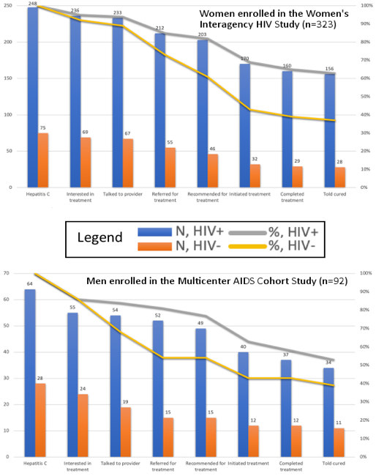
HCV Treatment Outcomes
Data from the Women’s Interagency HIV Study and the Multicenter AIDS Cohort Study were reviewed to assess the cascade of care for HCV in the era of DAAs:
  Women were more likely to progress through the cascade than men
  HIV+ adults were more likely to be linked to HCV care and complete treatment than HIV- adults, particularly women

Slide 104
HCV Treatment Rollout - Observations
Generic DAA achieve high SVR rates comparable to those seen in previous studies of DAAs.
Recently published meta-analyses support the efficacy of DAA treatment in PWID (88% SVR) and those receiving opiate substitution therapy (OST) (91% SVR)
Uptake in treatment in Australia (from 10 – 41% between 2015 and 2017) is associated with a decrease in HCV viremia prevalence from 43% to 25%
HCV re-infection is high among PWID and those who participate in OST
Perazzo, Hugo TUPEB172 IAS Mexico City July 21-24 2019
Latham et al. Liver Int 2019, Iversen et al. J Hepatol 2019
Iversen et al. J Hepatol 2019

Slide 105
New Data on HCV Re-Infection
The EuroSIDA cohort of PLH provided insight into HCV re-infection in this population. A 13.3% re-infection rate was observed (n=585) there. Re-infection risk varied by geographic region, era of treatment, CD4 count, and fibrosis score.
Odds of reinfection

Slide 106
HCV Treatment Impacts on HIV
DAA therapy in HIV/HCV co-infection appears to result in increased basal HIV transcription, which persists for up to 12 months after HCV clearance. This effect is more pronounced in participants who did not receive ribavirin.
  Cell-associated HIV RNA was increased in participants not receiving ribavirin.
HIV reservoir size, as measured by HIV-DNA content in HIV/HCV patients, was not affected by treatment with DAAs.
Turk, G IAS Mexico City July 21-24 2019
Navarrete-Munoz, MA IAS Mexico City July 21-24 2019

Slide 107
Co-Infections

Slide 108
HPV Screening: Benefits of HPV Testing for Screening
A recent trial suggests that screening for anal cancers in MSM PLH with HPV genotyping during Pap testing improved detection of HPV lesions which would benefit from monitoring.
 | HRA NEG (27) | HRA LSIL (27) | HRA HSIL (9) | HRA CIS (1)
Pap test Neg HRHPV + (11) | 4 | 4 | 3 | 0
Pap test LSIL (52) | 23 | 23 | 5 | 1
Pap test HSIL (1) | 0 | 0 | 1 | 0
Digaetano, M WEAB0306 IAS Mexico City July 21-24 2019

Slide 109
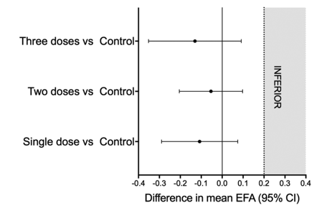
Cryptococcus – Treatment Updates
A Recent Phase II RCT demonstrated non-inferiority of short-term Liposomal Amphotericin (1, 2, or 3 doses) vs SOC in mean EFA, Phase III study is currently underway.
L-Amb 10 mg/kg on day 1
L-Amb 10 mg/kg on day 1 and 5 mg/kg on day 3
L-Amb 10 mg/kg on day 1, and 5 mg/kg on days 3 and 7
L-Amb 3 mg/kg for 14 days
Spec, A TUSY0804 IAS Mexico City July 21-24 2019
Clinical Infectious Diseases 2019;68(3):393–401

Slide 110
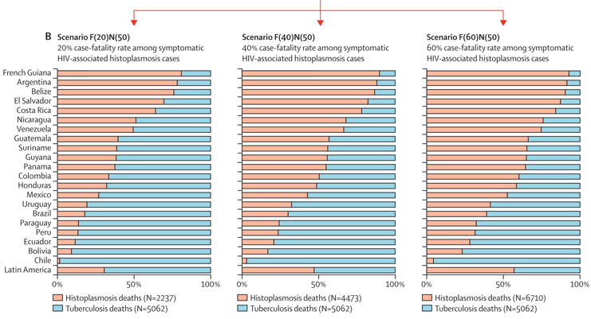
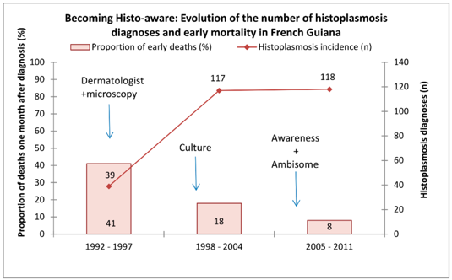
Histoplasmosis
Spec, A TUSY0804 IAS Mexico City July 21-24 2019
Histoplasmosis contributes significantly to mortality among PLH. In some regions, mortality associated with Histoplasmosis exceeds that for TB. Histoplasmosis remains challenging to diagnose, but clinician training for recognition, and use of antigen tests can significantly improve early diagnosis and prevent mortality.
J. Fungi 2019, 5, 51
Lancet Infect Dis 2018; 18: 1150–59

Slide 111
Schistosomiasis
Four prospective cohort studies (Partners in Prevention, Couples Observational Study, Partners PrEP study, and the Mombasa cohort) assessed schistosoma infection status in seroconverting HIV cases: no significant effect of schistosoma infection on HIV-1 acquisition risk was identified.
Bochner, A, IAS Mexico City July 21-24 2019

Slide 112
HIV & Comorbid Non-Communicable Diseases
Risk, Diagnosis, Management, & Polypharmacy Issues

Slide 113
Comorbid disease burden in PLH
Patients with HIV have a greater number of comorbid conditions, with respect to incidence and number of comorbidities, than those without HIV.
Aside from age, smoking remains a major risk factor for comorbidities in PLH, and interventions for smoking cessation improve comorbid disease burden.
SMART and START data demonstrated that ART interruption and delayed initiation increase non-AIDS comorbidities.
Results of studies which assessed lipid levels and BMD results suggest that specific treatment for comorbid diseases is more beneficial than changing ART, though an increased risk of DDI exists.

Slide 114
Non-communicable diseases
In the USA, 45% of PLH are over the age of 50, and new infections in people over 50 are increasing.
  Data from Mexico show that ~10% of new HIV diagnoses are made in those over 50
Prevalence of tobacco use is 17% higher among PLH than the general population
Population-based studies have demonstrated that PLH have more comorbid diseases earlier in life than the general population
Measurable markers of inflammation and inflammation-related disease burden is greater among PLH than the general population.
Guaraldi G Clin Infect Dis Dec;53(11):1120-6
Aberg WESY0702 IAS Mexico City July 21-24 2019
https://www.cdc.gov/hiv/group/age/olderamericans/index.html

Slide 115
NCDs and mortality in HIV
NCDs / comorbidities shorten life in HIV+ adults
1.0
Control
0.8
HIV+ only
0.6
HIV+ with risk factors
Probability of survival
0.4
HIV+ with comorbidity
0.2
HIV+ alcohol/ drug abuse
0
30
40
50
60
70
Age (years)
Hasse et al. Clin Infect Dis 2011; Pourcher et al, IAS 2017
Carr WESY0703 IAS Mexico City July 21-24 2019

Slide 116
NCDs in PLH: Cardiovascular Disease
MI rates have been shown to be associated with ART exposure, particularly Abacavir and Darunavir, though traditional risk factors continue to drive MI risk, and are also more prevalent among PLH
Addition of statins, rather than changing ART regimens containing PIs, can improve lipid profiles and, in some studies, reduce carotid plaque volumes.
Framingham | DAD model | HR for MI
Age | Age (per 5 year ↑) | 1.93
Sex | Male sex | 1.34
Current smoking | Current smoking | 4.02
.. | Ex-smoking | 2.01
.. | Diabetes | 2.28
Total cholesterol | Total chol (per 1 mmol/l ↑) | 1.28
HDL cholesterol | HDL chol (per 1 mmol/l ↑) | 0.66
Systolic BP | Systolic BP (per 1 mmHg ↑) | 1.04
.. | Indinavir (per year exposed) | 1.07
.. | LPV/r (per year exposed) | 1.12
.. | Abacavir (current) | 2.04
Lo et al, Lancet HIV 2015, Lee et al, HIV Med 2016
Friis-Møller et al, Eur J Cardiovasc Prev Rehabil 2009
https://www.chip.dk/Tools-Standards/Clinical-risk-scores
http://tools.acc.org/ASCVD-Risk-Estimator-Plus/#!/calculate/estimate
Carr WESY0703 IAS Mexico City July 21-24 2019

Slide 117
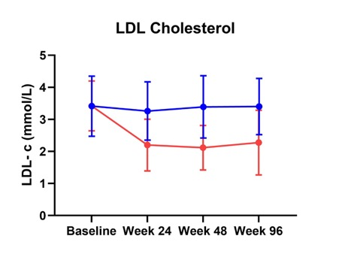
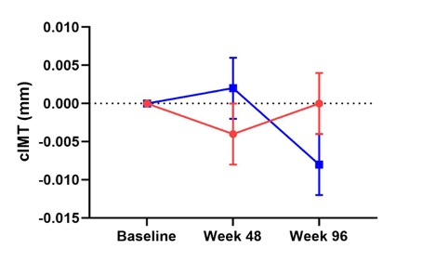
Statin Therapy for CVD in PLH
The REPRIEVE trial is ongoing, assessing the role of statins in controlling inflammation in PLH.
In a randomized trial of rosuvastatin on progression of atherosclerotic disease in PLH at moderate cardiovascular risk (Framingham 10-15%), rosuvastatin recipients had lower LDL and total cholesterol levels, but no difference in common carotid artery IMT progression compared to placebo.
Change in cIMT between each time point
● Placebo
● Rosuvastatin
ITT population
Trevillyan MOAB0201 IAS Mexico City July 21-24 2019

Slide 118
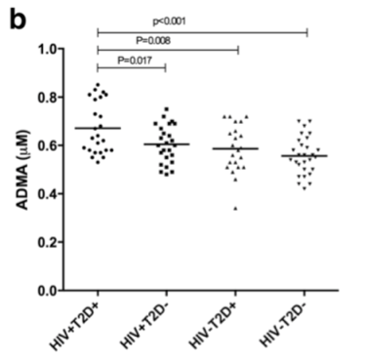
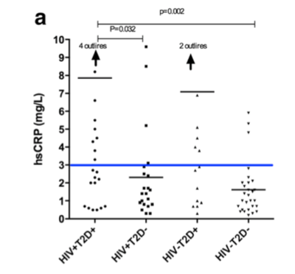
NCDs in PLH: Diabetes
Incidence of DM in PLH ~ 13.7 – 17.4/1000 person years (lower in Asia)
Compared with the general population, DM prevalence is higher among PLH (11.8% in the MMP cohort compared to 8.0% in the NHANES cohort)
Endothelial Dysfunction
Inflammation
Diabetes increases endothelial dysfunction and inflammatory markers in PLH with well-controlled HIV.
Butterfield TR. IAS 2019 TUPEB212
Kubiak R IAS 2019 TUPEB210
Colasanti WESY0704 IAS Mexico City July 21-24 2019
Duncan. et al. Diabetic Medicine 2019, Richie Nansseu J et al JAIDS 2018 Prioreschi A et al. BMJ Open 2016

Slide 119
NCDs in PLH: Diabetes Prevention
Lifestyle modifications are important for prevention of DM, there is a paucity of data among PLH. Results of a small single-arm study suggest traditional interventions on diet, exercise effective in PLH.
Measure | Pre | Post | Change (%) | P value
Fasting Glucose mmol/l | 6.3 ± 0.4 | 5.8 ± 0.7 | -7.9 | 0.003
Fasting Insulin pmol/l | 100.1 ± 70.1 | 77.1 ± 61.7 | -22.7 | 0.021
Weight, kg | 88.8 ± 15.8 | 84.7 ± 15.6 | -4.6 | <0.001
SBP | 135 ± 13 | 125 ± 20 | -7.4 | 0.006
DBP | 81 ± 11 | 74 ± 10 | -8.6 | 0.006
Duncan. et al. Diabetic Medicine 2019
Colasanti WESY0704 IAS Mexico City July 21-24 2019

Slide 120
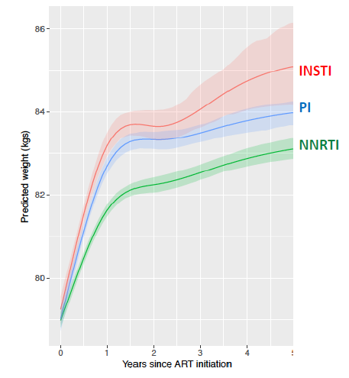
NCDs in PLH: Weight
Weight gain has been observed with ART including NNRTIs, PIs, and most recently INSTIs.
  Most studies do not demonstrate statistical significance for weight changes
86
84
82
80
  n=4,093
Predicted Weight (kg)
  n=7,063
  n=10,711
Predicted Weight Change (kg)
 | NNRTI | PI | INSTI
Year 2 | 3.3 | 4.3 | 4.4
Year 5 | 4.1 | 5.0 | 5.8
0 1 2 3 4 5
Years Since ART Initiation
Hill et al, IAS 2019
Carr WESY0703 IAS Mexico City July 21-24 2019
Stellbrink et al, Lancet HIV 2019; Wohl et al, Lancet HIV 2019

Slide 121
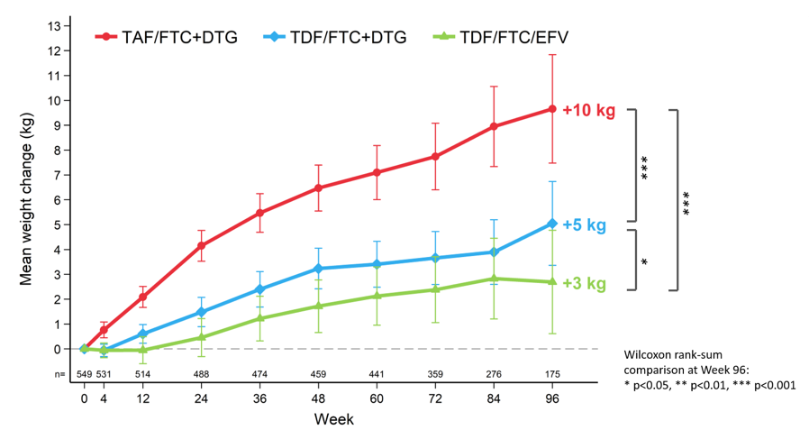
NCDs in PLH: Weight
The ADVANCE trial demonstrated weight gain, particularly in women, on INSTI-based regimens, which continued out to 96w of follow-up
Mean change in weight (kg) to Week 96: women
TAF vs TDF was also associated with more weight gain
Participants did not report concern regarding weight gain
No changes in BP, lipids, glucose, renal, bone or HbA1c noted
Weight change did not correlate with sleep, contraception use, mental illness or adherence
Venter WEAB0405LB, & MOAX0102LB IAS Mexico City July 21-24 2019

Slide 122
NCDs in PLH: Weight
Weight gain was not observed when witching from TDF to Raltegravir in the TROP study
From Tsepamo, HIV negative women gained more weight than HIV+ women during pregnancy.
  Women initiating DTG gained more weight than those initiating EFV.
Carr TUPEB211 IAS Mexico City July 21-24 2019
Caniglia, E IAS Mexico City July 21-24 2019

Slide 123
NCDs in PLH: Risk Assessment
Framingham, EURO, and asCVD risk assessment scores are poorer predictors of CVD in PLH as compared to the general population, underestimating CVD risk in this population.
Diabetes risk scores for non-HIV+ population are less sensitive and specific among PLH.
  HbA1c underestimates glycemia in PLH
Schulz TUPEB202 IAS Mexico City July 21-24 2019
Butterfield TR. IAS 2019 TUPEB212

Slide 124
Renal Disease
TDF-related renal injury can be reversed with early switching to alternate regimens
Petamatamkul IAS Mexico City July 21-24 2019

Slide 125
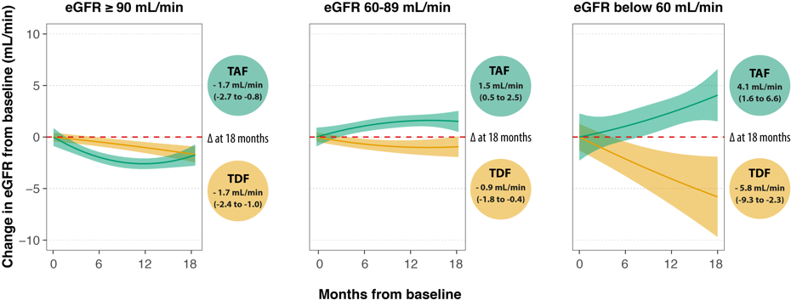
Renal Impairment
Surial, B MOAB0205, Teira TUBEP209 IAS Mexico City July 21-24 2019
In a Swiss cohort (n=3520) and a Spanish cohort (VACH) PLH who had mild or greater renal impairment (eGFR <90) demonstrated improved eGFR when changed from TDF to TAF.
eGFR change after switch to TAF vs maintenance of TDF in Swiss Cohort
Adjusted for age, sex, ethnicity, diabetes, arterial hypertension, cardiovascular disease, HCV and HBV infection, use of ritonavir, cobicistat, dolutegravir and cotrimoxazole

Slide 126
Liver Disease
PLH have a 2-fold higher odds of NAFLD than an uninfected population.
Serologic markers of fibrosis were assessed in the PROSPEC-HIV cohort* and showed good accuracy in detection of fibrosis and high specificity & NPV for severe fibrosis, suggesting a potential role in assessment of NAFLD in PLH
Pacheco, Perazzo, Cardoso et al AIDS conference 2018
Yanavich, C MOAB0203 IAS Mexico City July 21-24 2019
*HIV-monoinfected patients with no history of alcohol abuse

Slide 127
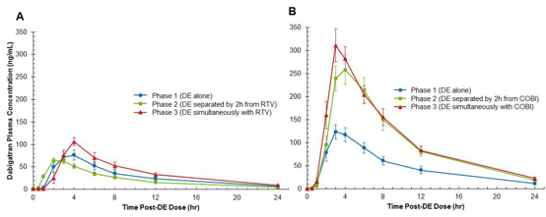
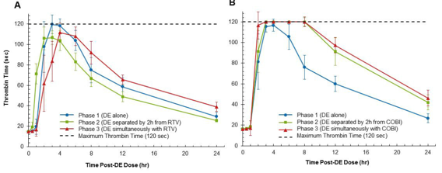
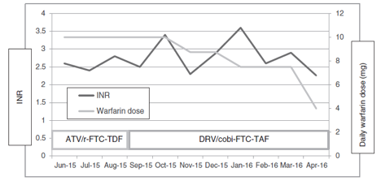
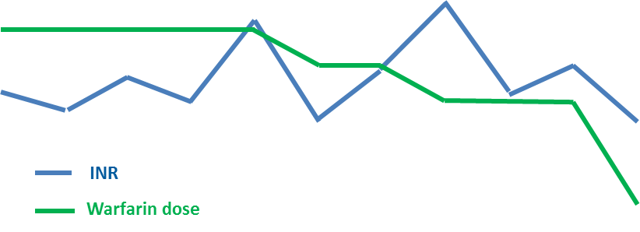
DDIs: Anticoagulants & Boosted agents
Avoid DOAC agents with boosted regimens
  Can consider dabigatran with PI/r
Use heparin derivatives or vitamin K antagonists instead and monitor INR.
  DRV/c less inhibitory of warfarin than ATV/r: allows for warfarin dose reduction
PK/PD study for dabigatran + RTV or Cobi
dabigatran alone
dabigatran adm 2 h before RTV
dabigatran adm together with RTV
dabigatran alone
dabigatran adm 2 h before Cobi
dabigatran adm together with Cobi
PK
PD
RTV effect on P-gp
(mixed inhibitory/inducing)
Cobi effect on P-gp
(inhibitory)
Catia, SUSA14 IAS Mexico City July 21-24 2019
Tseng A et al. AIDS 2017, Kumar P et al. AAC 2017

Slide 128
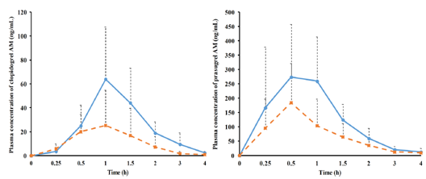
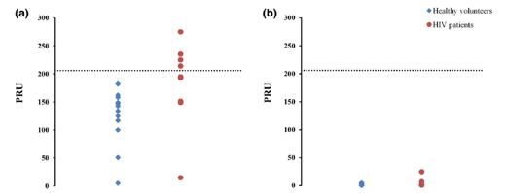
Boosted Regimens & Antiplatelet agents
Clopidogrel
Prasugrel
PK effect
Ritonavir significantly reduces the AUC of Clopidogrel, effect is less pronounced with Prasugrel. Drug activity (platelet receptor blockade) is preserved for Prasugrel + RTV, but not with Clopidogrel.
AUC -69%
AUC -52%
antiplatelet drug alone
antiplatelet drug + RTV/Cobicistat boosted regimen
PD effect (platelet receptor blockade)
healthy volunteers
HIV patients
efficient platelet inhibition
Catia, SUSA14 IAS Mexico City July 21-24 2019
44% HIV patients did not
achieve platelet inhibition
platelet inhibition remains adequate in all patients
Marsousi N et al. Clin Pharmacokinet 2018;
Itkonen MK et al. Clin Pharma Ther 2018, Bravo I et al. BJCP 2018

Slide 129
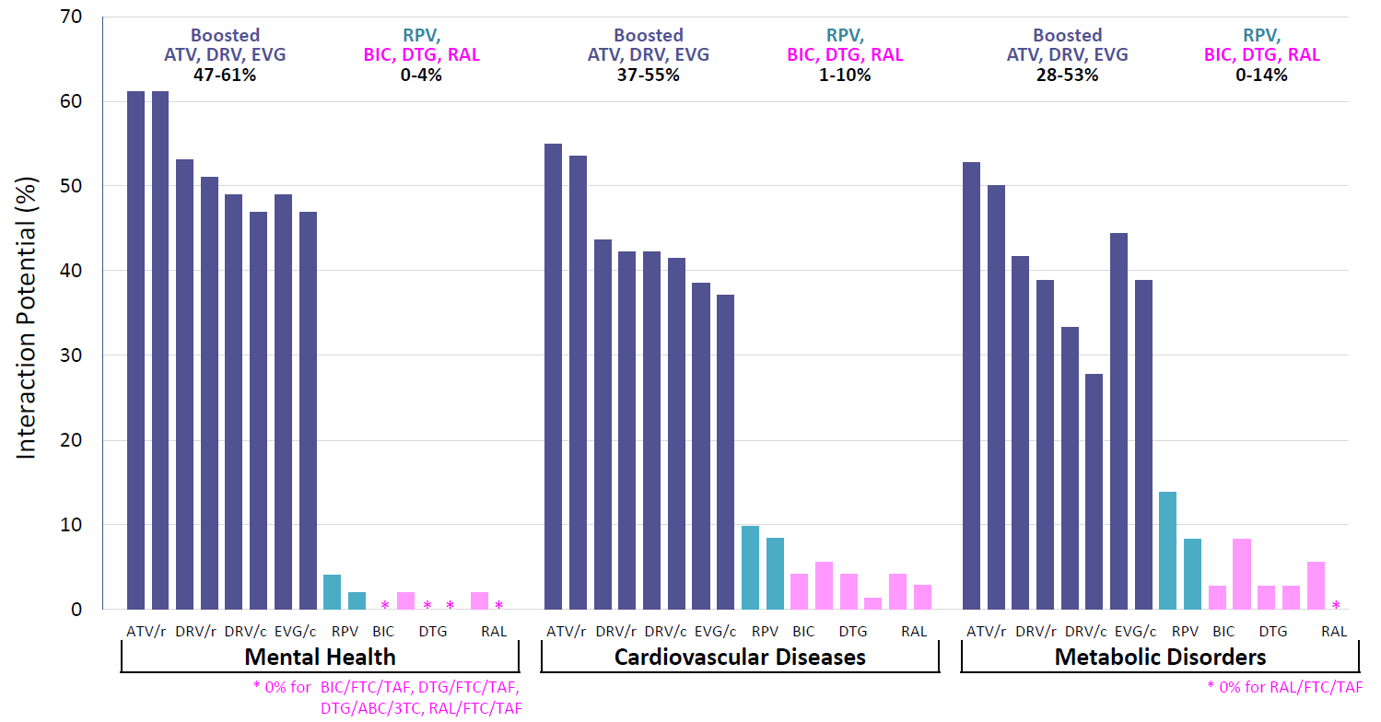
All regimens not created equal: Interaction potential between ART & treatments for common comorbidities
Gibbons S et al. 20th Workshop on Clin Pharmacol of HIV 2019, www.hiv-druginteractions.org
Catia, SUSA14 IAS Mexico City July 21-24 2019
 | Drug Classes | Comeds
Mental Health | Anxiolytics Hypnotics Sedatives Antidepressants | 49
CV Diseases | Beta blockers CCB Heart Failure agents | 71
Metabolic Disorders | Antidiabetic drugs Lipid lowering agents | 36

Slide 130
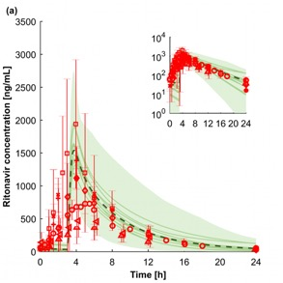
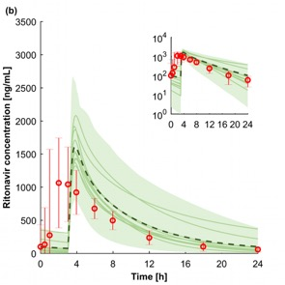
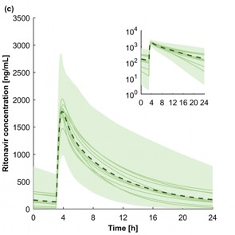
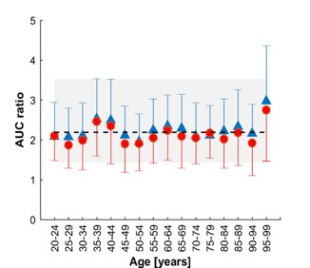
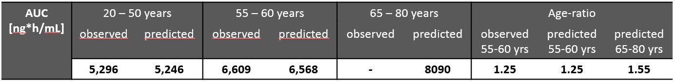
HIV Therapy, Considerations in the Elderly
Catia, SUSA14 IAS Mexico City July 21-24 2019
Advance age does not affect ritonavir exposure to a significant extent, and magnitude of DDIs appear similar to younger patients.
Adults aged 20-50 years
Adults aged 55-60 years
Adults aged 65-80 years
Impact of age on DDI magnitude
men
women
AUC Rivaroxaban + DRV/r
AUC Rivaroxaban alone
Observed clinical data
Mean of all predictions
Mean of each virtual trial
95% CI of predictions
Dumond J et al. HIV Medicine 2013; Stader F et al. International Workshop Clin Pharmacol Antivir Ther 2019; Stader F et al. CROI 2019

Slide 131
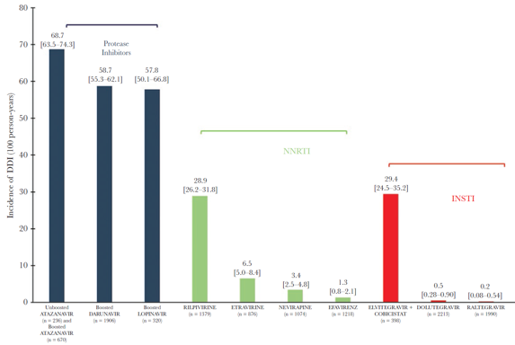
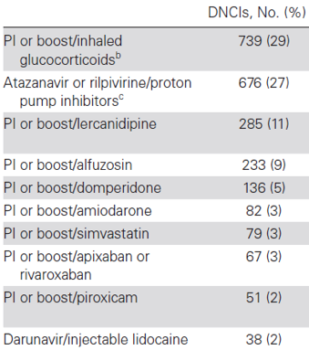
DDIs in the Elderly: Risk of harm
PIs associated with increased odds of DDI (OR 4.12), unboosted INSTI with reduced odds of DDI (OR 0.02)
Incidence of DDI per 100 person-years
10 most frequent encountered DDIs
PI
68.7
58.7
57.8
NNRTI
INSTI
Incidence DDI (100 person-years)
28.9
29.4
6.5
3.4
1.3
0.5
0.2
EFV
DTG
RAL
ATV
ATV/r
DRV/r
LPV/r
RPV
ETV
NVP
EFV
EVG/c
Desmessine L et al. Open Forum Infect Dis 2019
Catia, SUSA14 IAS Mexico City July 21-24 2019

Slide 132
Polypharmacy and the Elderly
Studies in both HIV and LMIC countries continue to demonstrate that PLH ≥65 experience polypharmacy to a significant degree, this is associated with adverse events and is often not related to ART medications.
Overall prescribing issues: 69% participants
In a Mexican retrospective study of PLH ≥65 (n=112, 99% male), the mean prescribed non-ART medications was 9 (+/-4.9).
  65% experienced ≥ 1 adverse event related to polypharmacy, and 35% were hospitalized.
  Inappropriate prescribing was correlated with polypharmacy and with adverse events
Incorrect drug dosage: 25%
No indication: 21%
Prescription omission: 19%
Inappropriate drug: 19%
Deleterious DDIs: 14%
Treatment duration exceeding 2%
recommendations:
Catia, SUSA14 IAS Mexico City July 21-24 2019
Cabanilla, Gabriela, WEPEB314 IAS Mexico City July 21-24 2019

Slide 133
Issues In Women’s Health

Slide 134
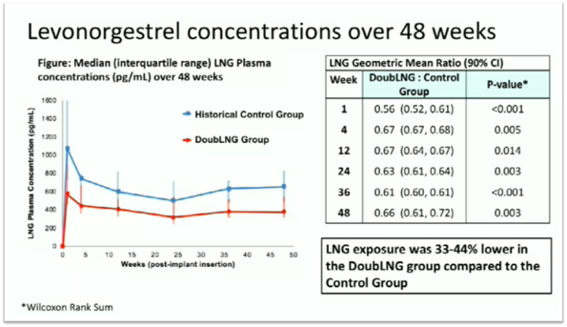
Contraception Challenges
Efavirenz-based regimens significantly decrease ethinyl-estradiol (EE), ENG, and levonorgestrel (LNG) concentrations
ATV/r-based ART decreases EE concentrations 29-35% and increases ENG concentrations 71-79%
  This is unlikely to impact effectiveness of vaginal ring contraceptives.
Double doses of levonorgestrel (LNG) still does not overcome the interaction with Efavirenz.
  LNG is an important component of emergency contraception regimens.
Cortes, C, SUSA12 IAS Mexico City July 21-24 2019

Slide 135
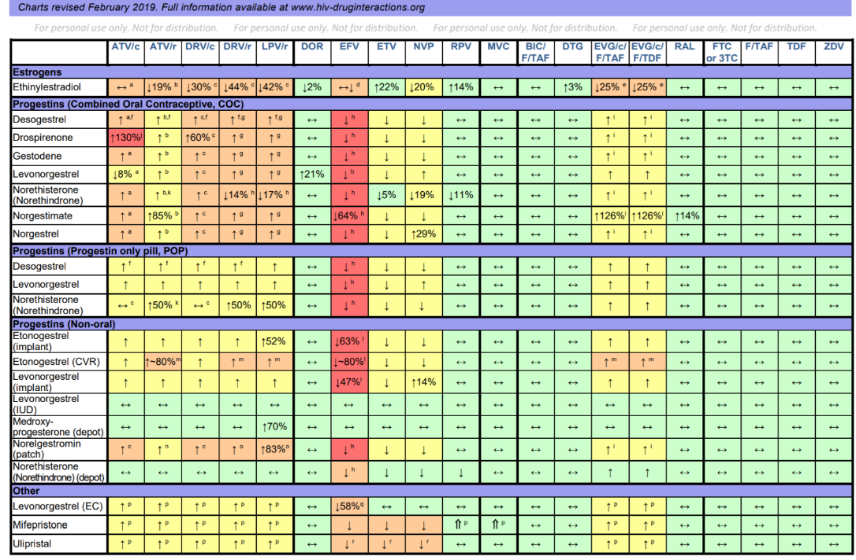
Slide: Cortes, C, SUSA12 IAS Mexico City July 21-24 2019

Slide 136
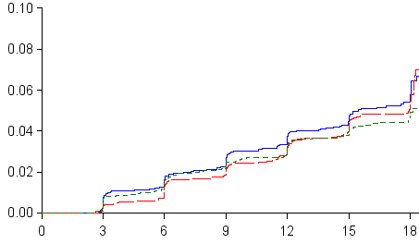
Choice of Contraception: STI and Pregnancy Risks
In the ECHO trial, HIV incidence and pregnancy was similar across contraception types.
  Women randomized to DMPA-IM had a 30% lower risk of NG at the end of the trial than those with copper IUD, and a 20% lower risk of CT than those with LNG implant.
HIV Incidence by contraception type
Pregnancy Outcomes by contraception type
Perfect use analysis
 | DMPA-IM | Copper IUD | LNG Implant
# Pregnancies | 18 | 31 | 21
Pregnancy incidence, per 100 woman-years | 0.61 | 1.06 | 0.63
DMPA-IM
Copper IUD
LNG Implant
Deese, J IAS Mexico City July 21-24 2019
Baeten, J WESY0104 IAS Mexico City July 21-24 2019

Slide 137
Sexual and Reproductive Health Challenges
Safer conception service and PrEP can improve PMTCT, but it is poorly integrated in many regions and is especially challenging in vulnerable populations (ie. FSW).
Knoza, N TUPDC0101, Wisse, E TUPDC0104 Mexico City July 21-24 2019
Periconception PrEP Adherence in ZINK
From the ZINK study in South Africa, under half of participants taking PrEP peri-conception achieved protective adherence.
A comprehensive Safer Conception Package (including counselling, testing, PrEP, and system navigation services) piloted in the Safer Conception Project was highly successful; 70% of unsuppressed patients became suppressed, and 0 MTCT events were observed in 68 pregnancies
Matthews, L TUPDC0102 Mexico City July 21-24 2019
At least 80% of doses taken N=49
Plasma TFV @ 3M N=40
Davies, N, TUPDC0103 Mexico City July 21-24 2019

Slide 138
STIs and HIV Prevention
Celum, C WESY0102, IAS Mexico City July 21-24 2019
In female participants in HIV Prevention studies, most incident STI infections occur in different women than prevalent infections, most incident infections are new, >90% were asymptomatic, and there were no clear differentiating risk factors for women with vs without STI
 | CT prevalence | CT incidence | GC prevalence | GC incidence
VOICE (South Africa, Uganda, Zimbabwe) N=5029 | 12% | 27% | 4% | 11%
MTN-020/ASPIRE (Malawi, So Africa, Uganda, Zimbabwe) N=2629 | 12% | 27% | 4% | 11%
Plus Pills (Cape Town) N=150 | 48% | NA | 6% | NA
HPTN 082 (Cape Town, Johannesburg, Harare) N=427 | 29% | 33% | 8% | 11%
POWER (Cape Town, Johannesburg, Kisumu) N=1504 | 26% | 53% | 10% | 20%
3P project (Cape Town) N=200 | 25% | 42% | 11% | 14%
ECHO (eSwatini,Kenya, South Africa, & Zambia) N=7829 | 18% | NA | 5% | NA
*Syphilis incidence <1%, Trichomonas 6-8%

Slide 139
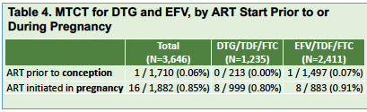
ART for women of reproductive age
Tsepamo updates:
  NTD risk associated with DTG exposure was much lower than that observed in the interim analysis (09.4 –> 0.3).
  In-utero transmission risk was equivalent for women on DTG and EFV-based regimens
Tsepamo NTD Prevalence
NTDs/Exposures | 5/1683 | 15/14792 | 3/7959 | 1/3840 | 70/89372
% with NTD (95% CI) | 0.30% (0.13, 0.69) | 0.10% (0.06, 0.17) | 0.04% (0.01, 0.11) | 0.03% (0.0, 0.15) | 0.08% (0.06, 0.10)
Prevalence Difference (95% CI) | ref | 0.20% (0.01, 0.59) | 0.26% (0.07, 0.66) | 0.27% (0.06, 0.67) | 0.22% (0.05, 0.62)
Davey et al. LBPEC30
Zash et al NEJM 2019, IAS 2019

Slide 140
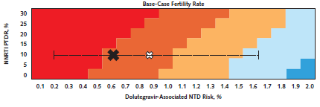
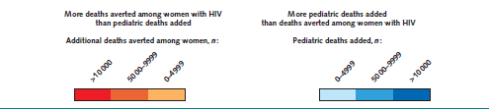
ART for women of reproductive age
More deaths in women of childbearing age, sexual transmissions, and perinatal transmissions would be averted than NTDs occurring with DTG as compared to EFV.
  Treatment-emergent resistance significantly more frequent with EFV than DTG
  DTG performed better than EFV for VL suppression, CD4 recovery, and rate of treatment discontinuation
J Acquir Immune Defic Syndr 2015 Dec 15; 70(5): 515–519
Dugdale et al. Ann Int Med 2019;apr 2, epub ahead of print
Black X= July 2018 rate, white X= May 2018 rate, white star July 2019 rate = 0.3%
Watts, H. IAS 2019 conference. TUSY0101
Kanters, S. WHO ARV GDG, May 2018

Slide 141
ART for women of reproductive age
From the Antiretroviral Pregnancy Registry (>20,500 pregnancy outcomes, predominantly from North America)
  536 birth defects were identified, including 241 birth defects from 8,546 pregnancies with periconception ARV exposure.
  No apparent increase in frequency of birth defects with 1st trimester exposure compared to later exposure was observed, and no pattern of defects were identified.
In the IMPROVE study of pregnancy outcomes in Lesotho (n=1004, 89% ART exposed):
  Adverse pregnancy outcomes were higher among HIV-positive women compared to HIV-negative women, irrespective of ART (aOR 2.29).
  Adverse event rates were similar for women who initiated ART prior to conception and after conception (0.8% vs 1.6%)
  Similar findings have been observed in other settings.
Mofenson, L. et al. IAS 2019 conference. TUAB0101
Tukei & Glaser et al. IAS 2019 conference. TUAB0102
Favarato JAIDS 2019, Santosa AIDS 2019, Shava JAIDS 2019

Slide 142
Vulnerable Populations

Slide 143

Combined Services for Better Outcomes
In Vancouver, receipt of opioid antagonist therapy (OAT) was the only significant protective factor against VL rebound in women with HIV who use drugs; service delivery which colocalizes HIV treatment delivery and opioid addiction services may improve ART adherence and VL suppression in this at-risk population.
Kaplan-Meier survival curve for time to first viral rebound following viral suppression by receipt of OAT (consistently on OAT, n=87 vs. never received OAT, n=50)
Adams, J TUPDD0105 IAS Mexico City July 21-24 2019

Slide 144
Substance Use – Populations at Risk
Studies in in South Africa, Kenya and Uganda demonstrated that alcohol use was associated is associated with lack of awareness around HIV status, likelihood of ART use, low retention in care, and lower viral suppression
Higher risk for HCV-HIV coinfection was described in the setting of MSM using methamphetamine and participating in group sex, as well as in a cohort of women who inject drugs in Nepal.
In Ukraine, community-based services for PWID were associated with improved diagnosis, treatment and viral suppression targets.
In the TEACH study, an HIV primary care program for chronic opioid therapy guideline concordance improved prescriber confidence without negatively impacting prescriber or patient satisfaction with pain management
Puryea, MOPDB0101 & Shapiro, MOPDB0105 IAS Mexico City July 21-24 2019
Wansom MOPDB0103 & Deuba MOPDB0106 IAS Mexico City July 21-24 2019
Varetska, MOPDB0102 IAS Mexico City July 21-24 2019
Del Rio, MOPDB0104 IAS Mexico City July 21-24 2019

Slide 145
Female Sex Workers
FSW experience greater barriers to access to HIV treatment and care. A new tool to measure sex-work stigma has been validated to aid assessing this barrier to care:
SN | Indicator/variable | Score | SN | Indicator/variable | Score
1 | Age (in years) |  | 5 | RTI/STI
1a | 18-25 | 0 | 5a | No RTI/STI | 0
1b | 26-35 | 4 | 5b | RTI/STI and treated | 1
1c | > 35 | 15 | 5c | Not visited clinic | 19
2 | Sex acts/week
2a | 0-4 | 0 | 6 | Condom use
2b | >=5 | 4 | 6a | Always | 0
3 | Years in sex work |  | 6b | Missed | 4
3a | 0-4 | 0
3b | 5-15 | 4 | 7 | Condom compromise
3c | >=16 | 4 | 7a | No | 0
4 | Years associated with the TI |  | 7b | Yes | 4
4a | 0-2 | 35
4b | 3-6 | 10
4c | >=7 | 0
Category | Score
High | >=39
Moderate | 19-38
Low | <=18
Kirubakaran TUPDD0105 IAS Mexico City July 21-24 2019

Slide 146
Transgendered Women – Improving Diagnosis
In Argentina, where HIV prevalence is 34% among TGW and syphilis prevalence is 50.4% a pilot project tested the acceptability of home-based HIV and Syphilis testing:
  From May 2018 – December 2018 home-based testing for syphilis and HIV was performed in 68 participants, (77.9% commercial sex workers).
  HIV prevalence was 4.4% and 50% were syphilis positive.
  Testing was acceptable and most participants would be willing to repeat testing in the future or recommend it to other TGW
Zalazar, V TUAC0102 IAS Mexico City July 21-24 2019

Slide 147

TGW – Hormones and ART, unanswered questions
In pilot studies exploring DDI between exogenous hormones for gender affirmation and PrEP, TDF concentrations in plasma and tissue are lower in TGW using hormonal therapy, but remain within the normal biological/clinical range.
Anderson, P WESY0103 IAS Mexico City July 21-24 2019
In the iPREX study, TGW were less likely than MSM to achieve detectable TDF levels on PrEP, this was particularly true for participants using hormones.
In other trials, rectal tissue concentration of intracellular TFVdp was 7-fold lower in TGW than cis-gender participants.
Shieh E, et al. HIVR4P. Madrid, 201
Omar, SUSA12 IAS Mexico City July 21-24 2019

Slide 148

Slide: Omar, SUSA12 IAS Mexico City July 21-24 2019

Slide 149


Slide: Omar, SUSA12 IAS Mexico City July 21-24 2019
Continuation

Slide 150

Slide: Omar, SUSA12 IAS Mexico City July 21-24 2019

Slide 151
TGW – Vulnerable Populations
Ramos, M TUAC0103 IAS Mexico City July 21-24 2019
Brignol TUAC0104 IAS Mexico City July 21-24 2019
Results of 2 recent Brazilian studies demonstrate the burden “syndemics” (2 or more of substance abuse, binge drinking, depression, sexual compulsive behaviour and intimate partner violence), and risky alcohol consumption (2x the general population) and their association with HIV risk and other important outcomes including suicidality.
Prevalence of syndemic conditions among 143 TGW screened for PrEPARADAS study. Rio de Janeiro, Brazil, 2018

Slide 152
TGW – Vulnerable Populations
TGW also have lower healthcare utilization (41% avoid seeking healthcare in a recent Argentinian study), and report stigma and discrimination as factors associated with healthcare avoidance.
Current ART use is low among TGW. In a Brazilian study use was at 46%, compared to 95% of MSM who knew their status.
  Younger TGW were more likely to be on ART, possibly due to recent changes in Health Policy (ie. chosen name use)
In surveys, TGW with HIV prioritize gender-affirming care over management of HIV. When HIV care providers are also hormone therapy prescribers, TGW are more likely to be retained in care and achieve viral suppression.
Omar, SUSA12 IAS Mexico City July 21-24 2019
Maschiao LF TUAC0105 IAS Mexico City July 21-24 2019
Chung Cecilia, 2016 TG Law Center
Poteat T, Positively Trans Survey, 2016

Slide 153

TGW – Vulnerable Populations
Celum, C TUAC0301 IAS Mexico City July 21-24 2019
Aristegui, I TUPD0106 IAS Mexico City July 21-24 2019
2 (1.5%)
TGW have lower engagement with PrEP and HIV treatment; this is strongly associated with basic social risk factors like education, stable housing, and substance use, as well as structural violence and stigma.
72 (55.4%)
79 (60.8%)
18 (13.9%)
19 (14.6%)
15 (11.5%)
Missing visit
12 (9.2%)
11 (8.5%)
BLQ
8 (6.2%)
<2 doses/week
12 (9.2%)
12 (9.2%)
2-3 doses/week
4-7 doses/week
W4
N=130
W12
N=130
Waiting for DBS results
Visits will be performed

Slide 154
Gaps in the Care Cascades
A Mexican study of PLH who were lost to care suggested that those who returned had higher CD4 T cell counts, longer time to treatment initiation, and were most likely to have further disengagement from care
  Do they have a lower perceived need for ART because they feel better?
Definitional differences in HIV treatment cascades in different regions makes for difficult comparisons between populations.
In LMIC nations, limited access to VL testing results in delayed identification of treatment failure and access to second-line therapies.
Martinez-Guerra, BA TUPDB0102 IAS Mexico City July 21-24 2019
Mosime, W TUPDB0103 IAS Mexico City July 21-24 2019
Warrier, R TUPDB0104 IAS Mexico City July 21-24 2019

Slide 155
Hard to Reach Populations
Beyrer, C MOAX0101LB IAS Mexico City July 21-24 2019
In the HPTN 078 Study no difference between SOC for linkage to services compared to enhanced case management for achieving VL suppression at 12 months was observed in a population of virally-unsuppressed MSM in the US.
  Identified using Deep-Chain Respondent Driven Sampling (DC-RDS) and Direct Recruitment (DR).
  Participants typically knew their status (89% reported previous positive test)
  Retention was high (91%)
  VL suppression was 54% in the enhanced case management arm, and 42% in the SOC are at 12 months
VL Suppression <200 copies/mL by arm and month
 | Overall | CM Arm | SOC Arm
Month 3 | 41 (28%) | 20 (28%) | 21 (29%)
Month 6 | 52 (36%) | 26 (36%) | 26 (36%)
Month 9 | 56 (39%) | 28 (39%) | 28 (39%)
Month 12 | 68 (48%) | 30 (42%) | 38 (54%)

