Slide 1
CAHR 2019
Scientific summary of the major clinical studies presented at the 28th Annual Canadian Conference on HIV/AIDS Research
Résumé scientifique des principales études cliniques présentées à le 28e Congrès annuel canadien de recherche sur le VIH/sida

Slide 2

CAHR is pleased to provide this scientific summary of the major clinical studies presented at the 28th Annual Canadian Conference on HIV/AIDS Research (CAHR 2019). The synthesis aims to improve the cascade of care by increasing the skills and knowledge of Canadian health care professionals working in the realm of HIV. This presentation was made possible with the support of an educational grant from ViiV Healthcare.
L’ACRV a le plaisir de vous offrir ce résumé scientifique des principales études présentées à le 28e Congrès annuel canadien de recherche sur le VIH/sida (ACRV 2019). Cette synthèse a pour objet d’améliorer la cascade de soins en relevant les techniques et connaissances des professionnels canadiens de la santé qui travaillent dans le domaine du VIH. Cet exposé a été rendu possible avec le soutien d’une subvention éducative de ViiV Soins de santé.

Slide 3
HIV Treatment Updates

Slide 4
New NNRTI: Doravirine
Doravirine was approved by Health Canada in October 2018
It is taken once daily without regard to food, and has a low potential for drug-drug interactions (including acid-blockers).
It has a unique resistance profile, and activity against many NNRTI resistance mutations.
Doravarine (DOR) was non-inferior to r/DRV and EFV-based regimens in ART-naïve participants, and in stable participants switching from bPI, cobicistat-boosted INSTI, or NNRTI-based regimens in Phase 3 studies.
  At 96 weeks, participants on DOR had more favourable lipid profiles than those on r/DRV or EFV, and fewer neuropsychiatric adverse events than those on EFV.
Kathleen Squires, CPS 2.08 & CPS 2.09, CAHR 2019
Alex Wong, CPS 2.01, CAHR 2019

Slide 5
Congenital anomalies among infants exposed to ART
In a Canadian surveillance study of infants born to HIV+ mothers, congenital abnormalities were present in 98 / 2,591 live births including 3 neural tube defects. No neural tube defects occurred among women treated with integrase-strand inhibitors. Congenital anomalies did not conform to any syndrome according to drug/drug class of exposure.
Variable | N | Presence of anomaly (Rate & 95% CI) | P | Odds ratio (95% CI) | P
Timing of ART exposure during pregnancy |  |  | 0.915
No ART exposure | 118 | 6 (5.1% [1.9 - 10.7%]) |  | 1
ARTs at conception | 1311 | 55 (4.2% [3.2 - 5.4%]) |  | 0.76 (0.33, 1.77) | 0.530
ARTs started in 1st trimester | 204 | 8 (3.9% [1.7 - 7.6%]) |  | 0.75 (0.26, 2.14) | 0.589
ARTs started from 14 weeks onwards | 690 | 27 (3.9% [2.6 - 5.6%]) |  | 0.72 (0.30, 1.73) | 0.459
ART timing Unknown | 100 | 2 |  | -
ART exposure during pregnancy |  |  | 0.746
No ART exposure | 118 | 6 (5.1% [1.9 - 10.7%]) |  | 1
Non-Dolutegravir | 2173 | 87 (4.0% [3.2 - 4.9%] |  | 0.73 (0.32, 1.65) | 0.444
Dolutegravir | 117 | 4 (3.4% [0.94 - 8.5%]) |  | 0.69 (0.20, 2.36) | 0.549
Unknown | 15 | 1 |  | -
Debra Money, CS 1.03 CAHR 2019

Slide 6
Weight Gain with INSTI?
Jun Chen/JP Routy, CS4.05, CAHR 2019
Evidence of weight gain after initiation of INSTIs has been mixed.
In a retrospective study from McGill, a mean weight gain of 4.33 kg and 2.34 kg over 2 years was observed in patients who were switched to RAL or DTG respectively from PI- (49%) or NNRTI-based (37%) regimens.
Weight change before and after switch to RAL and DTG

Slide 7
HIV patients in care maintain viral suppression and adherence
Andrea Bever, EPH 3.07, CAHR 2019
Data from the SHAPE study found 96% of participants experienced no viral rebound. Among those who were adherent at baseline, 94% had no interruption of ART and 92% had >80% adherence.
  Rebound was associated with incarceration history, homelessness, HCV diagnosis, lower annual income, IDU, and younger age.
  ART interruption was associated with younger age, indigenous self-identification, lower education level, incarceration history, and homelessness.
  Lower adherence was associated with age and indigenous self-identification.
Virologically suppressed at baseline: N=536
≥1 year of follow-up: N=410
Adherent at baseline and ≥1 year of follow-up: N=371
ART interruption - Yes: N=24 (6%)
ART interruption - No: N=347 (94%)
≥80% adherent: N=342 (92%)
<80% adherent: N=29 (8%)
Viral rebound - Yes: N=15 (4%)
Viral rebound -No: N=395 (96%)

Slide 8
POCT and rapid treatment starts

Slide 9
Rapid-Start ART can be successfully accomplished in a Canadian context
Rapid ART initiation is recommended where feasible by the latest IAS-USA guidelines and supported by WHO and DHHS guidelines.
At BC-CfE patients receive immediate (target 48h) access to ART after HIV diagnosis is confirmed.
  From June 2015 – June 2018, 104 patients initiated HIV therapy.
  Median time to ART start = 1 day for AHI & 14 days for CHI. Retention in care at 12 months and VL suppression at 12 months was high, especially among those with acute infection.
Variable | AHI (n= 53) | CHI (n= 51) | P value
Time to ART initiation from date of HIV Dx (days) Median (IQR) | 1 (0- 5) | 14 (7-21) | < 0.001
Time to HIV-RNA <40 c/ml from ART initiation (days) Median (IQR) | 67 (33-90) | 85 (42-169) | 0.021
First ART regimen: INSTI + bPi: + NRTI INSTI + NRTI bPi + NRTI | 52 (98%) 1 (2%) 0 (0%) | 2 (4 %) 13 (27%) 36 (73 %) | <0.001
Engagement in care at 12 months | 44 (83%) | 39 (76%) | 0.406
HIV-RNA VL at 12 months <40 c/ml | 47 (98%) | 39(95%) | 0.593
Silvia Guillemi CS 1.05 CAHR 2019

Slide 10
HIV self-testing strategies in development in Canada
HIVSmart! – oral self-test with integrated interaction through a connected digital platform for pre&post test counselling and test conduct.
  Developed and piloted in Montreal, expanded in South Africa
Dried blood spots: collected at testing location and sent to regional → national lab for testing.
Nitika Pant Pai, CAHR 2019
John Kim, CAHR 2019

Slide 11
Routine Offer of HIV Testing in Healthcare Settings
Routine offer of testing was implemented in a CHC in Ottawa, 31/95 patients offered testing agreed, 45% had never been previously tested.
In BC a routine offer of testing in primary care and hospitals was implemented, with an increase in testing from 223,300 to 337,900 tests from 2013 – 2017. Of 1,193 new diagnoses in that interval 51% reported the provider had offered the test and 91% had the test performed in a healthcare setting.
Pharmacy-based testing was also shown to be highly acceptable and to reach previously untested individuals.
Lepage, EPHP1.01, CAHR 2019
Nicolay, EPHP3.03, CAHR 2019
Nicolay & Matechuk, EPHP2.09, CAHR 2019

Slide 12
Event-Based HIV & STBBI Testing
Models of Event-based STBBI testing were highly acceptable in a broad array of settings:
  Indigenous events in Manitoba
  Community health days in Saskatchewan
  And, even a high school in an indigenous community in Saskatchewan
Testing was found to be highly acceptable by participants, and uptake of testing including POCT, DBS, and standard serology was good.
Smith, KP4.05, CAHR 2019
Van Haute, SSP7.06, CAHR 2019
McLeod, KP4.04, CAHR 2019
Nicolay, EPHP3.03, CAHR 2019

Slide 13
Co-infection

Slide 14
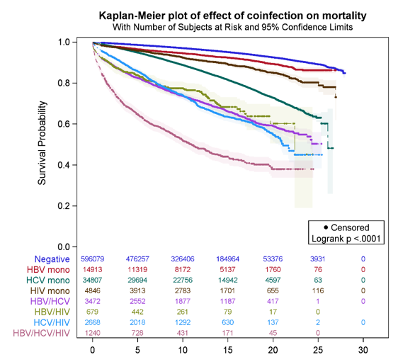

HCV, HBV, and HIV alone and in combination continue to have a significant impact on morbidity and mortality in Canada
Mortality among mono and co-infected individuals was also associated with chronic comorbid diseases, IDU, Caucasian ethnicity, later age at diagnosis (>45), material deprivation, and problematic alcohol use.
Zahid Butt, EPH1.02 CAHR 2019
Naveed Janjua, CAHR, 2018 EPH1.02

Slide 15
HCV, HBV, and HIV alone and in combination continue to have a significant impact on morbidity and mortality in Canada
All-Cause Mortality
ESRD
Data from the BC Hepatitis Testers Cohort (1992 -)
Naveed Janjua, CAHR, 2018 EPH1.02
Zahid Butt, EPH1.02 CAHR 2019

Slide 16
Progress toward HCV Elimination
Hepatitis global targets:
  90% reduction in new cases of chronic HBV and HCV, 80% of treatment eligible people with HCV or HBV on treatment, 65% reduction in mortality due to HCV and HBV¹.
Some jurisdictions already reporting significant treatment coverage rates for HCV, and where drug is accessible, high uptake of treatment.
Challenges of cost, re-infection remain.
¹World Health Organization. Draft global health sector strategies. Viral Hepatitis, 2016–2021. Available at: http://apps.who.int/gb/ebwha/pdf_files/WHA69/A69_32-en.pdf?ua=1 (accessed September 2016)

Slide 17
Progress toward HCV Elimination
Treatment of acute HCV in HIV+ population?
EACS 2018 guidelines now recommend treatment in acute phase for those at high risk of chronic disease¹.
  From the PROBE-C study, we have seen that in HIV/HCV spontaneous HCV clearance is rare, and a small (<2log) fall in HCV RNA 4 weeks after diagnosis is predictive progression to chronic disease².
A phase I trial for treatment of HCV in pregnancy has recently been completed, with promising results for efficacy and safety³.
³Chappel CA et al. CROI 2019; Abstract 087
¹EASL. J Hepatol 2018; doi: 10.1016/j.jhep.2018.03.026 [Epub ahead of print]
²Boesecke C, et al. CROI 2018; Oral #129

Slide 18
DAA therapy highly successful for HCV in the real world context
Patients from the BC Hepatitis Testers Cohort (1992 - ) who completed treatment with velpatasvir/sofosbuvir +/- Ribavirin and for whom follow-up SVR data was available at 10 weeks post treatment:
Not achieving SVR was associated with Recent or Former IVDU. PWID who did not achieve SVR were also more likely to have incomplete treatment courses and be lost to follow-up.
For GT1 patients, lower SVR was observed in those with cirrhosis (83% vs 93%) or HIV-coinfection (86% vs 94%), whereas for GT3 lower SVR was seen among those with diabetes (80% vs 93%) and prior HCV treatment (88% vs 93%).
N=628
N=351
N=725
Naveed Janjua, CS1.02 CAHR 2019

Slide 19
HCV Same-Day Treatment Start is feasible in Canadian Context
Same-day treatment initiation for HCV Program in PEI since Feb. 2018
73 patients on opioid substitution treatment were evaluated
  71 initiated therapy, and 67 started treatment at first visit; delays were due to medication interaction issues or pregnancy. 70 patients achieved SVR.
  Engagement in HCV treatment improved adherence with OST visits in 60% of patients.
Shawn Greenan SPH 3.03, CAHR 2019

Slide 20
HCV re-infection rates in the era of DAA
Naveed Janjua, EPH 1.06 CAHR 2019
HCV re-infection rate was 3.1/100PY among HIV+ MSM vs 1.55 among HIV- MSM in the BC-Hepatitis Treatment Cohort.
n=1349;
349 HIV+
1000 HIV-
  Among HIV- MSM, age <44, duration of HCV diagnosis, IVDU and problem alcohol use were associated with re-infection, while mental health counselling and SVR as method of clearance were protective.
  Among HIV+ MSM, age <35 and duration of HCV diagnosis were associated with re-infection, IVDU was less strongly associated than for HIV-. Mental health counselling and SVR as method of clearance were protective.

Slide 21
Novel insights in HCV pathogenesis
HCV liver tropism may be related to abundance of miR122 in hepatocytes.
miR122 and siRNA have a role in stabilizing the HCV genome and promoting translation, with the result that their presence improves HCV replication.
  The mechanism for this appears to be through conformational change of the HCV genome structure from closed to open as a result of miR122 binding.
Kunden BS2.06 CAHR 2019

Slide 22
STBBIs

Slide 23
Routinized syphilis screening in HIV+ men
Introducing routine syphilis serology to be performed with all VL testing in urban HIV clinics resulted in a non-significant increase in syphilis detection from 1.51 cases per 100PY to 2.5 cases per 100PY (aRR 1.27).
  Participants had a mean of 2 VL tests done/year and an increase in mean # of syphilis tests from 0.65 to 1.44 tests/year in the intervention sites.
  The trial was powered to detect a 75% increase in case detection assuming 3 tests per year. A lower mean testing frequency meant that the study was likely underpowered to detect a significant change in syphilis case detection.
Ann Burchell, CS1.06 CAHR 2019

Slide 24
Factors associated with G/C among MSM
Overall prevalence of 2.9% for CT and 5.8% for NG was observed from Engage study participants in Montreal (n=1145 MSM >16y/o).
  Infection site was predominantly rectal for CT and rectal or pharyngeal for NG.
HIV+ status, binge alcohol use, chemsex, transactional sex, number of reported sexual partners and participation in group sex increased the odds of G/C diagnosis.
Among HIV- participants, using PrEP was associated with increased odds of NG (OR 2.56).
G. Lambert, EPH1.04 CAHR 2019

Slide 25
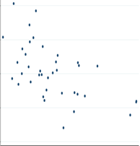
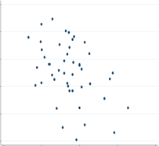
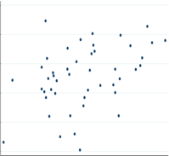
STBBIs in Saskatchewan
Linear Regression Output for HCV 5-yr. Average Rates
SDoH | aRR | 95% CI | p-value
Income | 0.95 | 0.92-0.97 | <0.000
STBBI rates in South & Central Saskatchewan 2-4x provincial rate and 4-10x the national rate.
Social factors (age, marital status) were strongly correlated with CT rate, while income was strongly correlated with HCV rates.
HCV Rate
Avg. Household Income of Community
Linear Regression Output for Chlamydia 5-yr. Average Rates
SDoH | aRR | 95% CI | p-value
Avg. Age | 0.92 | 0.87-0.97 | 0.004
% Unmarried | 1.032 | 1.01-1.106 | 0.022
Chlamydia Rates
Stephanie Konrad, EPH3.04, CAHR 2019
Average Age
% Unmarried

Slide 26
HIV Prevention Updates

Slide 27
Undetectable = Untransmittable
PARTNER-1
  888 heterosexual couples in 14 countries in Europe.
  0 linked transmission with 36,000 reported condomless sex acts.
Opposites Attract
  343 msm couples with 591 couple-years of follow-up.
  0 linked transmissions with 16,800 reported condomless sex acts.
PARTNER-2
  783 msm couples in 1596 couple years of follow-up.
  0 linked transmissions after 77,000 reported condomless sex acts.
Stefan Baral, CAHR 2019, Bavinton et al, Lancet HIV, 2018, Rodger et al, JAMA 2016, Rodger et al IAS 2018

Slide 28
Accessible testing, ART, and care linkage prevents new HIV infections
PopART (HTPN071) 21 clusters in Zambia and Western Cape, SA (N=~600,000)
Arm A: Universal home-based testing + active linkage to care + immediate ART
Arm B: Universal home-based testing + active linkage to care + ART as per national guideline
ArmC: (Control) Existing testing + prevention and referral to care, ART as per national guideline
http://www.ncbi.nlm.nih.gov/pmc/articles/PMC3929317/​
Modified from: https://www.lshtm.ac.uk/media/20901

Slide 29
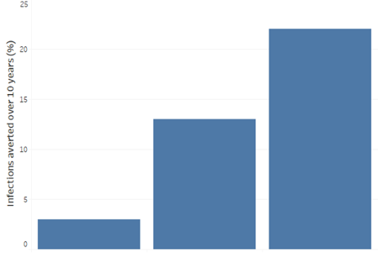
Targeting those left behind by 90-90-90
Impact of PrEP targeting on HIV infections averted
In sustained HIV epidemics, large population-level studies of policy implementation for universal HIV testing and/or ART coverage alone, or in combination with other chronic disease management, have improved rates of HIV suppression but have had modest, if any, impact on overall HIV incidence¹⁻³.
Smaller sub-populations are drivers for ongoing HIV incidence.
Focusing resources on HIV prevention and treatment within the subpopulations with highest population-attributable fraction for new infections is necessary to achieve global targets for HIV treatment and prevention⁴⁻⁵.
Uniform coverage
(no targeting)
50% high risk
receive PrEP
(some targeting)
PrEP targeted to high-risk individuals
(full targeting)
10% of population receive PrEP
Mishra S, Pickles M, et al, in preparation
¹Havlir et al, 2018, https://programme.aids2018.org/PAGMaterial/PPT/6212_8402/SEARCHv12.pdf
²Dabis, et al, 2016 The impact of Universal Test and Treat on HIV incidence in a rural South African Population IAS 2016
³http://www.ncbi.nlm.nih.gov/pmc/articles/PMC3929317/
⁴Knight J, Baral, Mishra et al, CROI 2019
⁵Mishra et al, CROI 2019

Slide 30
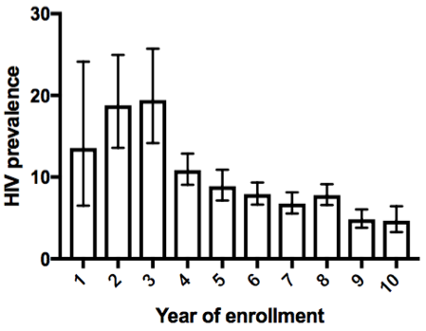
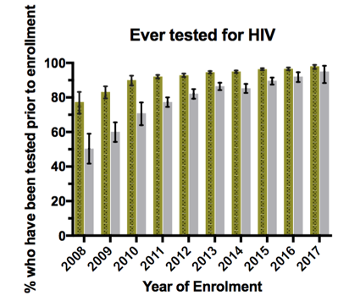
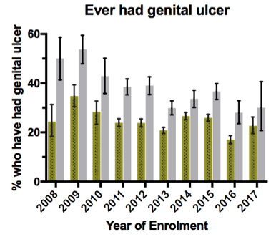
Good news? Declining prevalence of HIV among FSW in Kenya
Achieng Tago, EPH2.02 CAHR 2019
Large decline in HIV+ status prior to enrollment has been observed in the PEPFAR-funded Sex Worker Outreach Program in Nairobi Kenya from 2008-2017.
  While early in the study enrollment may be biased by need for access to ART, the trend continues after 2012, when ART was widely available.
Over the same interval, history of genital ulcer disease remained stable.

Slide 31
PrEP

Slide 32
PrEP use in Canada – still a long way to go
From Ontario drug dispensation data, it is estimated that only 13% of PrEP candidates had accessed it up to June 2018.
In a national survey, only 8.4% of gbMSM in Canada reported using PrEP in 2017 & 2018.
In Saskatoon, only 34% of clients of sexual health services had even heard of PrEP.
From the Engage study; only 35% of participants meeting Canadian PrEP guidelines reported PrEP being recommended to them (65% were not recommended PrEP).
  Among participants eligible for PrEP by Canadian guidelines 84.6% - 94.3% reported awareness of PrEP, but only 20.6% - 29.2% had tried to access it and 11% - 23%, reported currently using PrEP.
  Event-level PrEP use has increased from 16.9% in 02/2017 to 40.6% in 08/2018.
Tan, EPHP1.07, CAHR 2019
Lachowsky, EPHP6.05, CAHR 2019
Enebeli, EPHP2.08, CAHR 2019
Trevor Hart, Amila Heendeniya, H Apelian, N. Lachowsky, CAHR 2019

Slide 33
PrEP use among MSM: Results from the Engage Study
Participants reporting poppers and GHB use, sex with non-romantic partners, partners met online (vs bathhouse), and when partners had a known detectable viral load were more likely to use PrEP.
STIs were identified more frequently among PrEP users (OR ~2) compared to non-users.
Not seeking PrEP was associated with a low perceived risk of HIV infection (aOR 6.66), with the belief that PrEP was not completely effective for HIV prevention, and having insufficient knowledge about PrEP to decide on use.
Not seeking PrEP was also associated with not having a clinician sensitive and accepting of their sexual activities, not knowing where to access it, and not having health insurance
Trevor Hart, Amila Heendeniya, H Apelian, N. Lachowsky, CAHR 2019

Slide 34
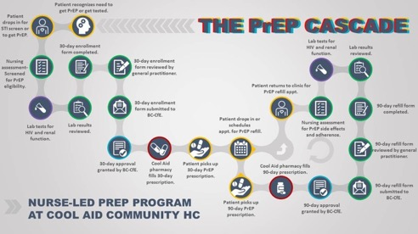
PrEP delivery: success with non-physician-led models
Nurse-led PrEP Program in a men’s STI testing clinic in Vancouver beginning in January 2018.
  124 participants enrolled in the program, 20% (31) discontinued PrEP after initiation.
  No incident HIV cases.
Kellie Guarasci CS2.02 CAHR 2019
Nurse and Pharmacist-Driven PrEP program based at a sexual health clinic in Saskatchewan beginning in January 2018.
  62% Caucasian, 4.6% PWID.
  125 participants were seen, 87 remain on PrEP.
  60.5% of the cohort achieving >85% adherence.
  No incident HIV cases.
Mike Stuber, CS2.08 – CAHR 2019

Slide 35
Behaviour and Risk

Slide 36
HIV & STBBI behavioural risk
Safer sex behaviours are influenced by systemic and social factors.
  Among indigenous adolescents in the Northwest Territories, safer sex was associated with being in a relationship, and negatively associated with food insecurity and IPV. For female participants, an urban living environment was also associated with safer sex.
Chemsex alters risk of HIV serconversion in gbMSM
  Chemsex was reported by 12% of adult MSM seeking PEP at L’Actuel Sexual Health Center in Montreal from Jan 2010 to Nov 2018.
    5 serconversion events occurred among chemsex users compared with 2 events in non-users, resulting in an aOR of 2.23 for seroconversion among PEP-seeking chemsex users.
    Chemsex users were more likely to report condomless anal sex (92% vs 86%).
Carmen Logie, SS 3.06, CAHR 2019
JC Guedes EPH2.01 CAHR 2019

Slide 37
Comorbidities and Chronic Disease in PLWH

Slide 38
Insights into the impact of HIV on inflammation and aging
Novel marker of inflammation: CXCL13.
  Levels are elevated in CHI vs EHI, and reduced under ART. Weak positive correlation with VL, serum LPS and βDG level, and negative correlation with CD4 T cell count and CD4:CD8 ratio. Moderate correlation with markers of T-cell activation.
Novel marker of gut damage: REG3α.
  Elevated levels were seen in HIV+ participants including EHI, CHI and EC (as compared to I-FABP, which is normalized in EC). Levels reduced over 2 years with ART. Weak positive correlation with VL and negative correlation with CD4, CD4:CD8, moderately correlated with LPS, βDG, IL-6 and IL-8.
  Tissue expression in colon was variable in ART/HIV
Slow Progressors have shorter B cell, CD4, & CD8 T cell telomere lengths than ART-controlled and HIV- individuals.
  CD8 T cells also demonstrated more differentiation toward effector cells than those of NSP and HIV- controls.
Rayoun Remendera BS1.03 CAHR 2019
Stephan Isnard BS1.05 CAHR 2019
Anthony Hsieh, CS4.02, CAHR 2019

Slide 39
Low awareness of HPV and cancer risk among women with HIV
48% of 287 women in the OHTN Cohort had not heard of HPV or did not know what it was.
  56% did not know that HPV caused anal cancer, or that receptive anal intercourse was not required to develop anal cancers.
  23% did not know that HIV increased their risk for HPV-related disease.
  51% did not know that smoking increased their risk for HPV-related disease.
  42% of participants had no cervical cancer screening in the past year.
Joanne Lindsay, CS3.03, CAHR 2019

Slide 40
Do PLWH need Lung Ca Screening?
Between 1980 – 2018, 21 patients from a specialized HIV clinic in Montreal were diagnosed with a primary lung cancer.
  15 NSCLCa, 4 SCLCa, 2 bronchial Ca.
74% of patients were current or former smokers.
The median age at diagnosis was 52 in this population.
Characteristics | N (%) or median (IQR)
Age, median (IQR) | 52 (46, 62)
Female, n (%) | 15%
Smoking status, n (%) Current Former Never Unknown | 55% 19% 11% 15%
Ethnicity, n (%) Caucasian Hispanic, born abroad Black African, born abroad | 93% 3.5% 3.5%
Duration of HIV infection, years, median (IQR) CD4 count, cells/mm3, median (IQR) CD4%, median (IQR) CD4/CD8 ratio, median (IQR) On ART before 1997 Suppressed viral load at time of lung cancer diagnosis, n (%) If viral load detectable, viral load copies/ml, median, IQR Duration of viral load suppression, years, median, IQR | 15 (9-22) 247 (47, 294) 16 (9, 21) 0.175 (0.0675, 0.225) 22% 74% 193,546 (1394, 194,949) 5 (1,8)
Cecilia Costiniuk, CS1.01 CAHR 2019

Slide 41
Burden of non-communicable comorbidities in PLWH
Comorbidity burden increases with age in PLWH in Saskatchewan .
Neuropsychiatric**
Dislipidemia**
Hypertension**
Overweight/Obese**
CVD**
Bone**
Renal**
Liver**
Diabetes**
Cancer**
n = | 124 | 291 | 450 | 684 | 334 | 117
Mean | 1.0 | 1.6 | 2.1 | 3.2 | 3.9 | 4.7
n= | 124 | 291 | 450 | 684 | 334 | 117
** indicates P<0.0001
  48% of PLWH 50-59 y/o at moderate or high CVD risk, >92% in >70 y/o.
  98% of PLWH 50-59 y/o at medium or high CKD risk, 100% at 60-69 y/o.
Alex Wong CS1.04 CAHR 2019

Slide 42
Non-HIV comorbidities in WLWH in Canada: Data from the CARMA cohort
Amber Campbell, CS3.05 CAHR 2019
In the CARMA cohort WLWH were more likely to be smokers, experienced higher rates of HCV & psychiatric diagnoses, had more diagnoses overall and used more medications than matched controls.
  Smoking had a significant impact on number and onset age of comorbid disease burden.
Non-HIV Diagnoses by Age

Slide 43
Specific Populations

Slide 44
HIV and HCV in incarcerated individuals: Updated from Correctional Services Canada
CSC provides voluntary testing at admission and during incarceration
  84% of HIV diagnosed before or at admission.
    43% of HIV+ inmates have indigenous ancestry (prevalence 1.48% vs 0.82%).
    9% of HIV+ inmates are female (prevalence 1.90% vs 0.93%).
    88% aware of status, 94% of those on treatment, 93% of those suppressed (90%, 94%, 92% for indigenous ancestry).
  HCV prevalence decreasing, treatment offered to all HCV+ offenders.
HIV prevalence rates among inmates, 2000-2018
Jonathan Smith, EPH2.04 CAHR 2019

Slide 45
Re-engaging lost patients in HIV Care in Saskatchewan
Johnmark Opongo, EPH2.03 CAHR 2019
An audit through eHealth in 2017 identified PLWH who were not in care (no VL test in 1 yr) to target for re-engagement by contact from clinical teams.
  2017 (N=954)
    60% in care
    20% not in care
    20% deceased
  2018 (N=655)
    86% in care, 14% not in care
    63% of not-in-care 2017 re-linked
    11% moved away
  2019 (N=709)
    89% in care
    11% not in care
Re-engagement in care was associated with improved overall proportion of undetectable VL.

Slide 46
PWUD

Slide 47
Supervised Consumption Sites in Canada
Currently 39 SCS with ministerial exemption (+3 pending site visit and 11 open applications) in 18 municipalities in 4 provinces (BC, AB, ON, QC).
  SCS also offered at overdose prevention sites in BC, AB and ON.
  Ministerial exemption allows sites to operate without staff or clients facing prosecution under the Controlled Drug and Substances Act for unauthorized possession of a controlled substance.
Complicated legal framework for exemptions, resistance at various levels of government, and funding continue to be significant barriers.
Cecile Kazatchkine, KP 3.05 CAHR 2019

Slide 48
Women

Slide 49
Mortality and Intimate Partner Violence in WLWH: Data from the LISA study
Some type of IPV reported by 60% of women living with HIV in the cohort.
  25% mortality of women in the cohort (age-adjusted mortality in the cohort 24/1,000 person years, and among WLHIV who experienced any form of IPV 29.5/1,000 person years) vs national mortality rate (7.2/1,000 person years).
  Women who experienced both sexual and physical IPV 2x more likely to die during the study.
  Women reporting IPV were also more likely to report experiencing violence in childhood, to have been ever incarcerated, and to report excessive alcohol use.
Kalysha Closson, SS 3.05, CAHR 2019

Slide 50
Contraceptive use among WLWH
There is a higher rate of unintended pregnancy among women with HIV (61% vs 40-50%) than the general population.
Data from the CARMA cohort found that WLWH were less likely to report using no contraception than their HIV- peers. The choice of contraception for WLWH was different than for their HIV- peers:
  Combination and Hormonal contraception was reported less often and hormonal IUDs, tubal ligation, and LARCs more often.
  Prevalence of contraindications to hormonal contraception higher among WLWH than among HIV- controls.
Chadni Khondoker, SS 4.02, CAHR 2019

Slide 51
Pregnancy Outcomes in HIV+ Women: Data from the CHIWOS study
61.4% of pregnancy events resulted in a live birth, 16.7% in termination, 14.5% miscarriage, 2% ectopic, 1% in stillbirth, and 4% were still pregnant at the study conclusion. 80 women (23.4%) reported a pregnancy termination.
N=622 pregnancies,
342 women
Angela Kaida, CS3.07 CAHR 2019

Slide 52
Mother-to-child transmission in Canada: Updates from the Canadian
HIV Surveillance for Vertical Transmission
Laura Suave, CS3.02, CAHR 2019
In 2018 there were 259 HIV+ mother-infant pairs (MIPs) across Canada.
In 2018, 4.7% (12) mothers with HIV did not receive ≥ 4 weeks of ART. Indigenous ancestry was a significant risk factor for not receiving ≥4 weeks of ART, and Saskatchewan had the highest rate of undertreated mothers at 10%.
A mean of 3 cases of vertical transmission occurred between 2010-2018, with 5 cases in 2018.
VT events
Vertical Transmission, 1990-2018
MIPs
MIPs who did not receive ≥4 weeks cART, 1990-2018
2018:
12 MIPs
2018:
4.7%

Slide 53
Breastfeeding for WLWH: Results of the CHIWOS Study
The majority of WLWH who had had children had been offered infant feeding support, but more than half still experienced social and cultural pressures to breastfeed and were concerned about being identified as HIV+ because of not breastfeeding.
Alexandre de Pokomandy, CS3.04, CAHR 2019
Gormley & Nicholson, SS2.08, CAHR 2019
Smith & Kazemi, EPH 2.08 CAHR 2019

Slide 54
Children

Slide 55
Viral suppression & rebound in Canadian children with HIV: Data from the EPIC4 cohort
131/226 infants and children enrolled in the cohort have had uninterrupted cART during their lifetime, and 97.7% achieved VS over a median of 1.03 years.
  Probability of viral suppression at 12 months = 50%.
Time to VS was shorter (22 vs 67 weeks) when ART started after age 5, when VL <100,000 (19.8 vs 41.7 weeks), with INSTI-based regimens (20.8 weeks vs 52.5 weeks for PI and 69 weeks for NNRTI-based), among Canadian-born infants (35 vs 67 weeks) and in those never placed in foster care (29 vs 67 weeks).
Children with HIV in Canada are a vulnerable population. 2/3 receive social assistance, 1/3 of children are ever in foster care. ART remains poorly tolerable. These factors are associated with longer time to suppression and higher likelihood of rebound.
Fatima Kakkar, CS3.01, CAHR 2019
Hinatea Diemegard BS1.06 CAHR 2019

Slide 56
Sustained Viral Suppression and Early Initiation of cART in
Canadian HIV+ infants: Data from the EPIC4 Cohort
Median age at diagnosis was 10d
13 (6 female, 7 male) received ART w/in 72h of birth.
  AZT/3TC/NVP in 10, AZT/3TC/NFV in 2, AZT/ddI/NFV in 1.
  2 did not achieve SVS, 5 achieved SVS with 1st regimen, 6 had at least one VR or treatment interruption, and achieved SVS with 2nd regimen.
  All children with SVS were judged to have excellent adherence.
  At latest follow-up (median age 5 years, range 0.6-16.9 years), 11 were suppressed.
There was a significant burden of clinical complications in HIV+ infants despite SVS.
  Congenital toxoplasmosis & CMV, HSV infection, developmental delay, and ADHD.
Jason Brophy, CS3.08, CAHR 2019

Slide 57
HIV reservoir in ART-treated children: Data from the EPIC4 Cohort
HIV reservoir size in perinatally infected children correlates with age of cART initiation& virologic suppression, and is inversely proportional to the proportion of life with virological suppression.
  HIV serology correlates similarly, and may be an indirect measure of reservoir size in children.
Initiation of cART before 6 months of age may be required to limit HIV reservoir size in peripheral blood.
Reservoir testing data was available for 4 children with VS who initiated ART <72h after birth: 4/4 had non-reactive serology, USVL of 0 copies/mL, and proviral DNA below limit of detection, 3/4 had undetectable cell-free RNA after prostratin stimulation.
Group 1: effective cART <6 months
Group 2: effective cART > 6 months
Group 3: effective cART but not with 1st regimen
Clin Infect Dis, 2019 Mar 28. pii: ciz251. doi:10.1093/cid/ciz251
A bitun, CS4.03, CAHR 2019

Slide 58
Indigenous Populations

Slide 59
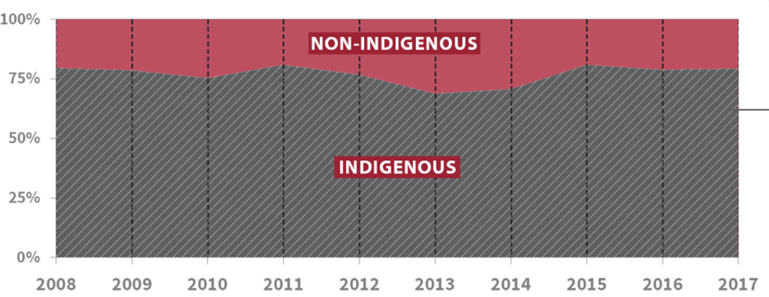
Ongoing HIV outbreak in Saskatchewan
HIV incidence occurring at more than 2x the national rate in Saskatchewan, where it disproportionately affects indigenous populations.
Proportion (%)
75–80% in Indigenous peoples who constitute ~16% of the Saskatchewan population
2017 rate in non-Indigenous Canadians: ~ 3.8 per 100,000
2017 rate in Indigenous Canadians: ~75 per 100,000; ~11.5 times the national average
S Shafran, CAHR 2019

Slide 60
HIV Cure Updates

Slide 61
Stem Cell Transplants for HIV Cure
9 reported instances of HSCT from CCR5 Δ32/Δ32 donor in HIV+ patients.
  2 apparently cured, 1 possibly cured, 6 deaths (evidence of HIV rebound in at least 1 prior to death).
  Case presented at CAHR did not result in HIV cure, but provides insight into immune exhaustion, viral reservoir reversibility, and anti-HIV immunity following CCR5 Δ32/Δ32 SCT.
BS1.01 – Clarissa Brisseau, CAHR 2019

Slide 62
Expanded Role of CD8+ T cells in controlling HIV infection
Ex vivo, activated CD8+ T cells from both HIV+ and HIV- donors can reduce HIV expression in memory CD4+ T cells.
  Without reducing the total frequency of HIV-infected cells.
  Via a contact-dependent, HLA-independent mechanism.
When CD8 T cells are depleted in macaque models:
  Viral load increases (even under suppressive ART).
  But the lifespan of productively infected cells does not change.
CD8 T cells may have a non-cytolytic role, silencing HIV by promoting & maintaining latency.
Klatt, NR et al. PlOS Pathogens 2010
Wong, Dandekar et al., PLoS Pathogens 2010.
Cartwright et al., Immunity, 2016​
Guido Silvestri, CAHR 2019

Slide 63
CD8+ T cells as HIV silencers
LRA activity is enhanced when combined with CD8+ T cell depletion.
  ATL-803 (IL-15 superagonist) induces CD4 T cell proliferation and activation.
  ALT-803 resulted in persistent reactivation in ART-treated macaques only when combined with CD8 Depletion.
  Similar results were seen in humanized mice and using other agents.
Victor Garcia, unpublished data​
Guido Silvestri, unpublished data

Slide 64
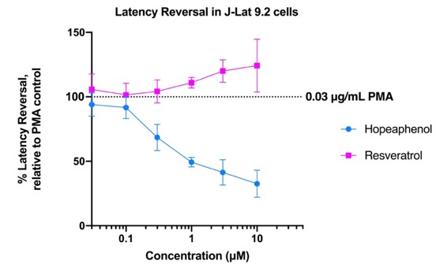
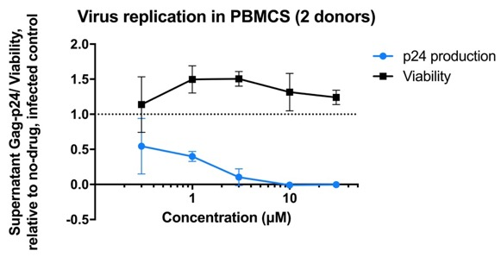
Searching for novel anti-HIV compounds
By screening products from a natural products database, 4 novel compounds which suppressed HIV latency reversal and viral replication without significant cytotoxicity were identified.
The most potent was Hopeaphenol (a resveratrol tetramer).
Zahra Haq BS 2.07 CAHR 2019

Slide 65
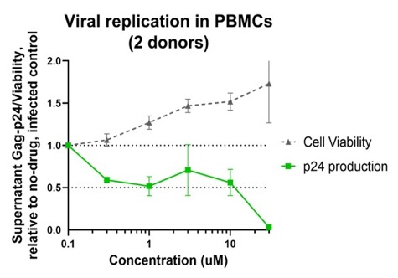
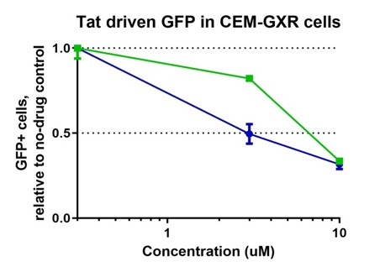
Searching for novel anti-HIV compounds
High-throughput screening of chemical library identified two potential inhibitors of Tat-dependent transcription: A7 and C11.
Both compounds inhibit Tat-dependent transcription in more than one cell line without significant cytotoxicity, inhibit latency reversal in vitro, and HIV replication & infectivity ex vivo.
C11
A7 and C11
Jennifer Yi, BS4.01, CAHR 2019

Slide 66
Reservoir under long-term ART
HIV DNA
Post-mortem assessment of HIV persistence in tissue reservoirs was performed in a Canadian patient in Ottawa.
  HIV DNA and LTR-Gag DNA was detected in all tested tissues, highest levels were in Lymph nodes and lungs. LTR-Gag RNA was also detected in LN and Lung, and at low levels in the other tested tissues.
In a macaque model of ART treatment after acute infection, viral DNA and reverse transcript products were detected in treated animals, particularly in TEM and TFH cells of the spleen and mesenteric LNs, but not in peripheral LNs.
Teslin Sandstrom, BS3.07, CAHR 2019
SPLEEN
P = 0.06
P = 0.03
MES LNs
Copies/10⁶ cells
Copies/10⁶ cells
Henintsoa Rabezanahary, BS3.08, CAHR 2019
E = reverse transcript
D = DNA

Slide 67
Decreased inflammation and T cell activation among HESN Female Sex
Workers
In a cohort of female sex workers (FSW) from Kenya, HIV-exposed seronegative (HESN) workers have lower cervical inflammation and lower systemic T-cell activation than newer HIV- sex workers.
Inflammation score
Regulatory T cells
HIV Target cells
Keith Fowke, KP1.05 CAHR 2019

Slide 68
Promising avenues for HIV Cure research
HIV subtypes target different regions of non-B DNA for integration, nearby non-B DNA structures affect HIV latency and re-activation. Changing the stability of non-B structures (as demonstrated using G4) can affect the proportion of latent vs productively infected cells.
TIGIT blockade resulted in increased NK-cell mediated killing of PVR labelled cells, while TIGIT engagement reduced HIV-specific ADCC in an in vitro model of cells harvested from HIV+/HCMV+ donors.
Hannah Ajoge, BS4.04, CAHR 2019
Kayla Holder, BS1.02 CAHR 2019

Slide 69


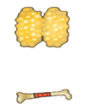
Promising avenues for HIV Cure research
Reducing endogenous IRF-1 expression (with CD4-specific aptamer SiRNA chimera) in a humanized mouse model resulted in resistance to HIV infection by intravaginal challenge and increased the frequency of Tregs without affecting antiviral cytokine expression.
New humanized mouse model to study HIV cure and reservoir.
  TKO-BLT mice have longer life expectancy, maintain HIV infection, and can be treated to viral suppression with cART and HIV latency can be induced.
Ruey Su, BS4.03, CAHR 2019
Kerry Lavender, BS4.06, CAHR 2019
Transplant Liver/Thymus under kidney capsule
Surrogate
human
thymus
T cells
500rad
B cells
CD34+ liver
Progenitor cells (IV)
thymocytes
NK cells
DC
Hematopoiesis
Other myeloid

Slide 70
Understanding initial infection

Slide 71
Novel insights to the role of HIV-Nef
HIV infection results in Nef-mediated endocytosis (or downregulation) of Serine Incorporator 5 (SERINC5), as well as CD4.
Both downregulation pathways use AP2, but mechanisms may be distinct.
Mitchell Mumby BS2.03 CAHR 2019
Hanwei Sudderuddin BS2.02 CAHR 2019

Slide 72
Steps in early mucosal infection
R5-tropic virus is translocated through endometrial epithelial monolayers with greater frequency and provokes less IFN response and lower translation of interferon-stimulated genes than X4 virus.
Glycosylation of viral gp120 allows for binding by lectins within host mucosal tissue, preventing conformational changes required for viral fusion. Gp120 glycosylation is associated with lower transmission fitness and trapping of virus within the tissue.
Aisha Nazlin, BS3.05 CAHR 2019
Adam Meadows, BS 3.06 CAHR 2019

Slide 73
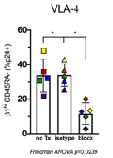
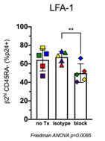
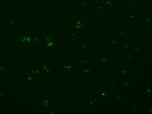

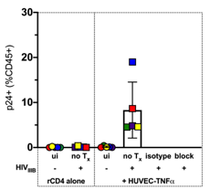

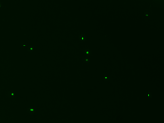


What is the role of endothelial cells in transmucosal HIV infection?
Endothelial cells may enhance HIV infection of tissue CD4 T cells expressing homing cytokines. Blockade of alpa4 and alphaL inhibited HIV infection of CD4 T cells co-cultured with ECs in vitro.
Cell Tracker Green-labelled CD4+ T cells adhered to (A) HUVEC or (B) rCAMs
A.
untreated
LFA-1 (αL) and VLA-4 (α4) block
HUVEC-TNFα
HUVEC-TNFα
B.
untreated
LFA-1 (αL) block
untreated
VLA-4 (α4) block
rICAM
rVCAM
20X mag
Catherine Card, BS 4.03, CAHR 2019

Slide 74
The Role of DCs in Early & Chronic HIV Infection
DCs compartmentalize HIV in vitro. Migration to lymph nodes by HIV-captured DCs is supported by expression of appropriate chemoattractant receptors in vitro, and observed migration to LNs in humanized mice.
DC:T cell trans-infection requires stable contact between the cells, initiated by Env:CD4 interaction and strengthened by ICAM-1/LFA-1 interaction.
  Blockade of these receptors disrupts DC:T cell trans-infection in vitro.
In macaques, the dynamics of SIV infection are similar in monocyte subsets to CD4 T cells during acute infection, with more infection of DCs in the spleen than in gut or LNs.
  After treatment interruption, early viral replication was observed in both CD4 T cells and monocytes.
Wan Koh. BS3.01 CAHR 2019
Julien Clain, BS3.02, CAHR 2019

Slide 75
The role of α4β7 during HIV infection
In humanized mice HIV with α4β7 incorporated in the viral envelope localizes to the gut (specifically, Peyer’s patches) vs. virus without α4β7 incorporation.
  α4β7 increased capture of virions by MADCAM-1, and variably increased capture by anti-gp120 antibodies, potentiated by the presence of Mn++.
Gag may have a role in directing α4β7 incorporation
Christina Guzzo BS2.05 CAHR 2019
Jonathan Burnie CAHR 2019

