Slide 1
CROI 2019
Scientific summary of the major clinical studies presented at CROI 2019
Résumé scientifique des principales études cliniques présentées à la CROI 2019

Slide 2

CAHR is pleased to provide this scientific summary of the major clinical studies presented at the Conference on Retroviruses and Opportunistic Infections (CROI 2019). The synthesis aims to improve the cascade of care by increasing the skills and knowledge of Canadian health care professionals working in the realm of HIV. This presentation was made possible with the support of an educational grant from ViiV Healthcare.
L’ACRV a le plaisir de vous offrir ce résumé scientifique des principales études présentées à la Conference on Retroviruses and Opportunistic Infections (CROI 2019). Cette synthèse a pour objet d’améliorer la cascade de soins en relevant les techniques et connaissances des professionnels canadiens de la santé qui travaillent dans le domaine du VIH. Cet exposé a été rendu possible avec le soutien d’une subvention éducative de ViiV Soins de santé.

Slide 3
New Antiretrovirals at CROI 2019
Oral Sessions: #139, #140LB, #142
Posters: #480, #481, #483, #486

Slide 4
LONG-ACTING CABOTEGRAVIR + RILPIVIRINE AS MAINTENANCE THERAPY: ATLAS WEEK 48 RESULTS
Objective: To assess whether switching to monthly LA CAB + LA RPV is noninferior to continuing 3-drug oral ART in virally suppressed HIV-1 infection.
Study Design:
A phase III, open-label, multicenter study, randomized, noninferiority trial
Primary endpoint: HIV-1 RNA ≥ 50 copies/mL at Wk 48 (FDA snapshot) in ITT-E
  6% non-inferiority margin for difference in efficacy between arms
Secondary endpoints: HIV-1 RNA < 50 or < 200 copies/mL at Wk 48, VF, safety, resistance, patient-reported outcomes
Wk 4
Wk 48 Primary Endpoint
Adults on stable ART with HIV-1 RNA < 50 copies/mL for ≥ 6 mos with no prev VF (N = 616)
Oral CAB
+ RPV†
(n = 308)
CAB LA 400 mg IM monthly + RPV LA 600 mg IM monthly†
(n = 308)
Continue Baseline ART
(n = 308)
Notes:
*Permitted baseline regimens: 2 NRTIs + INSTI (except DTG/ABC/3TC), NNRTI, or boosted PI (or unboosted ATV).
†CAB 30 mg + RPV 25 mg orally QD for 4 wks, followed by CAB LA 600 mg IM + RPV LA 900 mg IM at first injection, then CAB LA 400 mg IM + RPV LA 600 mg IM at Wk 8 and every 4 wks thereafter until withdrawal.

Slide 5
ATLAS: Virologic Outcomes at Wk 48
  Virologic Outcomes
CAB LA + RPV LA
Continued ART
  Adjusted Treatment Difference (95% CI)*
100
92.5
95.5
Primary endpoint
(HIV-1 RNA ≥ 50 c/mL):
CAB + RPV noninferior to continued ART
CAB LA + RPV LA
(n = 308)
Continue baseline ART
(n = 308)
0.6
80
-1.2
2.5
6% NI
margin
60
Patients (%)
-10
-8
-6
-4
-2
0
2
4
6
8
10
Continued ART
CAB LA + RPV LA
40
Difference (%)
20
Key secondary endpoint (HIV-1 RNA < 50 c/mL):
CAB + RPV noninferior to continued ART
1.6
1.0
5.8
3.6
-3.0
0
−10% NI
margin
-6.7
0.7
Virologic Nonresponse (≥ 50 c/mL)
Virologic Success
(< 50 c/mL)
No Virologic Data
-10
-8
-6
-4
-2
0
2
4
6
8
10
Difference (%)
In CAB + RPV arm, 2 of the 3 patients with virologic failure had baseline NNRTI RAMs

Slide 6
ATLAS: Conclusions
In patients with stable virologic suppression and no prior VF, switch to CAB LA + RPV LA non-inferior to continuing 3-drug ART at Wk 48
HIV-1 RNA ≥ 50 copies/mL in 1.6% vs 1.0% (FDA snapshot)
Treatment difference: 0.6% (95% CI: -1.2% to 2.5%)
HIV-1 RNA < 50 copies/mL in 92.5% vs 95.5%
Treatment difference: -3.0% (95% CI: -6.7% to 0.7%)
Most (95%) drug-related AEs in CAB + RPV arm were grade 1/2 severity
Most (99%) ISRs in CAB + RPV arm were grade 1/2, rarely lead to discontinuation
Increase in patient satisfaction higher in CAB + RPV arm
Notes:
* ISR, injection-site reaction; VF, virologic failure

Slide 7
LONG-ACTING CABOTEGRAVIR + RILPIVIRINE
FOR HIV MAINTENANCE: FLAIR WEEK 48 RESULTS
  Objective: To assess efficacy and safety of switching to LA CAB IM + LA RPV IM after induction on DTG/ABC/3TC PO vs continuing DTG/ABC/3TC PO in ART-naive patients.
  Study Design:
Multicenter, randomized, open-label phase III, non-inferiority trial
Primary endpoint: HIV-1 RNA ≥ 50 copies/mL at Wk 48 (6% noninferiority margin)
Secondary endpoints: HIV-1 RNA < 50 copies/mL at Wk 48, resistance at confirmed virologic failure, safety and tolerability, patient-reported outcomes
Induction Phase†
Maintenance Phase
Current Analysis
Wk 48
Day 0
Wk 4§
Wk 96
Wk 20
CAB 30 mg +
RPV 25 mg PO QD
(n = 283)
LA CAB 400 mg IM +
LA RPV 600 mg IM Q4W
(n = 278)
ART-naive patients with
HIV-1 RNA ≥ 1000 copies/mL,
(N = 629)
DTG/ABC/3TC
PO QD‡
Continue DTG/ABC/3TC PO QD‡
(n = 283)
Orkin C, et al. Presented at CROI 2019; Oral abstract #140LB Slidecredit:clinicaloptions.com

Slide 8
FLAIR: Efficacy at Wk 48
LA CAB + LA RPV
DTG/ABC/3TC
Virologic Outcomes (FDA Snapshot)
Adjusted Treatment Difference (95% CI)*
100
93.6
93.3
80
LA CAB + LA RPV
(n = 283)
DTG/ABC/3TC
(n = 283)
6% NI
margin
60
-0.4
Primary Endpoint
(HIV-1 RNA ≥ 50 copies/mL)
LA CAB + LA RPV noninferior to DTG/ABC/3TC
Patients (%)
-2.8
2.1
40
DTG/ABC/3TC
LA CAB + LA RPV
-10
-8
-6
-4
-2
0
2
4
6
8
10
20
Difference (%)
2.1
2.5
4.2
4.2
0
Virologic Nonresponse
(≥ 50 c/mL)
Virologic Success
(< 50 c/mL)
No Virologic Data
0.4
Key Secondary Endpoint
(HIV-1 RNA < 50 copies/mL)
LA CAB + LA RPV noninferior to DTG/ABC/3TC
-10% NI
margin
-3.7
4.5
Confirmed VF: n = 3 per arm; emergent NNRTI + INSTI resistance in all CAB + RPV failures (all HIV-1 subtype A1), no resistance in DTG/ABC/3TC failures
-10
Difference (%)
-8
-6
-4
-2
0
2
4
6
8
10
Difference (%)
Notes:
*Adjusted for sex, BL HIV-1 RNA (< vs ≥ 100,000 c/mL).

Slide 9
FLAIR: Conclusions
Following 20-wk induction with DTG/ABC/3TC, switch to LA CAB + LA RPV was noninferior to continued ART at Wk 48
‒ HIV-1 RNA ≥ 50 copies/mL in 2.1% vs 2.5%, respectively
‒ Treatment difference: -0.4% (95% CI: -2.8% to 2.1%)
‒ HIV-1 RNA < 50 copies/mL in 93.6% vs 93.3%, respectively
‒ Treatment difference: 0.4% (95% CI: -3.7% to 4.5%)
‒ Confirmed VF in 1.4% vs 1.1%, respectively
‒ NNRTI + INSTI resistance with all 3 cases in CAB + RPV arm; none in DTG/ABC/3TC arm
In CAB + RPV arm, most drug-related AEs (94%) and ISRs (99%) were grade 1/2
Patient-reported satisfaction significantly higher in CAB + RPV arm

Slide 10
SAFETY AND PK OF SUBCUTANEOUS GS-6207, A NOVEL HIV-1 CAPSID INHIBITOR
Objective: To describe in vitro pharmacological profile of GS-6207, a first-in-class HIV capsid (CA) inhibitor optimized for long-acting ARV.
Methods: Phase I ongoing study in 40 healthy volunteers randomized into 4 cohorts (4:1) to receive single SC doses of GS-6207 (n=8/cohort) or placebo (N=2/cohort), at 30, 100, 300 or 450mg.
Safety Results
  No deaths, serious AEs, or Grade 3 or 4 AEs. All AEs were mild to moderate (Grade 1 or 2 and resolved)
  Most common AEs transient injection site reactions (e.g., erythema)

Slide 11
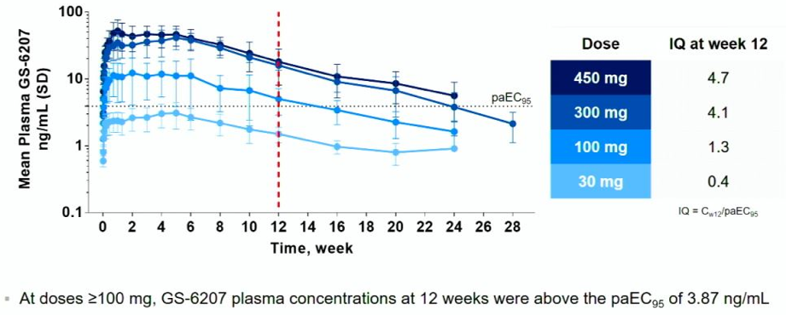
SAFETY AND PK OF SUBCUTANEOUS GS-6207, A NOVEL HIV-1 CAPSID INHIBITOR
Results: Sustained Delivery Supports Dosing Interval of at least 12 Weeks.
Notes:
*EC₉₅ determined in MT-4 T-Cell Line with WT HIV-1 (IIIB strain). C_{w12,} GS-6207 plasma concentration on Day 84; IQ, inhibitory quotient; paEC₉₅, protein adjusted EC₉₅

Slide 12
SAFETY AND PK OF SUBCUTANEOUS GS-6207, A NOVEL HIV-1 CAPSID INHIBITOR
Conclusions
  GS-6207 in single SC doses of up to 450 mg in healthy volunteers:
      Maintained systemic exposure for ≥ 24 weeks; most doses exceeded paEC₉₅ for ≥ 12 weeks
      Was well tolerated based on a pooled assessment of blinded safety data
  Sustained delivery supports dosing interval of at least 3 months
  A Phase I study in PLWH is ongoing to determine the dose and frequency of administration

Slide 13
A PHASE IIA STUDY OF NOVEL MATURATION INHIBITOR GSK2838232 IN HIV PATIENTS
Objective: This proof-of-concept phase II study assessed safety and tolerability, antiretro activity, and PK of QD PO GSK’232 + cobicistat (COB) in adults with HIV.
Methods: Dose-ranging two-part study evaluated 4 dose levels of QD GSK’232 + 150 mg COB for 10 days. PK samples collected at Days 1 and 10; safety assessments throughout the study. Subjects were followed for 11 days after the end of treatment (Day 21).

Slide 14
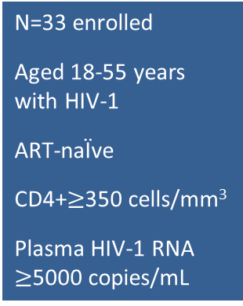
A PHASE IIA STUDY OF NOVEL MATURATION INHIBITOR GSK2838232 IN HIV PATIENTS: Study Design
Part A
Part B
GSK’232 200mg + cobicistat 150mg (n=8)
N=33 enrolled
Aged 18-55 years with HIV-1
ART-naÏve
CD4+$≥$350 cells/mm³
Plasma HIV-1 RNA $≥$5000 copies/mL
GSK’232 100mg+ cobicistat 140mg (n=10)
GSK’232 50mg + cobicistat 150mg (n=8)
GSK’232 20mg + cobicistat 150mg (n=7)
Screening
Part A
Day 1
(first dose)
Part A
Day 10
(Last dose)
Part A
Day 21
(end of follow-up)
Interim analysis
of
Part A
Part B
Day 1
(first dose)
Part B
Day 10
(Last dose)
Part B
Day 21
(end of follow-up)

Slide 15
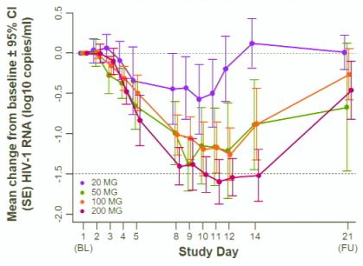
A PHASE IIA STUDY OF NOVEL MATURATION INHIBITOR GSK2838232 IN HIV PATIENTS
Antiviral Activity of GSK’232
Robust reductions in 50mg, 100mg, and 200mg cohorts; maximal effect in 200mg cohort
Figure. Change from baseline in plasma HIV-1 RNA
 | 20mg (n=7) | 50mg (n=8) | 100mg (n=10) | 200mg (n=8)
Plasma HIV RNA (copies/mL)
Max. decline from baseline, mean (SD) | -42,095 (37,576) | -49,066 (71,340) | -32,948 (54,291) | -33,149 (31,786)
Max decline from BL (log₁₀), mean (SD) | -0.67 (0.41) | -1.56 (0.67) | -1.32 (0.44) | -1.70 (0.38)
>1.5 log₁₀ copies/mL decrease from BL, n(%) | 0 | 2(25) | 2(20) | 5(63)
<400 copies/mL, n(%) | 0 | 2(25) | 2(20) | 4(50)
CD4 count
Change from baseline, mean (SD) | -1.4 (95.3) | 52.0 (145.4) | 40.7 (94.5) | 11.1 (75.2)

Slide 16
A PHASE IIA STUDY OF NOVEL MATURATION INHIBITOR GSK2838232 IN HIV PATIENTS: Conclusions
GSK’232 + cobicistat 10 days in adults with HIV was associated with:
Robust virologic responses with 50mg, 100mg, and 200mg, with the maximal effect at 200mg
No baseline polymorphism mutations affecting GSK’232 activity
Good tolerability/no GI tolerability issues, unlike previous studies with maturation inhibitor
Preliminary evidence of clinical activity provides positive proof-of-concept for GSK’232.

Slide 17
MK-8591 POTENCY AND PK PROVIDE HIGH INHIBITORY QUOTIENTS AT LOW DOSES QD AND QW
Objective: Evaluate the IQ of the NRTTI MK-8591-triphosphate (MK-8591-TP) in relation to other NRTIs for WT and NRTI-resistant HIV-1.
Results:
The MK-8591-TP IC50, IC for wt HIV-1 is >4-fold lower than any marketed NRTI
MK-8591 IQs at steady state with 0.25 mg qd and 10 mg qw dosing are 85.3 and 101, respectively, and proportionately greater for higher dose levels
Common NRTI mutations, including M184I/V, thymidine analog mutations, K65R, and K70E, confer low fold-shifts in antiviral potency, and MK-8591 retains greater IQs against these NRTI-resistant viruses than those of TDF, TAF and 3TC with wt virus

Slide 18
MK-8591 POTENCY AND PK PROVIDE HIGH INHIBITORY QUOTIENTS AT LOW DOSES QD AND QW Grobler J, et al.; Poster #481
Evaluate the IQ of the NRTTI MK-8591-triphosphate (MK-8591-TP) in relation to other NRTIs for WT and NRTI-resistant HIV-1
LONG-TERM SAFETY & EFFICACY OF FOSTEMSAVIR IN TREATMENT-EXPERIENCED HIV PARTICIPANTS Thompson M, et al.; Poster #483
PRO 140 SC: LONG-ACTING, SINGLE-AGENT MAINTENANCE THERAPY FOR HIV-1 INFECTION Dhody K, et al.; Poster #486
PRO 140 (leronlimab, a humanized CCR5 mAb)

Slide 19
ART Toxicity at CROI 2019
Oral Sessions: #442, #443, #439, #158
Posters: #669 ‒ #675, #679, #680

Slide 20
MEMORY AND LEARNING DYSFUNCTION WITH INTEGRASE STRAND TRANSFER INHIBITORS USE
Objective: To perform a cross-sectional analysis of neurocognitive function and neuroimaging of PLWH on INSTI-based regimens.
Subjects:
202 PLWH, median (IQR) age 55 (48, 60) years, 152 (75%) male, 136 (67%) black
Median recent CD4+ T cell count 576 (401, 818) cells/mm3, 96% HIV RNA <200 copies/ml
INSTI-based ART: 99 (49%) (40.4% raltegravir, 29.3% elvitegravir, 30.3% dolutegravir)
non-INSTI based ART: 103 (51%)
No between-group differences in age, sex, race, education, smoking status, depression scores, psychiatric medication use, HIV infection duration or nadir and recent CD4+ T cell count

Slide 21
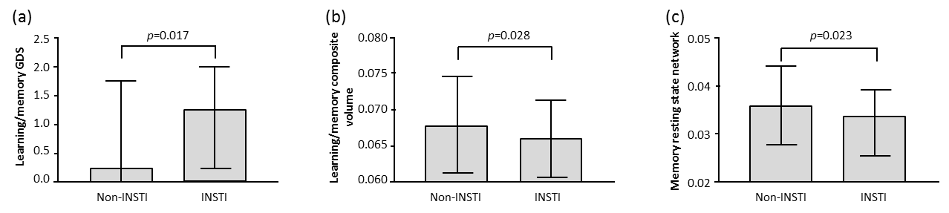
MEMORY AND LEARNING DYSFUNCTION WITH INTEGRASE STRAND TRANSFER INHIBITORS USE
Results/Conclusions of Neuropsychological assessment:
Learning/memory domain scores of the INSTI group were worse than those on non-INSTI based ART (1.25 (0.25, 2) vs 0.25 (0, 1.8); p=0.02) (figure a)
This difference remained significant when corrected for nadir CD4+ T cell count, current ART regimen duration, current NNRTI or PI use, current psychiatric medication use or having previously received another ART regimen (p=0.04)
Composite volumetric measures for learning/memory brain regions were significantly smaller in the INSTI group (figure b)
Functional connectivity of memory resting state network in the INSTI group was less (figure c)

Slide 22
CEREBRAL FUNCTION PARAMETERS IN PEOPLE LIVING WITH HIV SWITCHING INTEGRASE INHIBITOR
Objective: To assess changes in cerebral function parameters over 120 days in PLWH without overt neuropsychiatric symptoms receiving two different INSTI-containing ART regimens.
Study design:
Eligibility Criteria
PWH$≥$18 years of age
No neurological or cognitive complaints
Plasma HIV RNA undetectable for at least 3 months
ART comprising of TruvadaTM and raltegravir 400 mg twice daily
Control Arm (n=8)
Remain on raltegravir 400 mg twice daily
1:2
Switch Arm (n=12)
Switch integrase inhibitor to dolutegravir 50mg daily
Day 0 Day 120
Baseline
assessments
Day 120
assessments
Cerebral function assessments:
Cognitive testing
Patient Reported outcome measures (PROMs)
Cerebral metabolite ratios were measured using proton MR imaging
CSF parameters

Slide 23
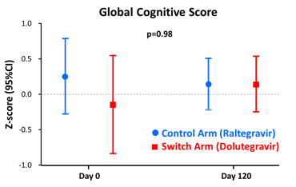
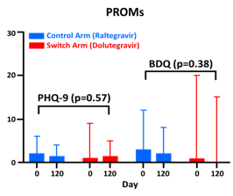
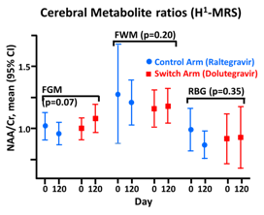
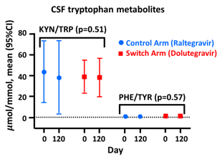
CEREBRAL FUNCTION PARAMETERS IN PEOPLE LIVING WITH HIV SWITCHING INTEGRASE INHIBITOR
Results
Patient characteristics:
Age, median (IQR): 43 (11.5) years
Male, n(%): 20/21 (95.2)
White Ethnicity n(%): 14/21 (66.7)
Baseline CD4 count, mean (SD): 717 (298) cells/$μ$L
In all individuals, CSF HIV RNA was <5 copies/mL
at both time points
Conclusion: No significant changes in clinical, CSF biomarker or cerebral imaging parameters occurred in virologically suppressed PWH without overt neuropsychiatric symptoms switching INSTI.

Slide 24
OBESITY: A GROWING PROBLEM IN ANTIRETROVIRAL THERAPY
Weight gain common when starting ART and may occur following regimen switches.
Where do we go from here?
PLWH exist in an ‘obesogenic’ environment: demographics of at-risk populations, geography, secular trends
Obesity compounds comorbid NCDs: cardiovascular, metabolic, hepatic, CNS, and others
Factors associated with weight gain: female sex, black race, older age, lower CD4 count, higher viral load
Weight gain with INSTIs?
Some studies show impact and within-class variability; others no effect
Clear need for prospective studies and pooled analyses of prior randomized clinical trials before drawing conclusions

Slide 25
OBESITY: A GROWING PROBLEM IN ART
(Weight Gain with INSTIs continued)
Scientific Perspective: If a true phenomenon, is weight gain an off-target effect or evidence of greater drug efficacy?
    Could INSTIs interfere with CNS appetite regulation, insulin signaling?
  Case reports of acute-onset diabetes (Fong P, IJSA 2017, Horikawa M, TJECM 2018)
    Are INSTIs just better at eliminating virus, lowering energy expenditure and reversing catabolic effects?
  Lack of weight gain in HPTN 077 with cabotegravir (CROI 2019 #034)
  Greater INSTI penetration of adipose tissue (Couturier J, Antiviral Res. 2018)
Recent Reports of INSTIs and weight gain represent an opportunity to further explore HIV effects on bioenergetic pathways

Slide 26
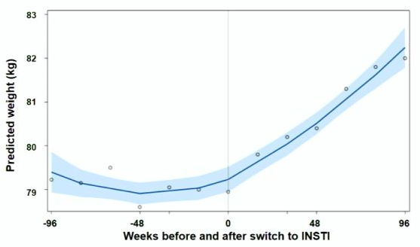
RISK FACTORS FOR EXCESS WEIGHT GAIN FOLLOWING SWITCH TO INTEGRASE INHIBITOR–BASED ART
972 adults switched to INST-base regimens in ACTG A5001 and A5322
Median 7.8 years of prior treatment
Women, blacks and persons age $≥$60 experienced the largest increase
Dolutegravir associated with greatest weight gain

Slide 27
Noteworthy Posters
Poster #670: Treatment-naïve PLWH starting INSTI, especially DTG and RAL, appear at higher risk of weight gain compared to those on older NNRTI-class regimens
Poster #671: Annualized weight gain on most recent ART exceeding 1 year in length in previously-treated adult patients with continued HIV suppression. Weight gain during INSTI-based ART did not remain significant
Poster #672: Among HIV+ women on ART followed an average 2.0 years, those who either switched to or added an INSTI had significant increases in body weight and BMI
Poster #673: Immune activation markers are significantly associated with weight gain following ART initiation
Poster #674: Association of weight gain among virally suppressed persons who switched to INSTI-based ART with non-Hispanic black race and lower pre-INSTI BMI

Slide 28
DOLUTEGRAVIR AND INSULIN RESISTANCE
Objective: To investigate risk factors associated with HOMA-IR (homeostasis model of assessment – insulin resistance) and the effect of dolutegravir (DTG) on IR over time.
Methods:
Data from 4 DTG clinical trials (SPRING-1, STRIIVING, SWORD-1 and -2) with fasting insulin and glucose measurements included
Excluded: subjects with diabetes
Relationship between potential risk factors and the proportion of participants with HOMA-IR cut-off >2, 3, or 4 was explored using logistic regression

Slide 29
DOLUTEGRAVIR AND INSULIN RESISTANCE
Results:
HOMA-IR data was available at BL, week 24, and week 48 for 824, 304 and 543 DTG-exposed subjects and 713, 219 and 460 control subjects, respectively
Subjects: male (81%); white (76%); median age 43yrs; overweight/obese (50%); 70% had a HOMA-IR>2
Similar modest increases in HOMA-IR between DTG and control groups over time (24 and 48 weeks)
Overall, no difference in odds of HOMA-IR>2 between treatment groups at 48 weeks
Risk factors for IR (HOMA-IR>2) at week 48 were BL HOMA-IR, Sex, BMI, AIDS CDC category, smoking history, and elevated ALT
Conclusions:
No association seen between treatment and IR over a 48 week period
IR increased modestly over time in all groups
Risk factors associated with IR at week 48 were consistent with known risk factors for diabetes/IR

Slide 30
LOWER CARDIOVASCULAR DISEASE RISK ASSOCIATED WITH INTEGRASE INHIBITORS
Objective: Examine the risk of CVD in PLWH on INSTI-based regimen.
Methods:
Study group: PLWH (MarketScan® database of commercially-insured or Medicaid-covered adults) newly-initiated on ART
Primary outcome: major adverse cardiac event (MACE) (composite: acute MI, ischemic stroke, CABG and PCI)
Exclusion criteria: MACE events 6 months prior to start of first stable regimen
Censoring: earliest MACE events during 1st 6 months of a stable regimen, 90 days post-ART switch, health plan disenrollment, death, or study end

Slide 31
LOWER CARDIOVASCULAR DISEASE RISK ASSOCIATED WITH INTEGRASE INHIBITORS
Results:
Median follow-up: 561 (348, 985) days
New ART initiators (79% males; mean age 40.6 yrs): 20,459
INSTI-based regimens: 5,128 (25%) (RAL 33%, ELV 49%, DTG 18%)
NNRTIs-initiated regimens: 11,191 (55%)
PIs-initiated regimens: 4,145 (20%)
INSTI-based ART associated with significantly lower risk of MACE events (HR 0.57; 95% CI 0.45, 0.73) compared to non-INSTI based regimens

Slide 32
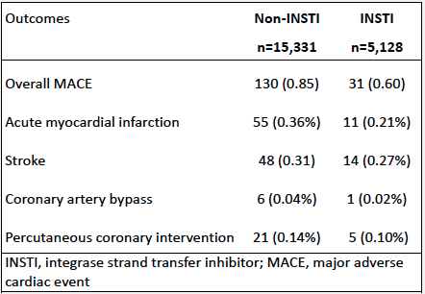
LOWER CARDIOVASCULAR DISEASE RISK ASSOCIATED WITH INTEGRASE INHIBITORS
Major Adverse Cardiovascular events
O’Halloran JA, et al. Presented at CROI 2019; Poster #680

Slide 33
LOWER CARDIOVASCULAR DISEASE RISK ASSOCIATED WITH INTEGRASE INHIBITORS
Conclusion:
INSTI-based regimens were associated with a 43% decrease risk of CVD events in this cohort.

Slide 34
Maternal and pediatric issues
at CROI 2019
Oral Sessions: #39LB, #40LB, #44, #59
Posters: #743 ~ #749

Slide 35
RANDOMIZED TRIAL OF RALTEGRAVIR-ART VS EFAVIRENZ-ART WHEN INITIATED DURING PREGNANCY
Background: Randomized data comparing efficacy and safety of INST- vs
EFV-based ART initiated during pregnancy are lacking.
Objective: To compare efficacy, tolerability, and safety of RAL- vs EFV
-based regimens in ART-naive pregnant women initiating treatment at 20
to < 37 wks of gestation.

Slide 36
RANDOMIZED TRIAL OF RALTEGRAVIR-ART VS EFAVIRENZ-ART WHEN INITIATED DURING PREGNANCY: Study Design
Multicenter, randomized, open-label phase IV trial
Primary endpoints: HIV-1 RNA < 200 copies/mL at delivery, discontinuation of RAL or EFV prior to delivery, grade ≥ 3 AEs (mother and infant)
Secondary endpoints: rapid/sustained HIV-1 RNA decline with continued use of study ARV until delivery, stillbirth, preterm birth, infant HIV infection
Stratified by gestational age
Raltegravir + ZDV/3TC‡
(n = 206)
ART-naive, pregnant women with HIV infection at 20 to < 37 wks of gestation (N = 408)
Patients followed until 24 wks postpartum
Efavirenz + ZDV/3TC‡
(n = 202)
Notes:
*Short-course ZDV (≤ 8 wks) for prevention of MTCT in previous pregnancies allowed. †Minimum gestational age reduced from
28 to 20 wks after 22% of study population enrolled. ‡Alternative NRTI backbone permitted if clinically indicated.

Slide 37
RANDOMIZED TRIAL OF RALTEGRAVIR-ART VS EFAVIRENZ-ART WHEN INITIATED DURING PREGNANCY: Efficacy
HIV-1 RNA < 200 Copies/mL at Delivery
P = .001
Interaction P = .04
100
94
96
97
RAL-based ART
EFV-based ART
93
84
80
71
60
Proportion With Outcome (%)
40
20
0
Overall*
(n = 307)
20 to < 28 Wks of Gestation at Entry
28 to < 37 Wks of Gestation at Entry
Notes:
*Primary efficacy population: women with HIV-1 RNA ≥ 200 copies/mL and no genotypic resistance to any study ARV at entry.
Similar trends observed in sensitivity analyses when restrictions on HIV-1 RNA and resistance lifted.

Slide 38
RANDOMIZED TRIAL OF RALTEGRAVIR-ART VS EFAVIRENZ-ART WHEN INITIATED DURING PREGNANCY
Secondary Efficacy/Tolerability Endpoint
Outcome, n/N (%) | RAL-Based ART | EFV-Based ART
Rapid, sustained virologic response in women remaining on study drug through delivery* | 121/132 (92) | 84/131 (64)
HIV-1 RNA decline ≥ 2 log or < 200 copies/mL by Wk 2 | 123/132 (93) | 91/131 (69)
HIV-1 RNA < 1000 copies/mL at all visits after Wk 4 | 115/120 (96) | 117/123 (95)
Remained on study drug through delivery | 131/132 (99) | 129/131 (98)
Secondary Safety Endpoint
Outcome, n/N (%) | RAL-Based ART | EFV-Based ART | P Value**
Stillbirth | 3/200 (2) | 1/194 (1) | .62
Preterm delivery (< 37 wks of gestation) | 24/195 (12) | 20/190 (11) | .63
Infant HIV infection | 1/190 (1) | 6/184 (3) | .06
*P < .001; includes women in primary efficacy/tolerability analyses with HIV-1 RNA data available at Wk 2 and
≥ 1 subsequent value after Wk 4.
**Fisher’s exact test.

Slide 39
RANDOMIZED TRIAL OF RALTEGRAVIR-ART VS EFAVIRENZ-ART WHEN INITIATED DURING PREGNANCY
Conclusions
Among ART-naive, pregnant women initiating RAL- or EFV-based treatment for HIV infection between 20 to < 37 weeks gestation
HIV-1 RNA < 200 copies/mL more common with RAL-based ART (P = .001), particularly in women who entered study later in pregnancy
No difference in proportion of women remaining on assigned treatment through delivery or frequency of grade ≥ 3 AEs in women or infants
Data support initiation of RAL-based ART during pregnancy, especially after 28 wks of gestation

Slide 40
RCT OF DOLUTEGRAVIR VS EFAVIRENZ-BASED THERAPY INITIATED IN LATE PREGNANCY: DOLPHIN-2
Objective: To examine efficacy and safety of DTG- vs EFV-based ART in pregnant women who initiated treatment in the third trimester.
Study Design:
Randomized, open-label, active-controlled phase III trial
Primary endpoint: HIV-1 RNA < 50 copies/mL at delivery
Secondary endpoints: HIV-1 RNA < 1000 copies/mL at delivery, MTCT, maternal and infant safety
Adult women with HIV infection at ≥ 28 wks of gestation; no ART within 12 mos (N = 268)
Dolutegravir + 2 NRTIs
(n = 137)
Treatment and
follow-up continued to
postpartum Wk 72
Efavirenz + 2 NRTIs
(n = 131)

Slide 41
RCT OF DOLUTEGRAVIR VS EFAVIRENZ-BASED THERAPY INITIATED IN LATE PREGNANCY: DOLPHIN-2
Baseline Characteristics
Characteristic in ITT Population | DTG-Based ART (n = 126) | EFV-Based ART (n = 123) | Overall (N = 249)
Median age, yrs (IQR) | 28 (24-32) | 27 (24-30) | 28 (24-31)
Median estimated gestation, wks (IQR) | 31 (29-34) | 31 (29-33) | 31 (29-34)
Median gravidity, n (IQR) | 3 (2-4) | 3 (2-4) | 3 (2-4)
Median previous live births, n (range) | 2 (0-9) | 2 (0-6) | 2 (0-9)
Primigravida, n (%) | 16 (12.7) | 14 (11.4) | 30 (12.0)
Previous stillbirth, n (%) | 2 (1.6) | 2 (1.6) | 4 (1.6)
Other medications, n (%) Herbal/traditional medicine Supplements and vitamins Other comedications | 41 (32.5) 48 (38.1) 32 (25.4) | 45 (36.6) 46 (37.4) 36 (29.3) | 86 (34.5) 94 (37.8) 68 (27.3)
Median CD4+ cell count, cells/mm³ (IQR) | 463 (327-660) | 414 (268-575) | 446 (295-633)
Median HIV-1 RNA, log₁₀ (IQR) | 4.4 (3.6-4.7) | 4.6 (3.9-4.8) | 4.5 (3.8-4.8)
No significant differences in alcohol use (19.7%), maternal smoking (5.6%), psychiatric disorders (4.5%), or maternal weight (70 kg) between arms.

Slide 42
RCT OF DOLUTEGRAVIR VS EFAVIRENZ-BASED THERAPY INITIATED IN LATE PREGNANCY: DOLPHIN-2
HIV-1 RNA < 50 Copies/mL at Delivery
DTG-based ART
EFV-based ART
100
P < .0001
P < .0001
P < .0001
P < .0001
P = .219
80
73.8
78.9
75.9
74.5
P = .124
70.8
60
P = .063
57.1
Patients With Outcome (%)
48.9
44.4
45.9
44.1
42.6
40
30.8
23.5
20
14.3
0
Overall*
(N = 237)
< 100,000
(n = 198)
≥ 100,000
(n = 39)
≥ 200
(n = 206)
< 200
(n = 31)
< 36
(n = 200)
≥ 36
(n = 37)
BL HIV-1 RNA,
copies/mL
BL CD4+ Cell Count, cells/mm³
Gestation,
Wks
HIV-1 RNA < 1000 copies/mL at delivery: 92.6% in DTG arm vs 82.6% in EFV arm
Median time on ART at delivery: 55 days (IQR: 33-77)

Slide 43
RCT OF DOLUTEGRAVIR VS EFAVIRENZ-BASED THERAPY INITIATED IN LATE PREGNANCY: DOLPHIN-2
Mother-to-Child Transmission
Infant transmissions: 3 in DTG arm vs 0 in EFV arm
Infant Safety
No difference between groups
Characteristic of Transmission Event in DTG Arm | MTCT #1 | MTCT #2 | MTCT #3
Gestation at enrollment, wks | 32 | 32 | 30
ART exposure before delivery, days | 35 | 32 | 24
Time from delivery to first PCR positivity for infant, days | 5 | 3 | 11
Maternal HIV-1 RNA, copies/mL Baseline Day 7 Day 28 Delivery | 48,969 5211 53 29 | 32,844 210 100 20 | 31,354 258 -- 200

Slide 44
RCT OF DOLUTEGRAVIR VS EFAVIRENZ-BASED THERAPY INITIATED IN LATE PREGNANCY: DOLPHIN-2
Conclusions
DTG-based therapy conferred more rapid virologic suppression vs EFV-based therapy
HIV-1 RNA < 50 copies/mL at delivery: 73.8% vs 42.6%, respectively (P < .0001)
3 MTCT events (all in DTG arm) likely to have occurred in utero
DTG-based therapy well tolerated
4 stillbirths in DTG arm associated with recognized risk factors, and unlikely ART-related
Stillbirths, infant deaths & infections illustrate poor outcomes in this population despite use of ART and regardless of assigned therapy

Slide 45
NEONATAL ART < 7 DAYS VS 7-28 DAYS
REDUCED TIME TO SUPPRESSION
Objective: To study whether HIV-perinatally-infected neonates initiating ART within <7 days of life have better long-term clinical and virological responses than those treated ≥7 days and ≤28 days of life.
Subjects: 44 children (median follow-up:11.5 years)
57% female, 35% preterm, 68% interpartum prophylaxis
Children aged 15.5 [0.00;24.2] days at ART initiation
CD4 total 2766 [2126;3368], CD4:CD8 2.5[1.6;3.1], and log₁₀VL 4.2[2.9;5.2] copies/ml
Assessments: mortality, progression to AIDS, time to virological suppression, time to virological failure, and proportion of time suppressed.

Slide 46
NEONATAL ART < 7 DAYS VS 7-28 DAYS REDUCED TIME TO SUPPRESSION
Results:
VL was higher in children treated <7 days (log₁₀VL 4.4 [4.2;5.4] vs 3.3 [2.9;4.4], p=0.018)
Participants had 2.9 ±1.8 ART regimen switches, 26% progressed to AIDS
83% 36/44 ever had VL≤50
Time to VS: 0.57[0.25;1.04] years
Time to suppression shorter in those treated in the first 7 days of life (18.9[7;41.7] vs 44.1[24.6;61.0] weeks, p = 0.038)
Probability of suppression decreased by 24% for each week ART initiation was delayed (aHR=0.76 [0.6;0.97], p=0.035
Conclusions:
Among children initiating ART<28 days of age, children starting ART in the first week of life suppress earlier
Probability of achieving early suppression decreased by 24% for each week ART initiation was delayed

Slide 47
NEONATAL ART < 7 DAYS VS 7-28 DAYS REDUCED TIME TO SUPPRESSION
Figure 1. Percentage Patients Suppressed
100%
80%
60%
40%
20%
0%
P=1.00
% Patients Suppressed
P=1.00
P=0.255
Group
ART<7d
ART 7-28d
P=0.074
3 months 6 month 1 year Ever

Slide 48
UPDATE ON ANTIRETROVIRAL DRUGS AND BIRTH DEFECTS
There Are Limited Data on Pregnancy for Approved Antiretroviral Drugs
Of the 32 ARVs approved in adults, only one (AZT) has specific indication in pregnancy (for prevention of perinatal transmission)
Generally, drug label language is “use in pregnancy only if potential benefit exceeds potential risk”
Of the 32 approved drugs:
26 had significant delay between FDA approval and data in pregnancy (range 1-12 years, mean 6 years)
Five, including newest drugs, have no pregnancy data

Slide 49
UPDATE ON ANTIRETROVIRAL DRUGS AND BIRTH DEFECTS
Do Pregnancy Outcomes Vary by ART Regimen?
Regardless of ART Regimen, Pregnancy Outcomes Were Worse
in HIV+ Women On ART than HIV-Uninfected Women
Zash R et al. JAMA Pediatr. 2017;171

Slide 50
UPDATE ON ANTIRETROVIRAL DRUGS AND BIRTH DEFECTS
Do Pregnancy Outcomes Vary by ART Regimen?
EFV-based ART appears safer than NVP or LPV-r-based ART
Do Birth Outcomes (Other than Birth Defects) Differ if Starting ART Before or During Pregnancy?
While most outcomes outside of birth defects appear similar regardless of timing or ART, preterm delivery may be increased with preconception ART compared to starting during pregnancy
When Started During Pregnancy, Do Pregnancy Outcomes Differ Between Women on DTG vs EFV-Based ART Regimens?
When started during pregnancy, EFV and DTG appear equivalent in terms of pregnancy outcomes (including birth defects)
But adverse outcomes with EFV or DTG are still higher than in HIV-uninfected women

Slide 51
UPDATE ON ANTIRETROVIRAL DRUGS AND BIRTH DEFECTS
Evaluation of Birth Defects ‒ Important Caveats
Studies come from different sources (RCT, observational studies, registries, case reports, adverse event reporting databases), with differing biases in reporting
Denominator of exposures may not be provided (e.g., FDA and WHO adverse event reports)
Some have stillbirth/abortion defect data vs only live births
Most don’t differentiate preconception vs 1st trimester exposure
In neural tube defect (NTD) studies, cofactors such as folate fortification makes a difference in background rate in the general population
Thus, data are not always comparable between studies

Slide 52
UPDATE ON ANTIRETROVIRAL DRUGS AND BIRTH DEFECTS
Prospective Reports Have Fewer Biases
Prospective reports, with follow-up for birth outcome, such as the Antiretroviral Pregnancy Registry, have fewer biases
In 1998, efavirenz (EFV) approved with a warning on use in pregnancy due to animal data showing CNS defects with in utero exposure in primates
Retrospective reports of NTDs in humans increased concern, leading to FDA classification of 'positive fetal risk' in 2005
Prospective studies over the subsequent 13 years: revealed no increased NTD risk with EFV
In contrast to the EFV experience: with DTG, animal data did not raise concerns
However, a well-designed prospective active surveillance study in Botswana detected a potential signal of concern for NTD with preconception DTG exposure: 0.67% (July 2018)

Slide 53
UPDATE ON ANTIRETROVIRAL DRUGS AND BIRTH DEFECTS
Drug-Specific Birth Defect Rates
Prevalence of birth defects (95% CI): (1 January 1989-31 July 2018 from Antiretroviral Pregnancy Report (APR)^{1, 2}
Control Population: 2.7% MACDP³; 4.2% TBR⁴
Overall rate among 19 1st trimester antiretroviral drugs, 2.7%
Dolutegravir 2.7%
Elvitegravir 2.4 %
¹Overall reported 20,064 exposures, 10,072 1st trimester exposures
²For a drug to be included for comparison with population rates, must meet the threshold of having ≥ 200 1st trimester exposed pregnancies
³MACDP Metropolitan Atlanta Congenital Defects Program
⁴TBR: Texas Birth Defects Registry

Slide 54
UPDATE ON ANTIRETROVIRAL DRUGS AND BIRTH DEFECTS
Recent Findings on Prevalence NTD
0.12% NTD rate, African Region, 11 studies from 8/47 WHO member countries
CROI 2019 (Late Breakers) showing DTG associated with:
NTD rate not associated with maternal age, HIV status, ART or parity in Birth Defect Surveillance in Uganda¹ - 4-hospital surveillance of 69,766 births
No NTDs overall among 604 live births with periconception exposure to an INSTI²
No NTDs in 115 EVG- or 18 BIC periconception exposures³
No NTDs in prospective Merck study of 456 periconception RAL-exposed infants⁴
No NTDs in study of 309 periconception INSTI-exposed infants⁵
¹Barlow-Mosha et al. CROI 2019 Poster #743
²Mofenson LM, et al. CROI 2019
³Gilead database on pregnancies with EVG or BIC exposure: Glasgow HIV Conf Oct 2018
⁴Shamsuddin HH, et al. CROI Poster #745
⁵Sibiude et al, CROI #744

Slide 55
UPDATE ON ANTIRETROVIRAL DRUGS AND BIRTH DEFECTS
When Will We Have More Data on NTDs?
Best data will likely be from the Botswana Tsepamo study in mid-2019 (N>1400), hopefully combined with other good quality observational data like APR
In the interim, it is important to recognize
NTD risk is not zero in the absence of drug
The risk, should it be confirmed, is still relatively small: 1 in 1000 in the general population with potential increase to 7 to 1000
Response with InSTI Started in Late Pregnancy
DTG associated with: Rapid VL decline, Improved tolerance, Effective in face of NNRTI
resistance^{1,2}
¹Khoo et al: CROI Oral abstract #40LB,
²Mirochnick M, et al. CROI Oral abstract #39LB
Mofenson L M, et al. Presented at CROI 2019; Oral abstract #59

Slide 56
NEURAL-TUBE DEFECTS, HIV, AND ANTIRETROVIRALS: BIRTH-DEFECT SURVEILLANCE IN UGANDA
Objective: To compare prevalence of NTDs among infants of HIV-infected women on ART and HIV negative women in a hospital-based birth defect surveillance (BDS) program in Kampala, Uganda
Population: All well-formed live births, stillbirths, and abortions regardless of gestational age four hospitals
Results:
Of a total of analyzed 69,766 births (Maternal median age 25 years)
6,494 (9.6%) delivered by HIV infected women
150 (0.2%) HIV status unknown
There was no significant difference in NTD prevalence between HIV-infected and HIV un-infected women; AOR 0.91 (95% CI:0.3-2.4), p= 0.86
NTDs were not significantly associated with maternal age, HIV status, ART, or parity

Slide 57
NEURAL-TUBE DEFECTS, HIV, AND ANTIRETROVIRALS: BIRTH-DEFECT SURVEILLANCE IN UGANDA
Table. Prevalence of Neural Tube Defects among Infants of Mothers with Known HIV Status per 10,000 Live Births
Common Birth Defects | Total Cases | HIV Unexposed Infants Cases | HIV Exposed Infants Cases | Prevalence HIV Unexposed Infants (95% CI) | Prevalence HIV Exposed Infants (95% CI)
All NTDs | 71 | 66 | 5 | 10.5 (8.3 - 13.3) | 7.4 (3.2 - 17.4)
Conclusion:
NTDs are common congenital malformations affecting births in Kampala
These findings are similar to the current estimates for Africa
ART was not associated with increased risk for NTDs

Slide 58
NO INCREASE IN BIRTH DEFECTS IN INFANTS EXPOSED TO INTEGRASE INHIBITORS AT CONCEPTION
Objective: Compare birth defect rates (BDR) among 3 InSTI-exposed groups of mother-infant pairs: 1. Ongoing InSTI (mostly raltegravir) at conception (OIC), 2. InSTI initiated during pregnancy as first-line regimen (IP1), and 3. InSTI initiated during pregnancy as 2nd-line regimen (IP2), and for each group with their respective matched group*.
Results:
BDRs of OIC, IP1, and IP2 were similar: (5.5%, [17/309]; 2.7%, [5/184]; and: 3.0%, [10/329], respectively
No neural tube defect occurred in OIC infants
Two BDs occurred among 41 infants exposed to dolutegravir (Down syndrome, persistent ductus arteriosus)
When restricting to matched infants, BDR in OIC did not differ significantly different from the matched InSTI-unexposed group (6.3%, 12/189 vs 3.7%, 7/189, respectively, P=0.26)
No difference in stillbirth rates (1.8% vs 0.4%, P=0.37), nor in preterm birth rates (14.3% vs 10.8%, p=0.29) occurred between OIC and matched pregnancies
65% of women of the OIC group remained on InSTI at delivery
No difference in BDR between InSTI-exposed infants in G2 and G3 and the matched unexposed infants
Conclusion: No evidence of a higher BDR among 309 OIC (infants exposed to ongoing InSTI at conception).
*Data from the French Perinatal Multicenter National Cohort including all HIV-infected women in 90 maternities

Slide 59
EVALUATION OF NEURAL-TUBE DEFECTS AFTER EXPOSURE TO RALTEGRAVIR DURING PREGNANCY
Objective: To evaluate the risk of neural tube defects (NTDs) after exposure to raltegravir (RAL) during pregnancy, based on prospective reports.
Methods: Pregnancy outcome data on HIV-1–infected women who received RAL during pregnancy were reviewed using three sources:
The Merck Adverse Event Reporting and Review System (MARRS)
National Surveillance of HIV in Pregnancy and Childhood (NSHPC)
The ANRS French Perinatal Cohort (EPF)

Slide 60
EVALUATION OF NEURAL-TUBE DEFECTS AFTER EXPOSURE TO RALTEGRAVIR DURING PREGNANCY
Results: A total of 2426 pregnancies with reported outcomes were identified among women exposed to RAL: 1238 from the Merck safety database and 1188 from United Kingdom/Ireland and French pregnancy cohorts. Among all 2426 pregnancy reports, 1991 were prospective.
Conclusion:
There were no reports of NTDs among 1991 prospective reports of RAL exposure in pregnancy, 456 of which were in the periconception period
One retrospective report of myelomeningocele was identified among live births following periconception exposure to RAL
The available data do not indicate an association between RAL exposure and NTDs

Slide 61
EVALUATION OF NEURAL-TUBE DEFECTS AFTER EXPOSURE TO RALTEGRAVIR DURING PREGNANCY
Figure: No NTD Cases Among Prospectively Reported Pregnancy Outcomes after RAL Exposure in Pregnant Women with HIV-1
RAL Exposure in Pregnancy
N=2426
MARRS
N=1238
Cohort Data
N=1188
Prospective
803
Retrospective
435
UK/Ireland(NSHPC)
709
France(EPF)
1st Trimester
443
1st Trimester
184
1st Trimester
140
Periconception
295
Periconception
161
Periconception
NR
NTD
0
NTD
0
NTD
0

Slide 62
InSTI EXPOSURE AND NEURAL-TUBE DEFECTS:
DATA FROM ANTIRETROVIRAL PREGNANCY REGISTRY
Objective: To describe CNS defects and NTD in infants born to a prospective international cohort of women receiving InSTIs (DTG, elvitegravir [EVG], raltegravir [RAL]).
Results: Of 1,193 live births with an InSTI exposure at any time during pregnancy:
604 had periconceptional exposure exposure, including 174 DTG, 186 EVG, and 244 RAL live birth outcomes
Conclusion: There were no NTD or other CNS birth defects among prospective cases for any InSTI drug.
*From a total of 19,688 pregnancies (20,026 fetal outcomes including 18,685 live births) of the Antiretroviral Pregnancy Registry (APR)

Slide 63
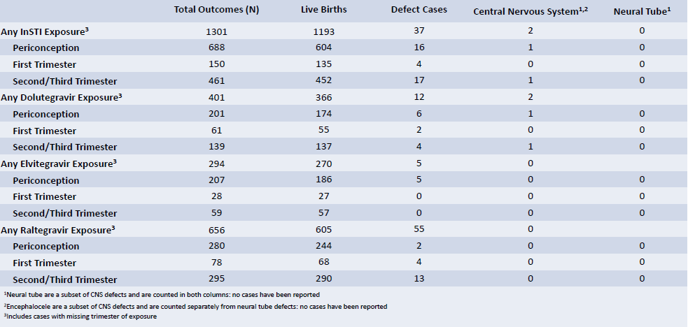
InSTI EXPOSURE AND NEURAL-TUBE DEFECTS: DATA FROM ANTIRETROVIRAL PREGNANCY REGISTRY
Table. Frequency of CNS and NTD Defect Cases by InSTI Drug and Timing of Earliest Exposure, Primary Prospective Enrollments with Outcome through July 2018

Slide 64
InSTI EXPOSURE AND NEURAL-TUBE DEFECTS: DATA FROM ANTIRETROVIRAL PREGNANCY REGISTRY
Discussion
The prevalence of NTD with InSTI in this study is consistent with the low prevalence of NTD in developed countries (~0.1%)
Because InSTIs are a newer class of ARVs, the number of pregnancies with InSTI exposure in the APR is insufficient to support conclusions about a potential association between DTG and NTD‒or specific geographic regions
Healthcare providers should continue to report pregnancies with prospective antiretroviral exposures to the APR

Slide 65
Broadly neutralizing Antibodies (bNAbs) at CROI 2019
Oral Sessions : #28LB, #100, #145LB

Slide 66
POTENT ANTIVIRAL ACTIVITY OF TRISPECIFIC BROADLY NEUTRALIZING HIV ANTIBODIES
Background: The monospecific nature of single bnAbs permits rapid selection for escape variants. The use of 2 or more bnAbs may therefore be desirable to maintain durable suppression of HIV-1 replication.
Methods
  Tri-specific Abs that allow a single molecule to interact with three independent HIV-1 envelope determinants were engineered for:
      1) the CD4 binding site
      2) the membrane proximal external region (MPER)
      3) the V1V2 glycan site
  Abs were assessed for Fc effector function and ability to suppress virus replication from activated HIV-1 infected donor T cells
  Abs were administered a tri-specific to SHIV-infected rhesus macaques to assess inhibition of viral replication

Slide 67
POTENT ANTIVIRAL ACTIVITY OF TRISPECIFIC BROADLY NEUTRALIZING HIV ANTIBODIES
Results/Conclusions
  Each of the 3 binding sites of the tri-specific Abs attached with high affinity to HIV envelope glycoprotein
  Tri-specific Abs retained binding to Fcγ receptors via their Fc region and mediated ADCC
  Compared to individual parental bnAbs, the tri-specific Abs durably suppressed viral replication in cultures of activated CD4+ T cells from HIV-1 infected patients
  Tri-specific Abs reduced plasma viremia in SHIV-infected macaques up to 1000-fold

Slide 68
PROTECTION AGAINST PENILE OR INTRAVENOUS SHIV CHALLENGES BY bNAb 10-1074 OR 3BNC117
Background: bNAbs 10-1074 or 3BNC117 protect against repeated rectal or vaginal SHIV challenge, but efficacy in men (penile) or IV drug users is unknown.
Objective: To evaluate efficacy of a single SC injection of 10-1074 alone, or in combination with 3BNC117, against repeated penile or IV SHIV challenge.
Methods
  Macaques (N=11) were injected SC once with 10-1074, or a combination of 10-1074+3BNC117, respectively (10mg each bNAb/kg)
  Beginning one week later, they were challenged repeatedly once weekly with SHIVsf162P3 (rhesus) or SHIVAD8-EO (cyno) via penile (200 TCID₅₀ into the prepuce pouch, 16 TCID₅₀ into the distal urethra) or IV (130 TCID₅₀) routes, respectively, until SHIV infection was confirmed via plasma VL assay
  Control macaques received no antibody, but were challenged identically (10 penile, 2 IV)

Slide 69
PROTECTION AGAINST PENILE OR INTRAVENOUS SHIV CHALLENGES BY bNAb 10-1074 OR 3BNC117
Results:
  Macaques given 10-1074 and challenged via the penis were protected against a median of 15.5 weekly challenges, as compared to controls (median=2.5; P=0.0007, Log-rank test) and exhibited a median 10-1074 plasma level of 0.50μg /ml (range=0.10-0.70μg/ml) at SHIV breakthrough
  Macaques administered both bNAbs and challenged IV were protected against a median of 5 weekly challenges, as compared to controls (median=1; P=0.0143, Log-rank test) and exhibited a median 10-1074 plasma level of 1.1µg/ml (range=0.6-1.6µg/ml), but undetectable 3BNC117, at SHIV breakthrough

Slide 70
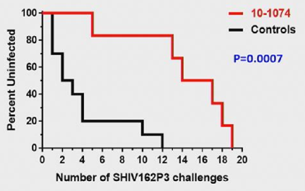
PROTECTION AGAINST PENILE OR INTRAVENOUS SHIV CHALLENGES BY bNAb 10-1074 OR 3BNC117
10-1074 protection against penile SHIV infection
Group | bNAb | Dose | Route | N
1 | 10-1074 | 10mg kg⁻¹ | SC | 6
2 | Control | ‒ | ‒ | 10
Number of challenges required to cause infection
No differences between groups for vRNA peak or AUC
 | Median | Range
10-1074 | 15.5 | 5-19
Control | 2.5 | 1-12

Slide 71
PROTECTION AGAINST PENILE OR INTRAVENOUS SHIV CHALLENGES BY bNAb 10-1074 OR 3BNC117
Conclusion
  A single SC administration of 10-1074 (10mg/kg) or 10-1074 + 3BNC117 (10mg ea/kg) protected macaques against repeated penile or IV SHIV challenges for a median of 15.5 or 5 weeks, respectively
  Protection in the 10-1074 + 3BNC117 group appears due to 10-1074, which persisted longer in vivo
  The plasma levels of 10-1074 associated with breakthrough infection are similar among all major mucosal routes of HIV acquisition (09.10 – 0.5 $μ$g/ml) and will facilitate dose selection for humans
  Higher level with IV infection (1.0 $μ$g/ml) may reflect higher challenge virus dose
  Our findings support the continued development of 10-1074 as long-acting HIV prevention for men, women and persons who inject drugs

Slide 72
THERAPEUTIC ACTIVITY OF PGT121 MONOCLONAL ANTIBODY IN HIV-INFECTED ADULTS
Background: PGT121, a human IgG1 mAb targeting V3 Env epitope is a potent neutralizer of 60‒70% of global HIV-1 viruses.
Objective: To present a first-in-human phase 1 US clinical trial of PGT121.
Methods:
  First part: HIV-uninfected (HIV-, N=20) and HIV-infected adults on ART (N=15) given PGT121 by single dose 3, 10, and 30 mg/kg IV and 3 mg/kg SC (N=5/group, 4:1 Ab/placebo)
  Second part: PGT121 given once at 30 mg/kg IV in HIV-infected adults not on ART with high VL (N=9) and low VL (N=3)

Slide 73
THERAPEUTIC ACTIVITY OF PGT121 MONOCLONAL ANTIBODY IN HIV-INFECTED ADULTS
Results
  PGT121 safe/well-tolerated with no related mod/severe AEs
  Elimination half-life: ~23 days in HIV- and HIV+/ART+ groups, varied with dose and route
  In viremic HIV+ individuals not on ART, PGT121 showed antiviral efficacy in 5/9 in high VL group (median drop in VL of 1.7 log cp/ml (1.3-2.1) by d10 & rebound by d28 with emergence of resistance
  In the low VL group, PGT121 decreased VL to <LLOQ by d7 in 3/3 participants
      Two of these individuals showed prolonged ART-free viral suppression
          First: rebound at 6 months;
        Second: VL still <LLOQ at 6 months, despite PGT121 level decline to <0.86 $μ$g/ml

Slide 74
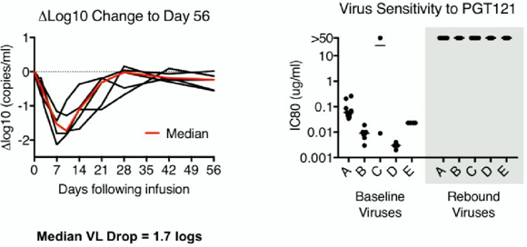
THERAPEUTIC ACTIVITY OF PGT121 MONOCLONAL ANTIBODY IN HIV-INFECTED ADULTS
High Viral Load Group: Responders
Conclusion: PGT121:
  Safe and well-tolerated
  Half-life 23 days
  1.7 log drop in VL in viremic HIV+ participants with PGT121-sensitive virus and high VL at baseline (5 of 9 participants)
  >5 months of viral suppression to <lower limit of quantification in 2 participants with lowest VL at baseline

Slide 75
Cure at CROI 2019
Oral Sessions: #25, #26, #27, #29LB
Posters: #356, #394LB

Slide 76
SUSTAINED HIV-1 REMISSION FOLLOWING HOMOZYGOUS CCR5 DELTA32 ALLOGENIC HSCT
Background: Which aspects of treatment (2 HSCTs + total body irradiation) led to HIV remission in 'Berlin Patient' are unknown.
Objective: To report on HIV-infected male Dx’d with Hodgkins Lymphoma undergoing allogenic HSCT from a homozygous CCR5Δ32 donor.
Case History
  HIV-1 Diagnosis 2003
  2013: Stage IVB Hodgkin lymphoma
  Atripla initiated. Viral suppression achieved
  Switch to TDF/FTC/Raltegravir (ABVD chemo)
  Failed multiple lines of chemotherapy and mobilisation for auto SCT
  Donor registry search for allo HSCT
      Unrelated 9/10 HLA high-resolution match
      Donor homozoygous CCR5Δ32 mutation

Slide 77
SUSTAINED HIV-1 REMISSION FOLLOWING HOMOZYGOUS CCR5 DELTA32 ALLOGENIC HSCT
Allogeneic Stem Cell Transplantation
LACE conditioning: lomustine, cyclophosphamide, cytarabine and etoposide
  Day 0 ‒ 13th May 2016: 3.61 $×$ 10⁶ CD34⁺/kg stem cell infusion
  Gram negative sepsis
  Dental abscess
  Colitis (day +77) ? GVHD on gut biopsy
  Discharged day +31
  CMV and EBV reactivation day +85; treated with Ganciclovir and Rituximab

Slide 78
SUSTAINED HIV-1 REMISSION FOLLOWING HOMOZYGOUS CCR5 DELTA32 ALLOGENIC HSCT
Results (See Figure: Course of Treatment)
  Single genome sequencing from pre-transplant PBMC identified multiple envelope clones all with predicted R5 tropism
  ART stopped 17 months post-HSCT
      HIV VL remained undetectable ( <1.4 copies/mL) at 33 months
      ART drugs absent in plasma
      Total HIV DNA in CD4+ T-cells at 33 mos not detected
      No signal in qPCR (<0.69 HIV-gag and <0.65 HIV-LTR copies/million cells)
  At 16 months
      p24/p31 bands absent
      low quantity and quality of HIV antibody titers
      qVOA at 3 time points: virus not re-activatable using a total of 24 million resting CD4+ T cells
      Post-transplant CD4+ T cells: no expression of CCR5 and susceptible to X4- but not R5-tropic virus

Slide 79
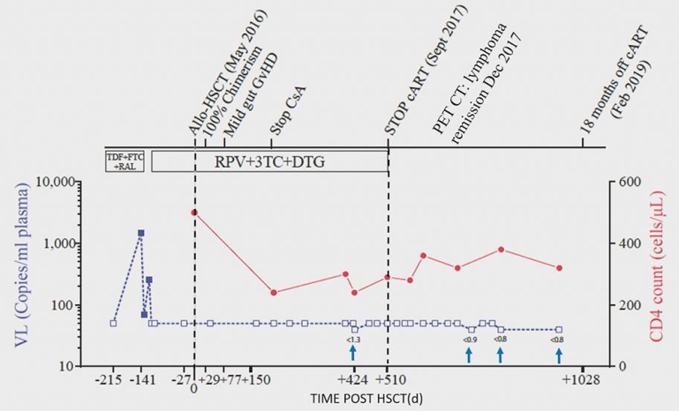
SUSTAINED HIV-1 REMISSION FOLLOWING HOMOZYGOUS CCR5 DELTA32 ALLOGENIC HSCT
Course of Treatment

Slide 80
SUSTAINED HIV-1 REMISSION FOLLOWING HOMOZYGOUS CCR5 DELTA32 ALLOGENIC HSCT
Conclusion
  18 months remission with no viral rebound after single allogeneic CCR5Δ32 HSCT and no irradiation
  Adaptive immune responses declining or absent post-transplant
  Case reaffirms CCR5 as a candidate for remission approaches
(See CROI poster 394 for further case of HSCT)

Slide 81
SUSTAINED HIV-1 REMISSION FOLLOWING HOMOZYGOUS CCR5 DELTA32 ALLOGENIC HSCT
Comparison of London and Timothy Brown Patients
‘The London Patient’
Timothy Brown
Homozygous for wild type CCR5
Infection with R5 using virus
Hodgkin Lymphoma
Single HSCT
No Irradiation
Reduced intensity conditioning
T cell depletion with a CD52
Mild GVH
100% T cell donor chimerism
Heterozygous for ∆32
Infection with R5 using virus
Acute Myelogenous Leukemia
Two HSCT
Total Body Irradiation
Full intensity conditioning
T cell depletion with ATG
Mild GVH
100% T cell donor chimerism

Slide 82
ANALYTIC TREATMENT INTERRUPTION (ATI) AFTER ALLOGENEIC CCR5-D32 HSCT FOR AML IN 2013
Background
  49y-old HIV-infected male received unmodified HSCT from a CCR5Δ32 donor in Feb 2013 after developing AML
  HIV co-receptor-usage was R5
  Although he had a 2nd relapse of AML in Jun 2013, he achieved CR after 8 courses of 5-azaC and 4 lymphocyte infusions
  Immunosuppression was discontinued in Oct 2017
  ART continued during HSCT until Nov 2018 with undetectable plasma VL since

Slide 83
ANALYTIC TREATMENT INTERRUPTION (ATI) AFTER ALLOGENEIC CCR5-D32 HSCT FOR AML IN 2013
Post-Transplantation Analyses
Summary & Conclusion:
  No virus detected in qVOA/mVOA, despite low signals in ultrasensitive assays
  ART discontinued Nov 2018 and so far, pVL undetectable
  Though early, this may represent a third person in whom remission has been established following HSCT from a CCR5Δ32 donor
PBMC samples | All negative for pro-viral HIV-DNA
HIV-DNA in lymph nodes | None
In-situ hybridization | Few positive signals
Viral outgrowth assays | Negative
CTL | Recognized HLA-A2-restricted RT-epitope YV9 and HLA (B7-restricted Gag-p6 epitope YL9 not present in cells from stem-cell donor)

Slide 84
ANALYTIC TREATMENT INTERRUPTION (ATI) AFTER ALLOGENEIC CCR5-D32 HSCT FOR AML IN 2013
Course of Management: January 2011 to March 2019

Slide 85
DELAYED VIRAL REBOUND DURING ATI AFTER INFUSION OF CCR5 ZFN-TREATED CD4 T CELLS
Subjects: 14 chronically infected pts doing well on ART
  93% male; 57% Black, 7% Hispanic; median age 44
  Median baseline CD4: 831 cop/mm3
  Duration of ATI phase: 16 weeks
Design
  3-arm open-label pilot study
  Well controlled HIV+ individuals in which some were CCR5 ∆32 heterozygotes
  Single infusion of autologous CD4 T cells modified at the CCR5 gene by RNA encoding ZFN SB-728
  With or without the prior administration of two different doses of cyclophosphamide
Cohort 1
ZFN no CTX (N=3)
Cohort 2
WT CCR5
ZFN+CTX
1g/m² (N=3)
ZFN+CTX
1.5g/m² (N=3)
Open simultaneously
Cohort 3
∆32 heterozygous
ZFN+CTX
1g/m² (N=3)
ZFN+CTX
1.5g/m² (N=3)

Slide 86
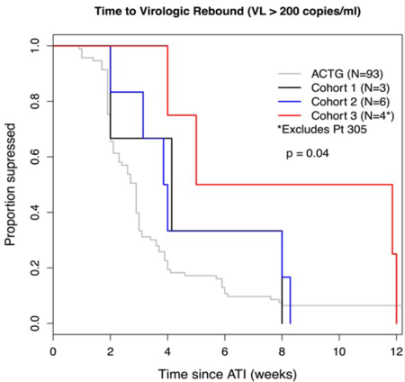
DELAYED VIRAL REBOUND DURING ATI AFTER INFUSION OF CCR5 ZFN-TREATED CD4 T CELLS
Time to virologic rebound compared to historical ACTG controls

Slide 87
DELAYED VIRAL REBOUND DURING ATI AFTER INFUSION OF CCR5 ZFN-TREATED CD4 T CELLS
Conclusions
  Introduction of CCR5 ZFNs via RNA transfection was safe and well tolerated
  Led to similar levels of disruption as Ad5/35 vectors
  A single dose of CTX led to a increase in engraftment
  The administration of the product was associated with a modest delay in viral rebound during the ATI (compared to historic controls)
  Maintenance of low level viremia for up to 40 weeks in some suggested that with a more efficient CCR5 modification, more individuals could potentially benefit from this cure strategy

Slide 88
MULTIDOSE IV ROMIDEPSIN: NO INCREASED HIV-1 EXPRESSION IN PERSONS ON ART, ACTG A5315
Objective: To determine if multiple doses of romidepsin (RMD) would be safe and induce HIV-1 expression.
Methods:
  16 (11 male) HIV-1-infected/suppressed viremic subjects (13 RMD, 3 placebo) were randomized in a double-blind, placebo-controlled study, to receive RMD 5 mg/m² x 4 doses (at days 0, 14, 28, 42)
  Enrollees were receiving RAL- or DTG-containing ART with plasma HIV-1 RNA <50 cps/mL and CD4 counts ≥300 cells/mm³

Slide 89
MULTIDOSE IV ROMIDEPSIN: NO INCREASED HIV-1 EXPRESSION IN PERSONS ON ART, ACTG A5315
Summary
  Safety: multiple doses of RMD were safe, generally well-tolerated
  Dose: RMD achieved blood levels associated with HIV proviral activation ex vivo in infected donor cells
  Virologic: No increase in viremia by any measure at 24 hours after each infusion, 72 hours post-infusion 2, or by day 7
  Host PD: significant effects observed 24 hrs after RMD infusion
      ↓ in CD4%
      ↑ in % CD4 with NFKB activation
      ↑ in % CD4 with PTEFb activation

Slide 90
MULTIDOSE IV ROMIDEPSIN: NO INCREASED HIV-1 EXPRESSION IN PERSONS ON ART, ACTG A5315
Implications: There is …
  a disconnect between ex vivo and in vivo virologic responses to romidepsin
  a disconnect between virologic responses and dose-related PD effects on host
  value in romidepsin as a latency reversal agent uncertain
      Multiple romidepsin + bnAbs clinical trials are in progress

Slide 91
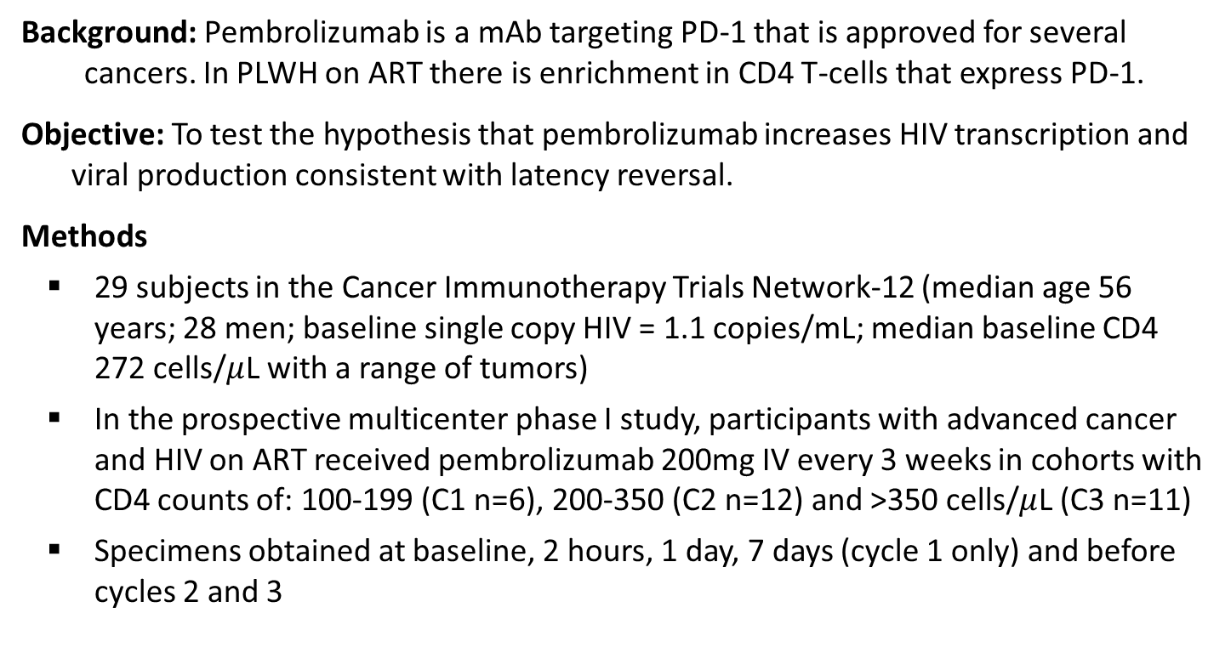
PEMBROLIZUMAB INDUCES HIV LATENCY REVERSAL IN HIV+ INDIVIDUALS ON ART WITH CANCER
Background: Pembrolizumab is a mAb targeting PD-1 that is approved for several cancers. In PLWH on ART there is enrichment in CD4 T-cells that express PD-1.
Objective: To test the hypothesis that pembrolizumab increases HIV transcription and viral production consistent with latency reversal.
Methods
  29 subjects in the Cancer Immunotherapy Trials Network-12 (median age 56 years; 28 men; baseline single copy HIV = 1.1 copies/mL; median baseline CD4 272 cells/$μ$L with a range of tumors)
  In the prospective multicenter phase I study, participants with advanced cancer and HIV on ART received pembrolizumab 200mg IV every 3 weeks in cohorts with CD4 counts of: 100-199 (C1 n=6), 200-350 (C2 n=12) and >350 cells/$μ$L (C3 n=11)
  Specimens obtained at baseline, 2 hours, 1 day, 7 days (cycle 1 only) and before cycles 2 and 3

Slide 92
PEMBROLIZUMAB INDUCES HIV LATENCY REVERSAL IN HIV+ INDIVIDUALS ON ART WITH CANCER
Conclusions:
  Pembrolizumab leads to transient  in HIV transcription in CD4+ T-cells in PLWH on ART consistent with latency reversal, but not  in plasma HIV RNA after 2 doses
  Evaluation of the long-term effects of pembrolizumab on HIV persistence and HIV specific immunity are ongoing

Slide 93
PrEP at CROI 2019
Oral Sessions: #104LB, #106, #107
Posters: #944
Themed Discussion: #962

Slide 94
THE PHASE 3 DISCOVER STUDY: DAILY F/TAF OR F/TDF FOR HIV PREEXPOSURE PROPHYLAXIS
Objective: To evaluate efficacy and safety of F/TAF vs F/TDF for PrEP in cis-MSM and TGW at high risk of HIV.
Discover: A Randomized, Noninferiority Trial of F/TAF for PrEP.
F/TAF QD
n=2694
At entry and Q12W:
Adherence counseling
Prevention services
Risk reduction counseling
Condoms/lubricant
Primary analysis:
HIV incidence/100 PY
when 100% complete W48
& 50% complete W96
Randomized
1:1
Double-blinded
Active controlled
MSM or TGW
participants
Open-label
switch
for 48 weeks
96 weeks
F/TDF QD
n=2693
Eligibility required high sexual
risk of HIV
2+ episodes condomless anal sex
in past 12W or rectal gonorrhea/
chlamydia, syphilis in past 24W
HIV & HBV negative, eGFR ≥60 mL/min
Prior use of PrEP allowed
Study conducted in NA,
EU in cities/sites with
high HIV incidence
94 sites in 11 countries
Participants: US, 60%;
EU, 34%; Canada, 7%
Primary efficacy endpoint:
HIV incidence
Evaluated by rate ratio with noninferiority (NI) margin <1.62
Expected incidence of 1.44/100 PY based on pooled studies:
iPrEx, PROUD, IPERGAY

Slide 95
THE PHASE 3 DISCOVER STUDY: DAILY F/TAF OR F/TDF FOR HIV PREEXPOSURE PROPHYLAXIS
Discover Primary Endpoint Analysis: HIV Incidence
22 HIV infections in 8756 PY of follow-up
HIV Incidence
Incidence Rate Ratio [95% CI]
Favors F/TAF
Favors F/TDF
Noninferiority
15 infections
HIV Incidence Rate/100 PY
4386 PY
0.47
7 infections
0.19
1.15
4370 PY
F/TAF
n=2694
F/TDF
n=2693
1.62
RR = 1, no difference
NI margin
CI, confidence interval; RR, rate ratio.
F/TAF is noninferior to F/TDF for HIV prevention

Slide 96
THE PHASE 3 DISCOVER STUDY: DAILY F/TAF OR F/TDF FOR HIV PREEXPOSURE PROPHYLAXIS
Comparing DISCOVER Results to HIV Infection Rate In MSM at HIV Risk but Not on PrEP
In the absence of placebo control, we sought to contextualize the HIV incidence rates in DISCOVER to the rate in MSM not on PrEP
Using CDC-reported HIV surveillance data, we calculated the background infection rate for MSM at HIV infection risk in US metropolitan statistical area (MSAs) that overlapped with DISCOVER sites
HIV infection rate for MSM not on PrEP in 2016:
4.02/100 PY 95%CI [3.96, 4.09]
HIV incidence rates in US DISCOVER sites:
F/TAF = 0.08/100 95%CI [0.01, 0.28]
F/TDF = 0.45/100 95%CI [0.23, 0.78]
HIV Rate Comparison
(US MSAs & US DISCOVER sites)
HIV Incidence/100 PY (95% CI)
MSM
Not on PrEP
F/TAF
F/TDF

Slide 97
THE PHASE 3 DISCOVER STUDY: DAILY F/TAF OR F/TDF FOR HIV PREEXPOSURE PROPHYLAXIS
Conclusions:
F/TAF was noninferior to F/TDF in preventing HIV infection in high-risk cis-MSM and TGW
HIV incidence: 0.16/100 PY vs 0.34/100 PY
The majority of HIV infections occurred prior to study entry or in participants with low or undetectable drug levels
Both drugs well tolerated, with low rates of AEs-related discontinuations (1% to 2%)
F/TAF had significantly more favorable bone and renal safety outcomes vs F/TDF
Study participants had consistent high rates of sexual risk behavior, with a lack of risk compensation
F/TAF is an effective and possibly safer option for PrEP in cis-MSM and TGW at risk for HIV infection

Slide 98
PERSISTENCE WITH HIV PREEXPOSURE PROPHYLAXIS
IN THE UNITED STATES, 2012-2016
Background: Adherence to a PrEP regimen of daily emtricitabine + tenofovir disoproxil fumarate, and persistence with that regimen during periods of HIV risk is highly effective prophylaxis.
Objective: To estimate persistence* and associated factors among a cohort of PrEP users with commercial health insurance.
Results: Among 7,250 commercially-insured PrEP users (98.2% Male; 10.6% aged 18-24 years):
6-month and 12-month rates of persistence were 74.8- and 55.7%, respectively
Median persistence was 14.5 months overall, 6.9 months for females, and 8.6 months for users aged 18-24 years
Reduced persistence was associated with being female, being young or living in a rural area.
Kaplan-Meier curves of PrEP persistence stratified by age group showed PrEP persistence increased with age
36.6% of users aged 18-24 years persisted for 12 months, compared to 65.3% of those aged 55-64 years
Conclusion: Improved understanding of factors contributing to non-persistence could improve adherence during periods of risk.
*Patients were considered non-persistent if they did not refill within 30 days after exhausting PrEP medications from previous fill

Slide 99
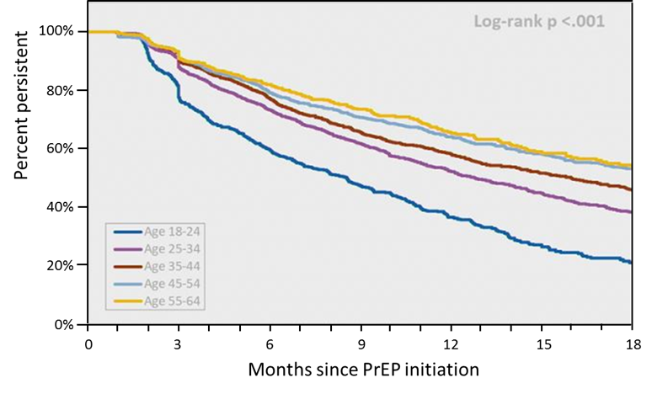
Figure: PrEP Persistence by Age Group among Commercially Insured PrEP users
MarketScan Commercial Database, 2012-2016 (n=7,250)

Slide 100
IMPACT OF PrEP ON DRUG RESISTANCE AND ACUTE HIV INFECTION, NEW YORK CITY, 2015-2017
Objectives
Determine rate of resistance to PrEP ARVs in persons with prediagnosis PrEP use
Compare PrEP users vs never-users regarding resistance to PrEP drugs and AHI
Determine frequency and timing of negative NAAT prior to PrEP initiation in PrEP users
Data Sources
PrEP use: HIV partner services, medical provider report forms, NYC surveillance field investigation
Drug resistance, HIV NAAT, and AHI: NYC surveillance registry and laboratory database
Analyses
Rate of prediagnosis PrEP use in those diagnosed with HIV within 12 mos and assigned to HIV partner services
Descriptive statistics for duration of PrEP use; time from PrEP start to diagnosis; characteristics of PrEP users vs never-users
Rate of resistance mutations to FTC (M184/V) and TDF (K65R)
Bivariate analyses with chi-squared/Fisher’s exact test of significance comparing rate of M184/V mutation at first HIV genotyping and AHI in PrEP users vs never-users

Slide 101
IMPACT OF PrEP ON DRUG RESISTANCE AND ACUTE HIV INFECTION,
NEW YORK CITY, 2015-2017
Patient Characteristics:
Of 3685 patients diagnosed with HIV in past 12 mos and referred for partner services in NYC, n = 91 (2%) used PrEP prior to diagnosis
Median duration of PrEP prior to HIV diagnosis: 106 days (IQR: 214)
Median duration from PrEP initiation to HIV diagnosis: 250 days (IQR: 395)
Higher rates of PrEP use among individuals who were younger
(< 30 yrs), cis-men, white, and MSM
Characteristic, % | PrEP Users (n = 91) | Never-Users (n = 3594)
Aged < 30/≥ 30 yrs | 58/42 | 37/63
Gender Cis-women Cis-men Transgender: MTF | 2 92 5 | 21 76 3
Race/ethnicity Black Hispanic White Other | 2 27 41 9 | 46 32 14 7
Transmission risk Heterosexual IDU MSM Transgender sex | 3 2 89 6 | 28 3 66 3

Slide 102
IMPACT OF PrEP ON DRUG RESISTANCE AND ACUTE HIV INFECTION,
NEW YORK CITY, 2015-2017
Conclusions:
In a NYC surveillance population recently diagnosed with HIV, the following factors differed among those who used PrEP before diagnosis vs never used PrEP
Higher prevalence of FTC resistance mutations (29% vs 2%)
Higher prevalence of AHI (33% vs 9%)
Higher prevalence of available genotype data (75% vs 63%)
No TDF resistance mutation (K65R) identified among PrEP users
Only 25% of PrEP users had evidence of negative NAAT before starting treatment, with 5% having negative NAAT within 0-2 days before PrEP initiation
Study limited by potential misclassification of never-users due to incomplete data, missing genotypes, inability to differentiate acquired vs transmitted resistance or identify cause
Investigators recommended rigorous HIV screening with NAAT to decrease PrEP initiation while HIV infection undetected along with routine genotyping at diagnosis in those with recent PrEP history

Slide 103
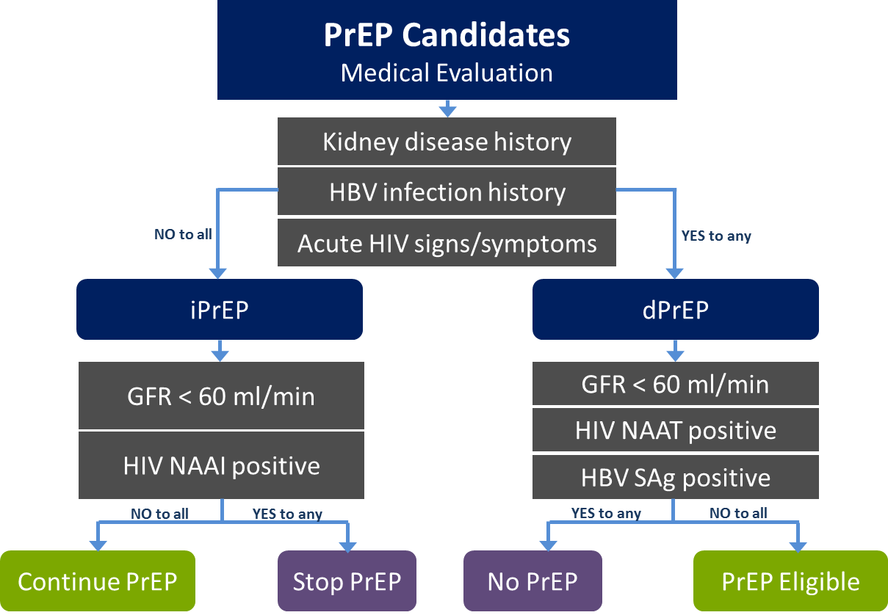
IMMEDIATE PrEP INITIATION AT NEW YORK CITY
SEXUAL HEALTH CLINICS
Objective: To determine prevalence of PrEP-related medical contraindications among candidates evaluated for iPrEP at NYC Sexual Health Clinics (SHC).
iPrEP vs dPrEP Pathways

Slide 104
IMMEDIATE PrEP INITIATION AT NEW YORK CITY SEXUAL HEALTH CLINICS
Table: Prevalence of Medical Contraindications to PrEP among PrEP Initiation Candidates: Immediate vs. Delayed; January 2017 – June 2018; New York City Sexual Health Clinics.
Contraindication Type | iPrEP (n=1387) n(%) | dPrEP (n=50) n (%) | p Value
Acute HIV (+HIV viral load) | 2 (0.1) | 1 (2.0) | 0.005
Chronic Kidney Disease (GFR < 60ml/min) | 2 (0.1) | 4 (8.0) | <0.001
Active HBV Infection (+HBV Sag) | 6 (0.4) | 2 (4.0) | <0.001
Any of the above | 10 (0.7) | 7 (14.0) | <0.001
Conclusions:
Immediate PrEP initiation a promising model in walk-in settings
PrEP rarely discontinued (0.2%) among iPrEP patients due to absolute contraindications
A substantial loss to follow-up occurred among patients who delayed PrEP due to contraindications concerns

Slide 105
INCIDENCE OF HIV IN A NATIONAL COHORT RECEIVING PREEXPOSURE PROPHYLAXIS
Objective: To determine incidence of HIV infection in patients in VHA* system initiating PrEP and to describe relationships between HIV cases and patterns of PrEP use.
* VHA: Veterans Health Administration
Study Design
Figure 1: Algorithm for identifying PrEP users in the VHA
Results/Conclusions
825 patients initiating PrEP; median observed PrEP duration of 8 months, ,total cohort observation of 736.6 person-years. 97% male, 67% white, mean age 41 years
Incidence during active PrEP use: 0.3 cases/100 person-years
Two patients acquired HIV during a period of high measured adherence, both demonstrating resistance to emtricitabine
2/3 HIV infections occurred during inactive or inconsistent PrEP use, emphasizing need for interventions to improve PrEP persistence
Veterans with an outpatient fill for FTC/TDF
from 6/1/2012 – 4/7/2016; N=13,318
Exclude veterans with HIV diagnosis prior to first FTC/TDF fill and ICD diagnosis code for needle stick injury
Veterans without HIV at time of first fill of FTC/TDF
N=1,855 (sampled for initial chart review)
Exclude chronic Hepatitis B Virus
Exclude if initial fill < 30 days supply
Veterans with chart review confirmed PrEP OR ≥ 30 day initial fill of FTC/TDF; N=864
Completed chart review, excluding instances of PEP, Hepatitis B, HIV
Chart review confirmed PrEP
N=825

Slide 106
TB at CROI 2019
Oral Sessions: #80LB, #82, #83, #114

Slide 107
SAFETY & PK OF WEEKLY RIFAPENTINE/ISONIAZID (3HP) IN ADULTS WITH HIV ON DOLUTEGRAVIR
Background
  Short-course preventive therapy with 12 once-weekly rifapentine/isoniazid doses (3HP) could transform TB control, but interactions with antiretrovirals may pose challenges
  In a previous trial, 3HP administered with DTG resulted in SAEs in 2/4 healthy subjects (fever, hypotension, elevated transaminases) and study termination
Objective: To characterize safety, drug interactions, and viral suppression in a Phase I/II study of 3HP and DTG in adult PLWH.

Slide 108
SAFETY & PK OF WEEKLY RIFAPENTINE/ISONIAZID (3HP) IN ADULTS WITH HIV ON DOLUTEGRAVIR
Study Design
Design: Single-arm Phase I/II PK and Safety study of DTG-based ART and once-weekly rifapentine plus isoniazid (3HP) in adults with HIV infection on ART with suppressed viral load who have indication for treatment of LTBI
Timeline: DTG + TDF/FTC daily $×$8weeks (EFV washout)
      DTG + TDF/FTC daily + HP weekly $×$ 12 weeks
Regimens: Group 1A (n=12): DTG 50mg daily + TDF/FTC + 3HP (900/900)
         interim analysis
        Group 1B (n=18) and 2 (n=30): DTG 50mg daily + TDF/FTC + 3HP

Slide 109
SAFETY & PK OF WEEKLY RIFAPENTINE/ISONIAZID (3HP) IN ADULTS WITH HIV ON DOLUTEGRAVIR
Results
  All participants received ≥6 3HP doses by the time of this report
  Three Grade 3 AEs occurred (2 elevated creatinine, 1 hypertension)
  HIV viral loads at baseline were all <40 c/mL at all time points
  The geometric mean trough concentration of DTG on Day 58 (pre-3HP) was 1003 $μ$g/mL (5th-95th %ile: 500-2080), and during 3HP treatment 546 (134-1616) with all trough levels but one above DTG IC₉₀ of 64 $μ$g/mL)
  Overall, 3HP administration decreased DTG bioavailability by 29% (+18%, -37% and -35% for week 1, 3 and 8), while clearance remained unchanged

Slide 110
SAFETY & PK OF WEEKLY RIFAPENTINE/ISONIAZID (3HP) IN ADULTS WITH HIV ON DOLUTEGRAVIR
Table. Dolutegravir trough concentrations, alone and with 3HP, GROUPS 1 and 2, N=60
Study Day | Week on 3HP | N | Day Post HP Dose | Geometric mean | Troughs, 5th and 95th % | Regimen
57/58 |  | 60 | 0 | 1003 | 500 – 2080 | DTG alone
59 | Week 1 | 30 | 1 | 1053 | 412 – 1834 | DTG+HP
72 | Week 2 | 30 | 7 | 492 | 200 – 1063 | DTG+HP
73 | Week 3 | 60 | 1 | 657 | 295 – 1502 | DTG+HP
74 | Week 3 | 60 | 2 | 355 | 134 – 933 | DTG+HP
78 | Week 3 | 30 | 6 | 388 | 140 – 794 | DTG+HP
108 | Week 8 | 60 | 1 | 703 | 289 – 1603 | DTG+HP
109 | Week 8 | 60 | 2 | 394 | 121 - 1079 | DTG+HP
* HP doses were given on Days 58, 65, 72, 79, 86, 93, 100, 107, 114, 121, 128, 135

Slide 111
SAFETY & PK OF WEEKLY RIFAPENTINE/ISONIAZID (3HP) IN ADULTS WITH HIV ON DOLUTEGRAVIR
Summary
  Co-administration of dolutegravir-based ART and 3 HP was well-tolerated in PLHIV
      No adverse events leading to withdrawal
      No HP-related Grade 3 or higher clinical or laboratory adverse events
  Trough DTG concentrations were reduced by ~50% and AUC were reduced by ~30% with HP, with median values > 300 ng/mL at all time points
  Virologic suppression maintained throughout 3HP/DTG treatment

Slide 112
EARLY BACTERICIDAL ACTIVITY (EBA) OF HIGH-DOSE ISONIAZID AGAINST MULTIDRUG-RESISTANT TB
Background: High-dose isoniazid (INH) may be useful in treating multidrug-resistant tuberculosis (MDR-TB), particularly in inhA mutation-mediated INH resistance. The WHO recommends 'high-dose' INH as part of the new shorter MDR-TB regimen.
Objective: To investigate optimal dose and efficacy of ‘high-dose’ INH-shorter MDR-TB regimens.
Methods: Phase 2A randomized, 21-day, open-label trial. 59 participants (73% male, median age 32 years, 20% HIV co-infected, 88% cavitary lung disease) assigned to either: Group 1 (43 smear-positive to pulmonary MDR-TB with INH resistance mediated by an inhA mutation) or Group 2 (16 controls with drug-sensitive TB).

Slide 113
EARLY BACTERICIDAL ACTIVITY OF HIGH-DOSE ISONIAZID AGAINST MULTIDRUG-RESISTANT TB
Results:
Figure 1. Mean (95% CI) EBA_{CFU}(0-7) based on log₁₀ CFU count, by arm
Figure 2. Mean (95% CI) EBA_{TTP}(0-7) based on time to positivity, by arm
Mean EBA(0-7) Based on Log₁₀ CFU
0.3
0.2
0.1
0.0
Mean EBA(0-7) Based TTP
0
-5
-10
-15
INH-R 5mg INH-R 10mg INH-R 15mg INH-S 5mg
Treatment Arm
INH-R 5mg INH-R 10mg INH-R 15mg INH-S 5mg
Treatment Arm

Slide 114
EARLY BACTERICIDAL ACTIVITY OF HIGH-DOSE ISONIAZID AGAINST MULTIDRUG-RESISTANT TB
Conclusion
  INH had substantial EBA against Mycobacterium tuberculosis strains with inhA mutations among patients with MDR-TB, at 10-15 mg/kg, supporting WHO recommendations for high-dose INH in this population
  Activity at these doses similar to standard 5 mg/kg dose in drug-sensitive TB
  Longer-term tolerability, plus efficacy of high-dose INH against strains with katG mutations require further study

Slide 115
LONG-TERM MORTALITY AFTER TUBERCULOSIS CURE
IN THE CIPRA HT-001 TRIAL
Background: Studies from industrialized settings suggest elevated risk of long-term mortality (LTM) after TB recovery. Long-term outcomes data for individuals co-infected with TB and HIV from the developing world are limited.
Objective: To investigate LTM risk after TB treatment among HIV positive patients TB at enrollment or incident TB during follow-up.
Methods: A retrospective analysis of 14-year follow-up data (2005-2018) for 739 adult PLWH (151 with TB at enrollment or incident TB during follow-up) cases, 588 controls) in CIPRA HT-001 study.

Slide 116
LONG-TERM MORTALITY AFTER TUBERCULOSIS CURE IN THE CIPRA HT-001 TRIAL
Results
  6,042 patient-years of follow-up
  Median (IQR) time to incident TB diagnosis 1.74 years (0.59, 3.14)
  134 (89%) participants in TB cohort survived 8 months after TB diagnosis and were included in analysis
  574 (98%) participants in non-TB cohort survived 8 months after enrollment and were included in analysis
  Starting 8 months after TB diagnosis or enrollment, mortality during follow-up was:
      17.9% in the TB cohort
      8.4% in no-TB cohort
      p<0.001

Slide 117
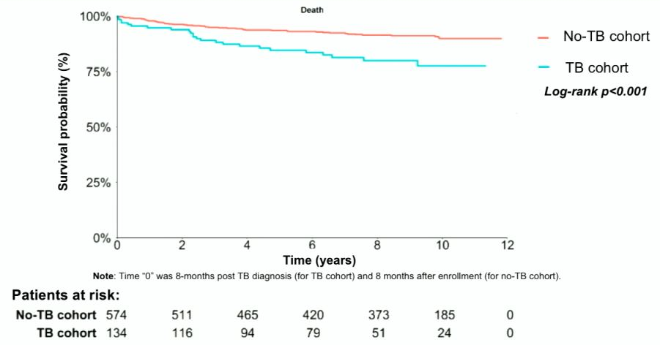
LONG-TERM MORTALITY AFTER TUBERCULOSIS CURE IN THE CIPRA HT-001 TRIAL
Results – Primary Survival Analysis

Slide 118
LONG-TERM MORTALITY AFTER TUBERCULOSIS CURE IN THE CIPRA HT-001 TRIAL
Conclusions
  CIPRA cohort presented:
      Convenient sample with high TB incidence and excellent longitudinal follow-up
      Narrow range of CD4 count at inclusion limits this model’s ability to assess the independent predictive power of CD4 count
  Nearly 3-fold increase in the hazards of death in the 10 years after TB cure for PLWH vs PLWH who have never had TB
      HR 3.12 (95% CI 1.81, 5.37, p<0.001)
  This elevated risk is consistent across multiple statistical models
  More robust morbidity and mortality data are needed to inform follow-up care and identify opportunities for intervention

Slide 119
HCV at CROI 2019
Oral Sessions: #86, #87, #90, #112, #113
Posters: #564, #576, #577

Slide 120
HCV REINFECTION AMONG HIV-INFECTED MSM
IN NEW YORK CITY
Background
  High HCV re-infection rates of 3-15% have been reported after IFN treatment in HIV-infected MSM in Europe
  This longitudinal study assessed HCV reinfection rates among HIV-infected MSM using data from the New York Acute Hepatitis C Surveillance Network
Subjects:
  305 HIV-infected MSM with documented clearance of primary HCV infection
  Median age 45; 247 (82%) white, 55 (8%) black, 66 (22%) Hispanic

Slide 121
HCV REINFECTION AMONG HIV-INFECTED MSM IN NEW YORK CITY
Study Flow Diagram
Cleared HCV: 304
followed: 845 PY
(median 2.2yr)
4 men without
subsequent clearance
Cleared re-infection: 33
= incidence 4.4/100PY
median 1.9 yr (IQR 1.3, 3.6)
followed: 69PY
Re-infection: 6
= incidence 8.7/100PY
median 1.1 yr (IQR 0.6, 2.5)

Slide 122
HCV REINFECTION AMONG HIV-INFECTED MSM IN NEW YORK CITY
Conclusions
  HCV re-infection rate in NYC is 4.4/100 PY
  >7 times the primary infection rate in NYC, similar to pattern seen in Europe
  High re-infection rate demonstrates the inadequate level of HCV treatment among MSM in NYC, despite DAA “availability” in NYC since Dec ’13
  Large difference between primary and re-infection rates suggests HCV risk is not distributed evenly among all HIV-infected MSM, but is concentrated among much smaller sub-population
  Subpopulation has higher prevalence, higher transmission risks, or both
  Higher rate in Latinos suggests healthcare disparity (well known in the US)
  Suggests transmission among HIV-infected MSM not as inefficient as believed

Slide 123
A PHASE 1 STUDY OF LEDIPASVIR/SOFOSBUVIR IN PREGNANT WOMEN WITH HEPATITIS C VIRUS
Objective: To define the safety of and virologic response to ledipasvir 90mg-sofosbuvir 200mg (LDV/SOF) therapy in pregnancy.
Subjects/Design:
  Open-label, phase 1 study among 8 HIV-negative women with chronic genotype 1 HCV infection
  Enrolled at 23-24 weeks of gestation in 12-week course of LDV/SOF
Results/Conclusions:
  In this first study of HCV treatment during pregnancy, LDV/SOF was safe for pregnant women and effective for HCV cure
  100% of women were cured of HCV; all infants are HCV-negative to date
  LDV/SOF was well tolerated; treatment related AEs were mild/ moderate
  No infant safety concerns to date after LDV/SOF in utero exposure

Slide 124
HIV VIREMIA AND LOW CD4+ INCREASE HCC RISK
IN THOSE WITHOUT ADVANCED LIVER FIBROSIS
Background: Despite rising incidence of hepatocellular carcinoma (HCC) in HIV+ patients, few studies have evaluated determinants of HCC during the ART era.
Objective: To evaluate HIV-related and traditional risk factors for HCC in a large cohort of HIV+ patients.
Methods:
  A retrospective cohort study among HIV+ patients in the Veterans Aging Cohort Study from 1999-2015
  At least 180 days follow-up and no HCC prior to start of follow-up

Slide 125
HIV VIREMIA AND LOW CD4+ INCREASE HCC RISK IN THOSE WITHOUT ADVANCED LIVER FIBROSIS
Results:
Factors Associated with HCC
Strongly Associated Factor | Hazard Ratio | Independently Associated Factor | Hazard Ratio
FIB-4 > 3.25 | 15.1 [9.7-23.5] | FIB-4 <3.25 (36.4% of HCC events) Older age Morbid obesity Diabetes ≥12 mos unsuppressed HIV RNA Lower CD4+ count 200 - 349 cells/mm³ <200 cells/mm³ HBV co-infection HCV co-infection Higher HIV RNA level | 1.4 [1.2-1.7] per 10 years 2.6 [1.2-5.3] 1.5 [1.1-2.1] 2.0 [1.4-2.9] 1.5 [1.1-2.2] 1.6 [1.0-2.4] 5.2 [3.7-7.3] 6.1 [4.1-9.0] 1.3 [1.1-1.4] per 1.0 log₁₀copies/mL)

Slide 126
HIV VIREMIA AND LOW CD4+ INCREASE HCC RISK IN THOSE WITHOUT ADVANCED LIVER FIBROSIS
Conclusion: Factors associated with increased risk of HCC in HIV+ patients w/o advanced liver fibrosis, beside HBV and HCV coinfection, are:
higher HIV RNA
longer duration of HIV viremia
greater immunosuppression
morbid obesity
diabetes

Slide 127
HCV LATE RELAPSE IN PATIENTS WITH DIRECTLY ACTING ANTIVIRAL–RELATED SVR 12
Objective: To identify, among HCV patients with failure to a DAA regimen, those with a late relapse (after a sustained virological response at week 12) and to characterize the clinical, epidemiological and virological features of these patients.
Methods:
  129 HCV patients with non-response to an IFN-free regimen were enrolled
  Sanger sequencing of NS3, NS5A and NS5B was performed at failure by home-made protocols
Results: Of 129 patients enrolled:
  8 (6.2%) experienced breakthrough
  15 (11.7%) non-response,
  99 (76.7%) a relapse by week 12 after the end of DAA therapy
  7 (5.4%) a late relapse (after week 12; median 24 weeks, range 24-72)
  In 2 of the 7 patients with late relapse, analysis of available pre-DAA serum suggested reactivation of initial HCV strain
  In the remaining 5, re‐infection cannot be excluded, as no serum samples were available.

Slide 128
HCV LATE RELAPSE IN PATIENTS WITH DIRECTLY ACTING ANTIVIRAL–RELATED SVR 12
Table. Clinical and virological data of the 7 patients with a late relapse
Notes: Sof: sofosbuvir; Riba: ribavirin, Sim: simeprevir; Ldv: ledipasvir; 3D: ombirasvir, dasabuvir, paritaprevir+ritonavir
* HIV infection; Intravenous drug use; men who have sex with men; prisoners; recent history of surgery
Pt n⁰ | HCV genotype before DAA | HCV Therapy | Duration of HCV therapy | Risk factors* for reinfection | Time of Relapse | HCV genotype at DAA failure | RASs at DAA failure
 |  |  |  |  |  |  | in NS3 | in NS5A | in NS5B
1 | 1a | Sof+Riba | 12 | no | 72 | 1a | / | M28T, Q30H | /
2 | 1b | Sim+Sof | 12 | no | 72 | 1b | / | P58S | C316N
3 | 4 | Sof+Ldv+Riba | 12 | no | 24 | 4 | / | L28M, Y93H | /
4 | 1b | Sof+Ldv+Riba | 12 | no | 24 | 1b | V170A | L28M, Y93H | /
5 | 1b | Sof+Riba | 12 | no | 24 | 1b | V107T, S122N | L28M, Y93[C, S] | S556G
6 | 1b | 3D | 12 | no | 24 | 1a | Y56H, D168V | Y93H | L159F, C316N, S556G
7 | 1b | Sof+Ldv | 12 | surgery | 48 | 1b | / | L31M | /

Slide 129
HCV LATE RELAPSE IN PATIENTS WITH DIRECTLY ACTING ANTIVIRAL–RELATED SVR 12
Conclusions:
  Late relapse may occur in patients who obtained an SVR12 with DAA treatment
  This finding consistent with recently published data¹ and partially disagrees with recommendation of international guidelines of a post-treatment follow-up of 12 weeks
¹Sarrazin C, et al. Clin Infect Dis. 2017

